Slide 1
Baylor College of Medicine
Neurosurgical Residency Program
2023-2024

Slide 2
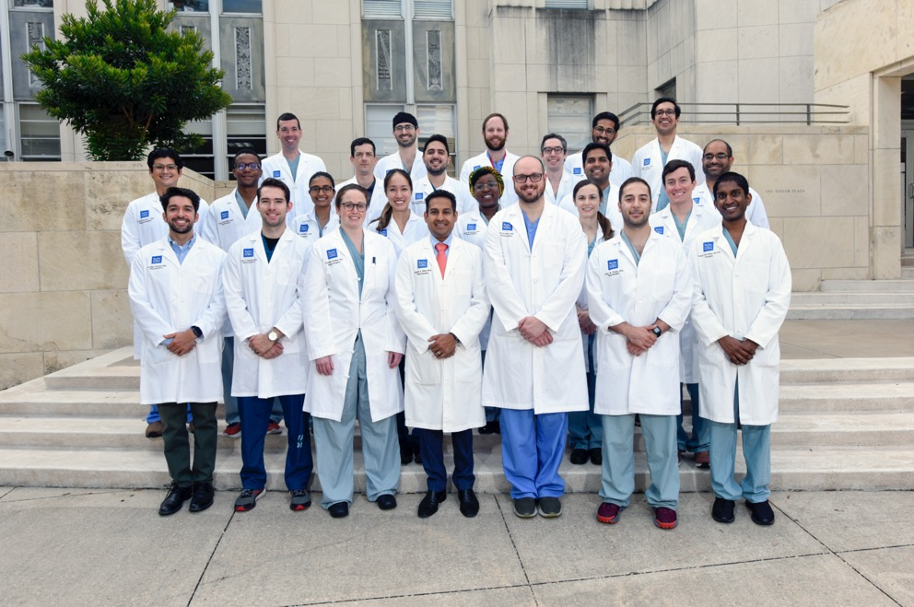
2022-2023 Residents

Slide 3
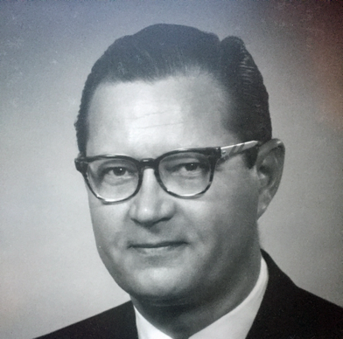
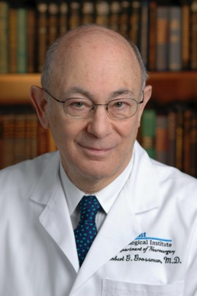
History of the Training Program
Approved by the ABNS to train residents in 1954
1959-1979
1980-2004

Slide 4
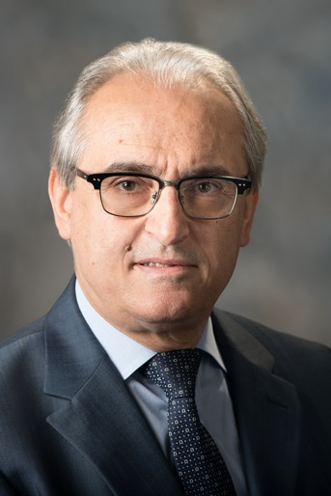
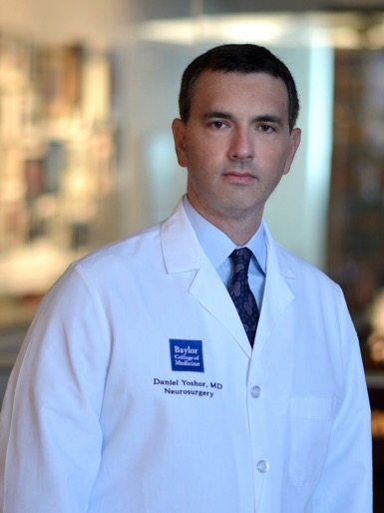
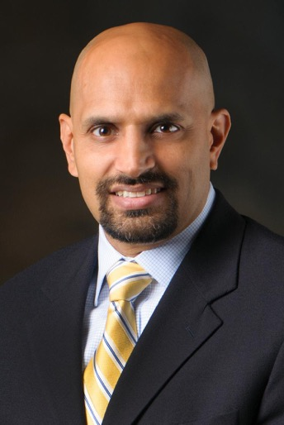
History of the Training Program
2005-2015
2015-2020
2020 to present

Slide 5
History of the Training Program
Currently trains 4 residents per year
Training occurs across 5 sites
Baylor St. Luke’s Medical Center
Ben Taub Hospital
MD Anderson Cancer Center
Texas Children’s Hospital
VA Medical Center

Slide 6
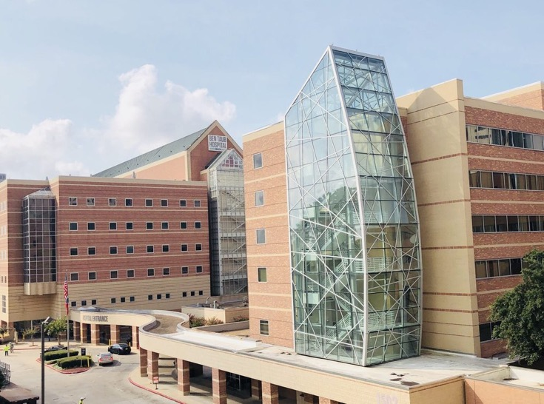
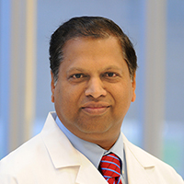
Ben Taub Hospital

Slide 7
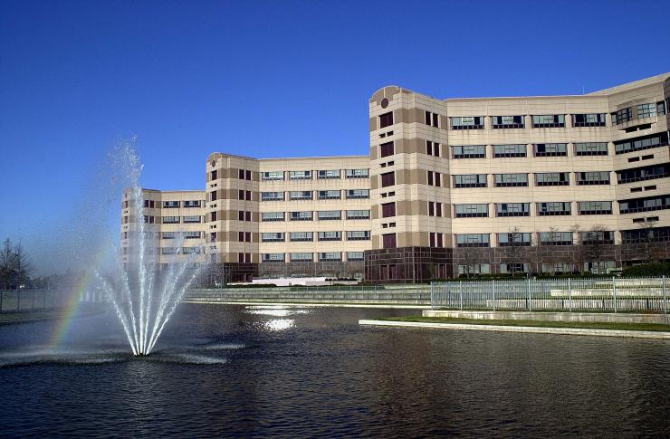
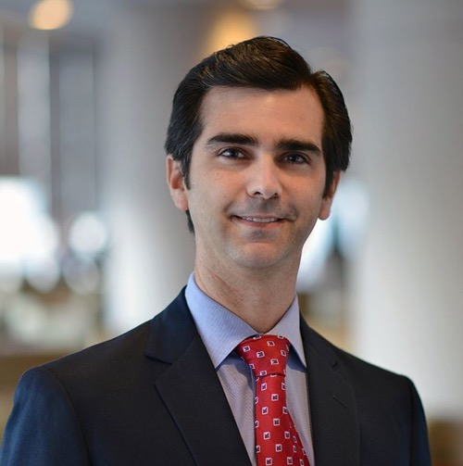
VA Hospital

Slide 8
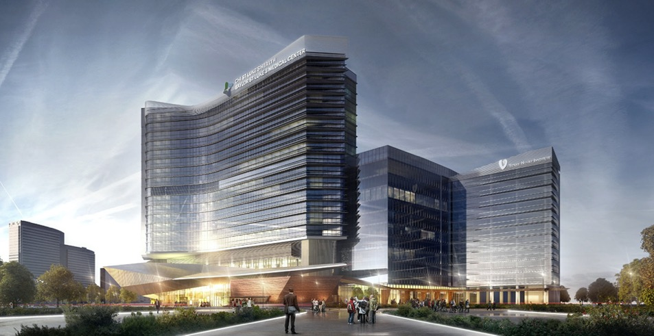
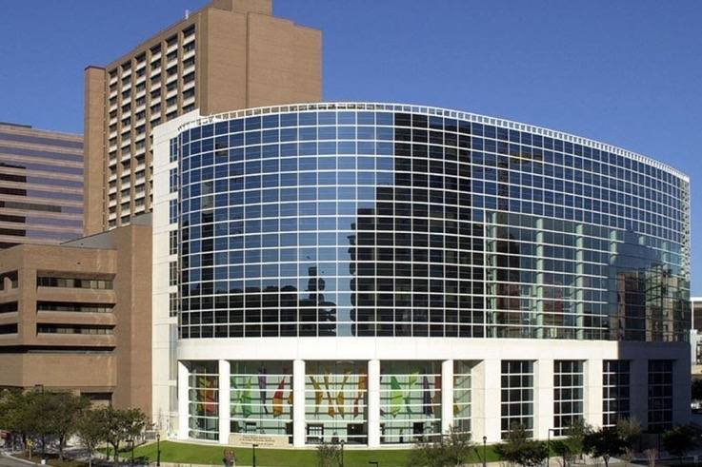
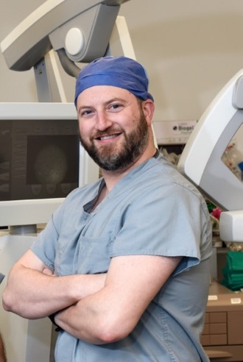
Baylor St. Luke’s Hospital

Slide 9
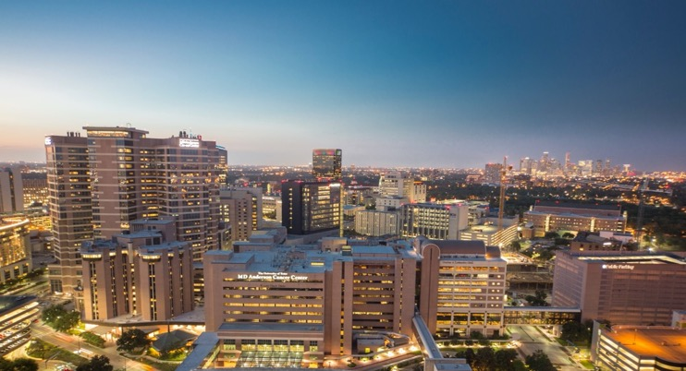
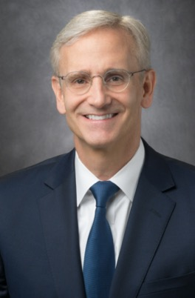
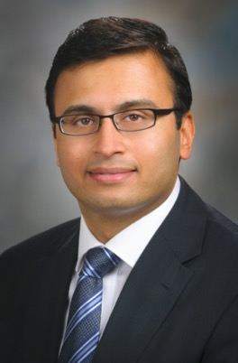
MD Anderson Cancer Center

Slide 10
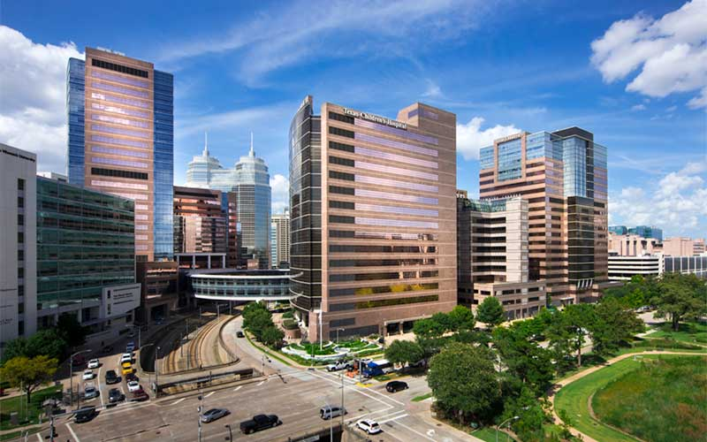
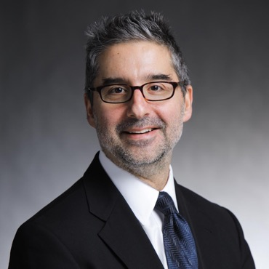
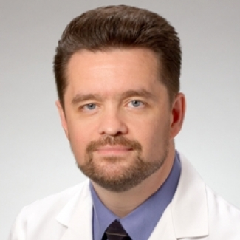
Texas Children’s Hospital

Slide 11
Overview
PGY1:
7 months on the neurosurgery service, 3 months critical care education applicable to neurosurgical patient, 1 month of neurology, 1 month of neuroendovascular
PGY2-4:
36 months clinical neurological surgery
PGY5:
12 months research/career development
PGY6-7:
24 months operative neurological surgery
12 months (PGY7) served as chief resident

Slide 12
PGY2 Rotation
Ben Taub
Texas Children’s Hospital
MD Anderson Cancer
Night Float*

Slide 13
PGY3 Rotation
Ben Taub
Veterans Affairs Hospital
Baylor St. Luke’s Medical Center
MD Anderson Radiosurgery

Slide 14
PGY4 Rotation
Ben Taub
Baylor St. Luke’s Medical Center
Texas Children’s Hospital
Baylor St. Luke’s Medical Center Neuroendovascular

Slide 15
PGY5: Career Development/Research
Funded by NIH R25 Grant
Up to 24 months of protected research time
Successful transition to mentored research funding after completion of training
Basic Neuroscience Research
BCM Department of Neuroscience, Top 10 in NIH funding
MDACC widely recognized as the world leader in cancer research
Clinical Research
Abundant opportunities throughout the affiliated hospitals
Enfolded experiences available in spine, endovascular, functional

Slide 16
PGY6 Rotation
Veterans Affairs Hospital Chief
MD Anderson Cancer
Baylor St. Luke’s Medical Center
Potential for additional enfolded experience*

Slide 17
PGY7: Chief Resident
Ben Taub
MD Anderson Cancer
Baylor St. Luke’s Medical Center

Slide 18
CAST Certified Fellowships
Critical Care
Endovascular Neurosurgery
Functional Neurosurgery

Slide 19
Didactic Conferences
Wednesday and Friday departmental conferences
BSLMC
Tuesday: Epilepsy and Vascular
Thursday
1st/3rd Thursday: Spine
2nd/4th Thursday: Tumor board
TCH
Morning report
Wednesday: Tumor board
MDACC
Wednesday Afternoon: Tumor board
Monday: Teaching conference

Slide 20
What makes us special?
Diverse Faculty
Unmatched autonomy (with great support) in public hospitals
Full breadth of neurosurgery
Tremendous academic resources
Practical clinical training
Supportive working environment
Enfolded subspecialty experience
Incredible basic science research opportunities

Slide 21
Recent Graduates
Most recent graduates
Spine Oncology Attending (Pittsburgh)
Skullbase Fellowship (Univ Washington)
Graduates from 2021/22
Epilepsy/Tumor Attending (UTMB)
Pediatric Neurosurgery Fellowship (TCH)
Private Practice (Oregon)
Tumor Attending (LSU Shreveport)
Pediatric Neurosurgery Fellowship (Northwestern)
Private Practice (Florida)

Slide 22
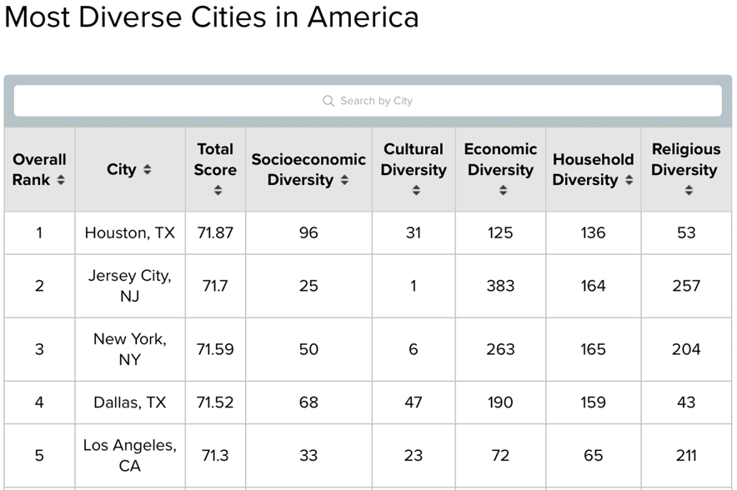

Slide 23
