Slide 1
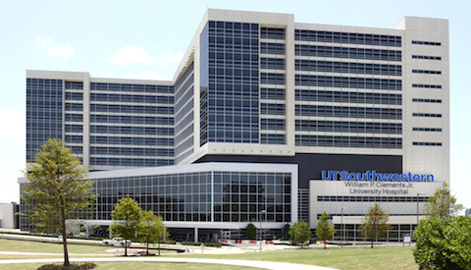
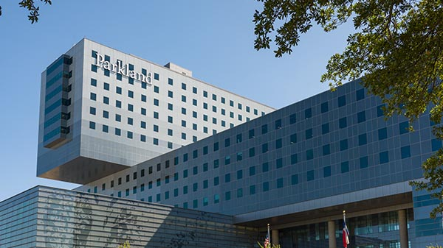
UT Southwestern Neurosurgery Residency Program

Slide 2
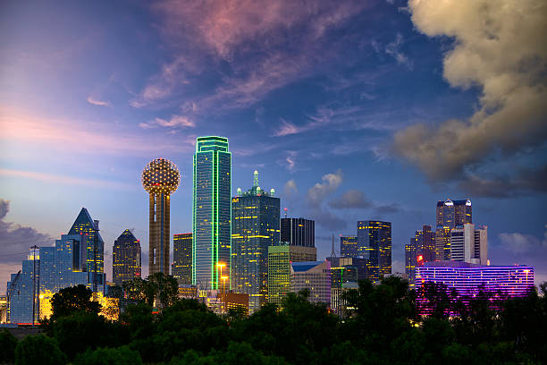
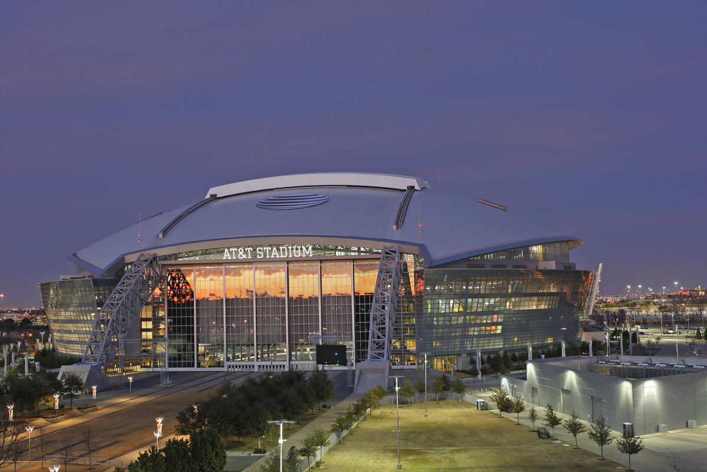
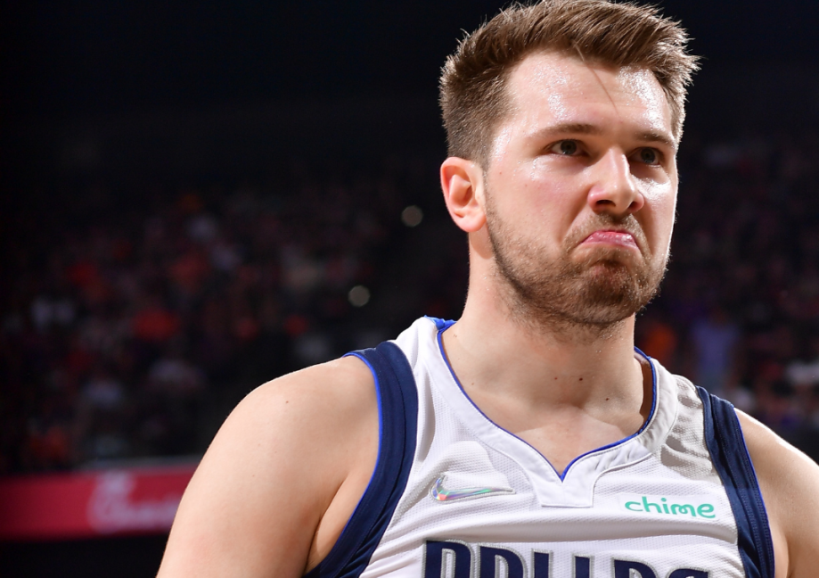
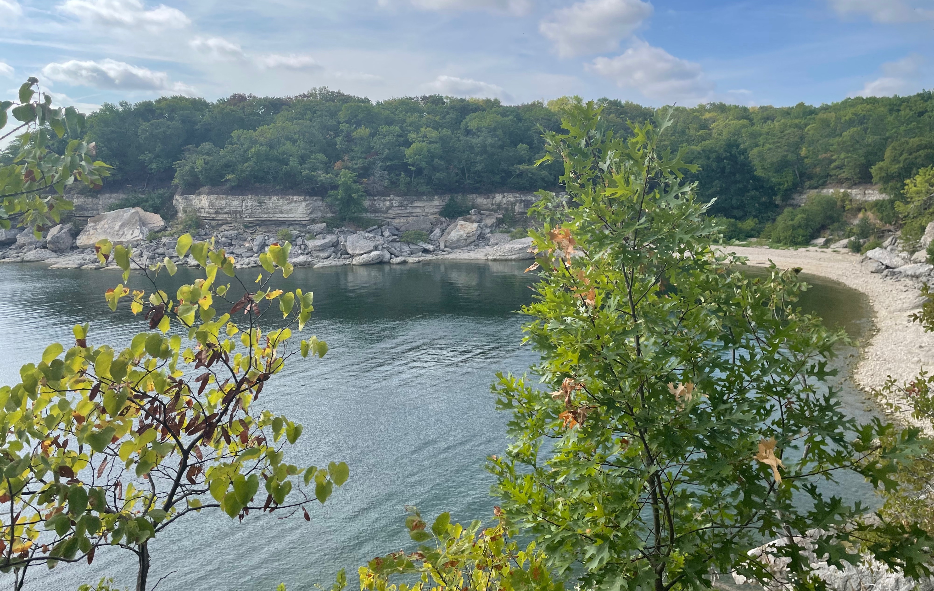
Dallas Facts
Dallas is the 4th largest metropolitan city in the U.S.
Home to 5 major league sports teams: Mavericks, Rangers, Cowboys, Stars and FC Dallas
Diverse and evolving food scene. Bon Appetite “Restaurant City of the Year” in 2019
DFW is home to 24 Fortune 500 companies
Walking trails, bars and concerts
2 major airports: Love Field (5 mins from UTSW/Parkland) and DFW

Slide 3
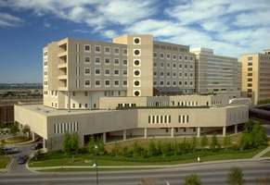
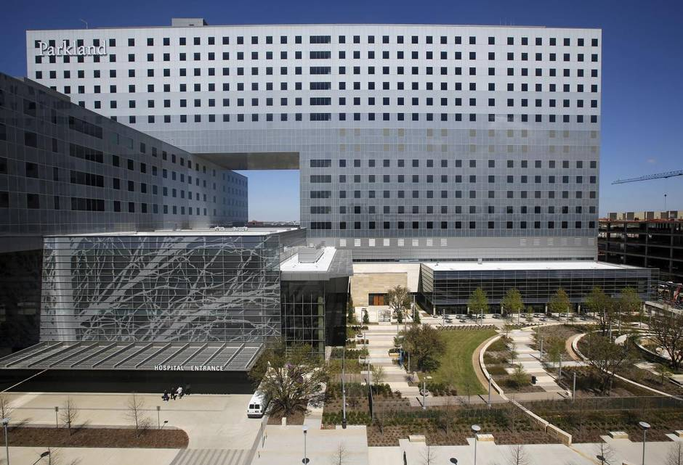
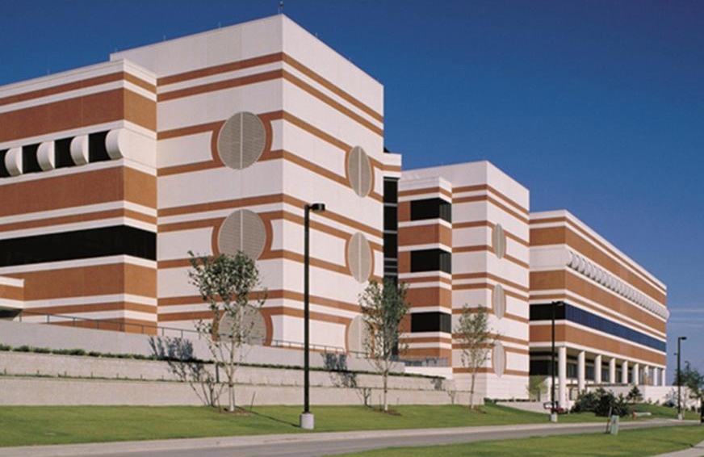
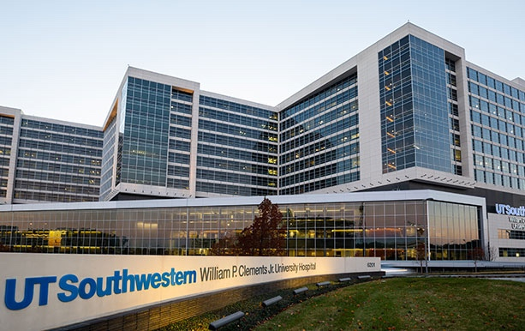
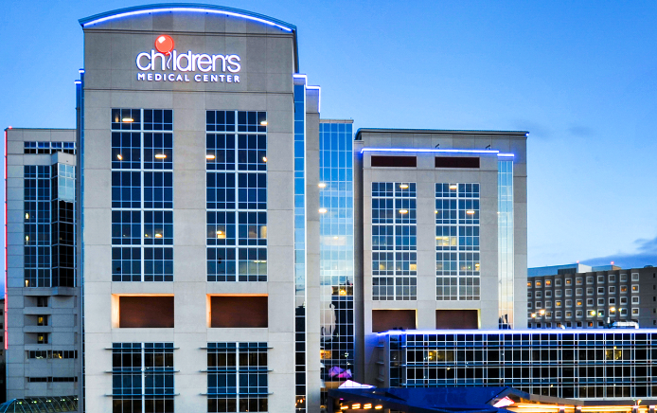
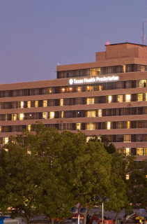
Rotation Sites
Department of
Neurological Surgery

Slide 4
Intern Year
3 months of General Surgery
Trauma, SICU and VA
6 months on Parkland NSGY
Mastery of bedside procedures
Management of floor and ICU patients
In-house call and clinic
OR exposure: positioning, pinning, closure, etc.
3 months on NCC/Vascular Service
ICU management
Airway management, arterial line, central line

Slide 5
PGY-2
6 months on Vascular/Functional
OR daily as first-assist
Cases e.g. ATL, low-grade AVM, DBS, LITT, HIFU, peripheral nerve, IR cases
Operate with Dr. Pouratian
Home call
6 months on Parkland NSGY
OR daily as first-assist with Chief
Present at Spine, Vascular and Tumor conference
Manage service

Slide 6
PGY-3
6 months at THD
No chief
First-assist
Manage service
Home call and moonlighting
6 months at Children’s Hospital
No chief
First-assist
Manage service
Home call

Slide 7
PGY-4
Exploratory Year
Bench, clinical or translational research
Advanced degree
Mentorship to tailor career pursuits
Infrequent home call
No publication obligation

Slide 8
PGY-5
Spine Service
Complex spine deformities, intradural tumors, ACDF, ALIF, TLIF, etc.
Tumor service
Complex skull base cases, insular gliomas, meningiomas, GKRS and etc.

Slide 9
PGY-6
Parkland Chief
Primary surgeon
Management from clinic-to-OR
Vascular Chief
Surgical management of cerebrovascular disease (e.g. open aneurysm treatment, AVM, AVF, IR, etc.)
VA Chief
Complex spine deformities, intradural tumors, ACDF, ALIF, TLIF, etc.
Tumor Chief
Complex skull base cases, insular gliomas, meningiomas, GKRS and etc.

Slide 10
PGY-7
Elective/Enfolded/Chief
Fellowship Opportunities
Spine (CAST)
Pediatric Neurosurgery (CAST)
Functional (CAST)
Neuroendovascular (CAST)

Slide 11
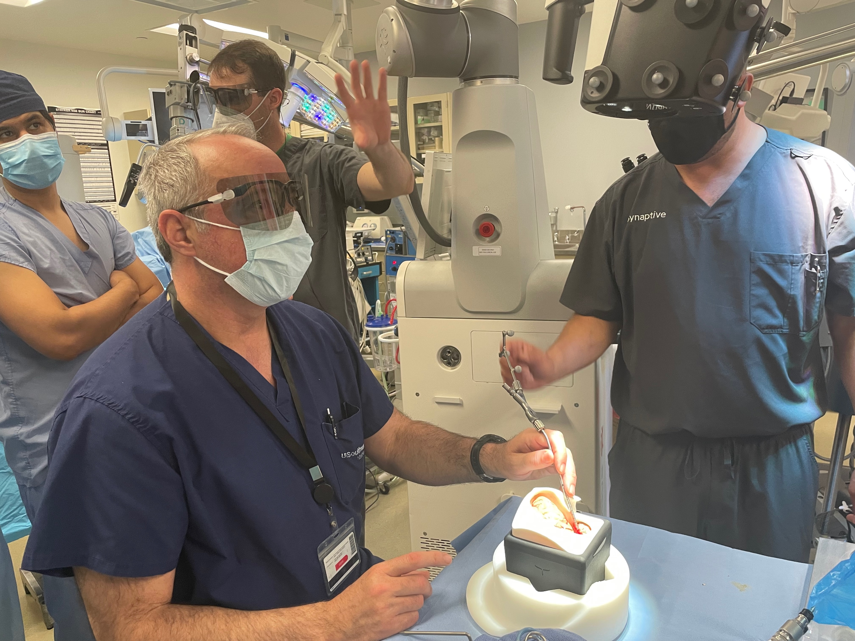
Teaching/Education
Conferences
Tuesdays: Vascular Conference
Wednesdays: Chairman’s Conference
Oral boards style review
Thursdays: Spine Conference
Fridays: Tumor Board
Visiting Professor Lectureships
Clark Samson Bioskills Lab
Approach courses
Resident education fund
Books, exam costs, conferences, computers, etc.

Slide 12
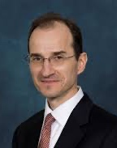
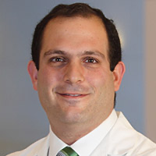
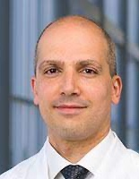
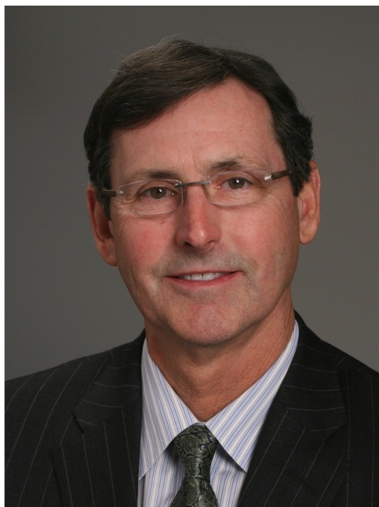
Faculty
Dr. Jonathan White
Dr. Babu Welch
Dr. Carlos Bagley
Dr. Bradley Weprin
Dr. Venkatesh Aiyagari
Dr. Brett Whittemore
Dr. Robin Novakovic
Dr. Alex Valadka
Dr. Dale Swift
Dr. Lee Pride
Dr. Mazin Al Tamimi
Dr. Bruno Braga
Dr. Kathryn Hoes
Dr. Angela Price
Dr. Rafael de Oliveira Sillero
Dr. Salah Aoun
Dr. Nader Pouratian,
Chairman
Dr. Toral Patel
Dr. Kevin Morrill
Dr. Christopher Madden
Dr. Samuel Barnett
Dr. Bradley Lega
Dr. Russell Payne
Dr. Duke Samson
Dr. Hunt Batjer

Slide 13
Quick Facts
Graduating case numbers
2021: 1,225
2022: 1,520
Department Research Productivity
Annual publications: ~100
NIH funding:
35 active grants
$1.2 million in funding

Slide 14
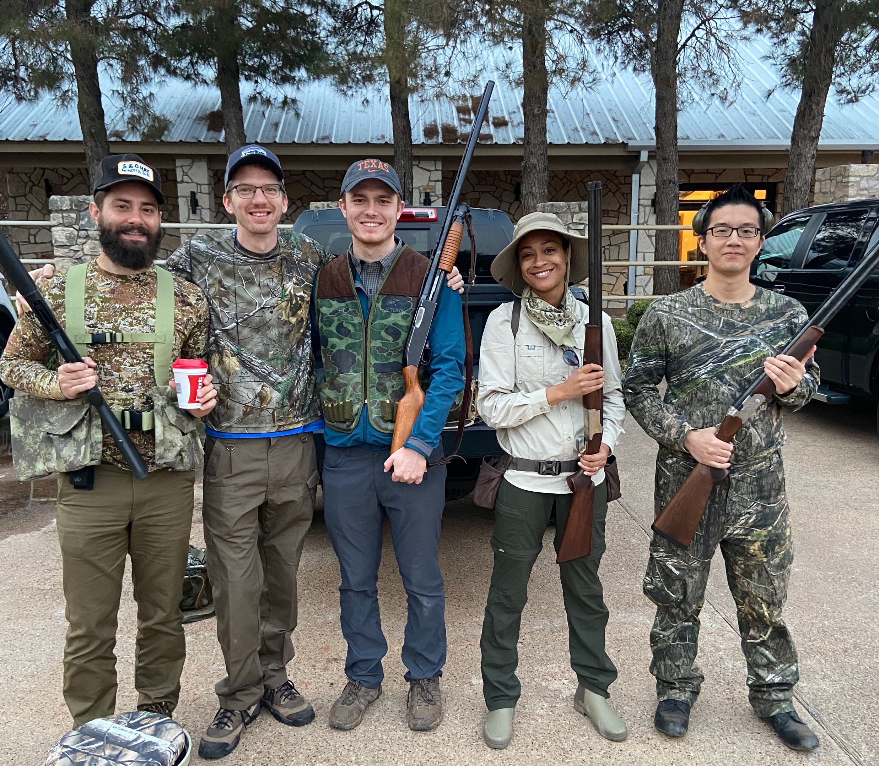
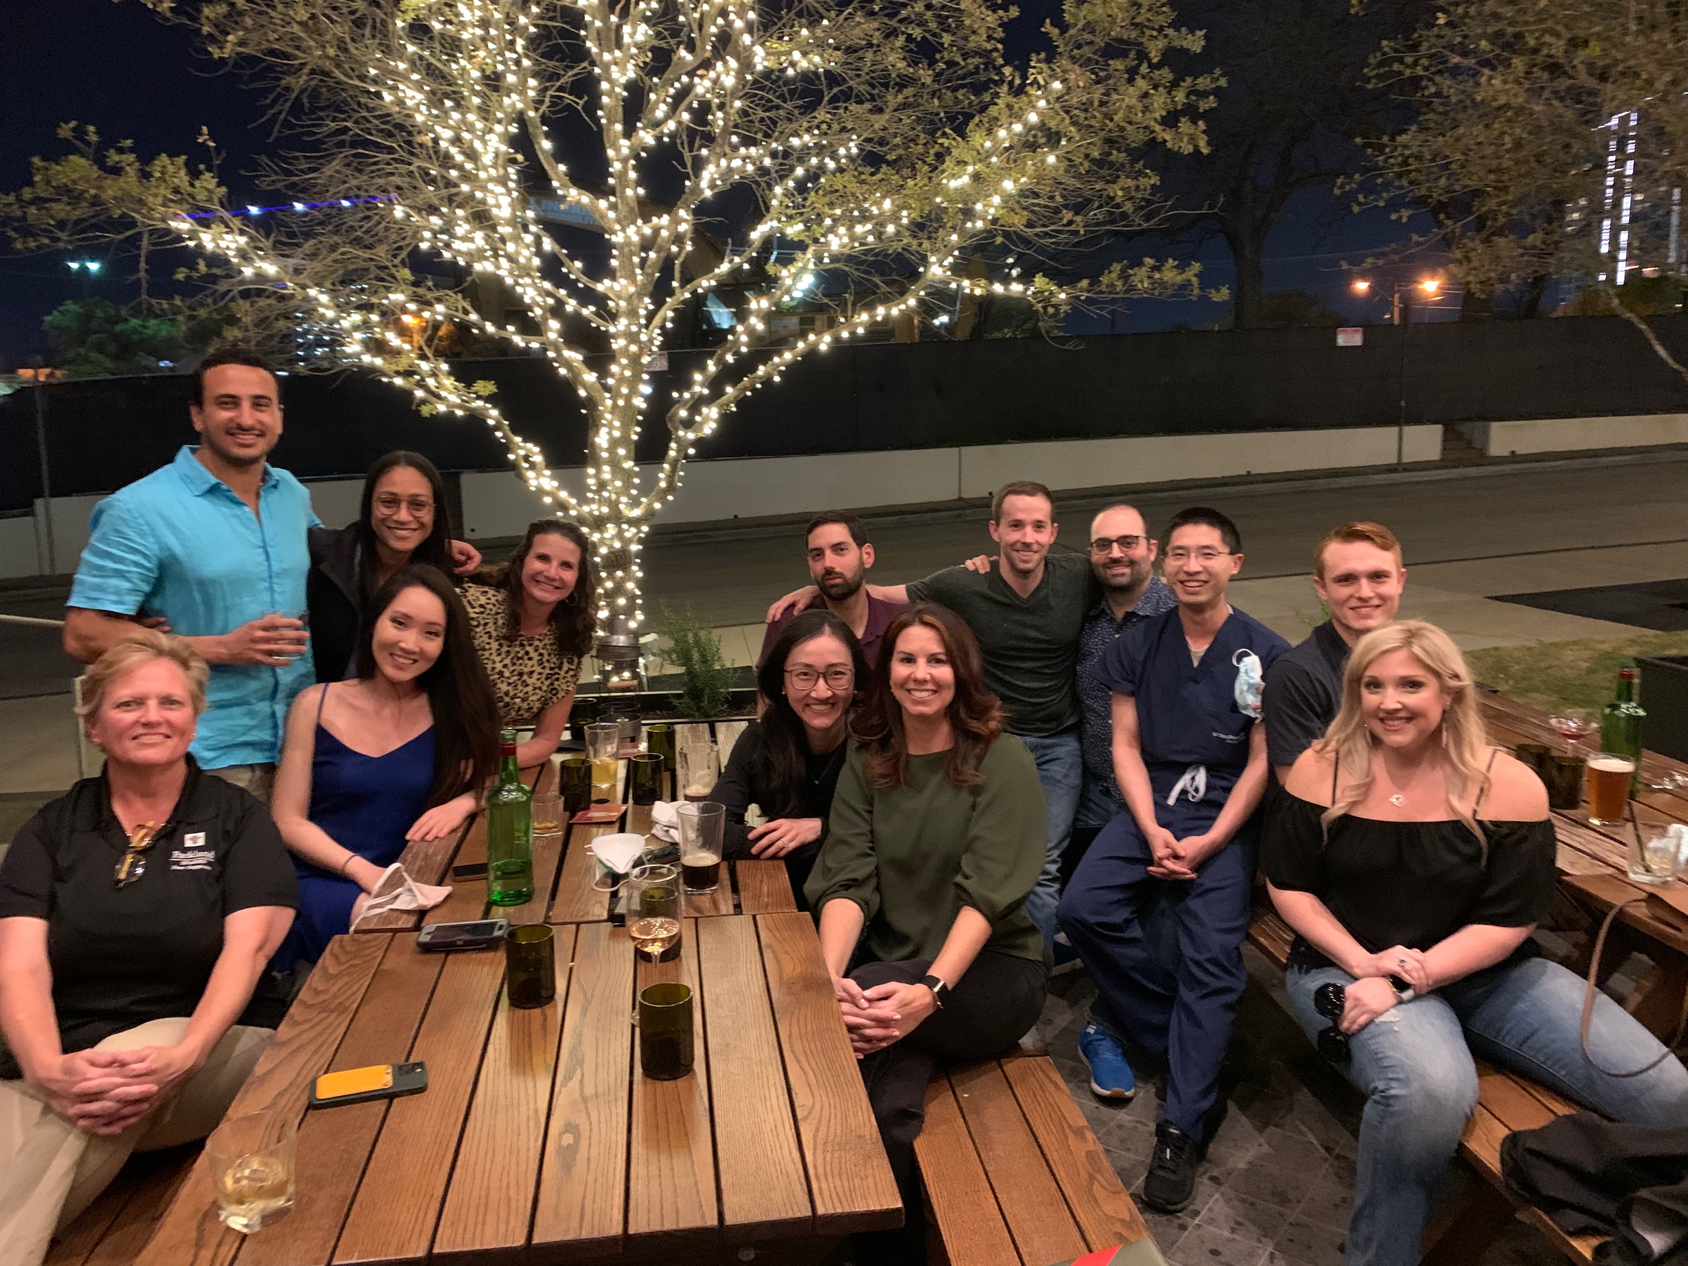
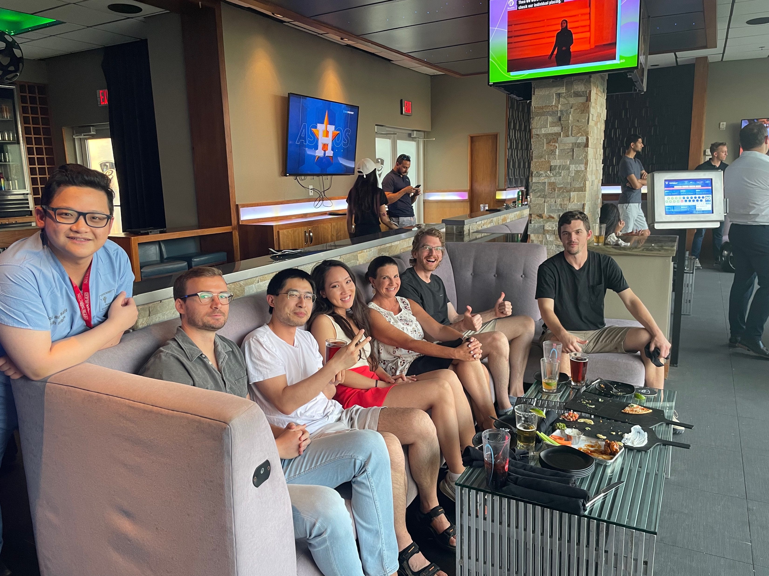
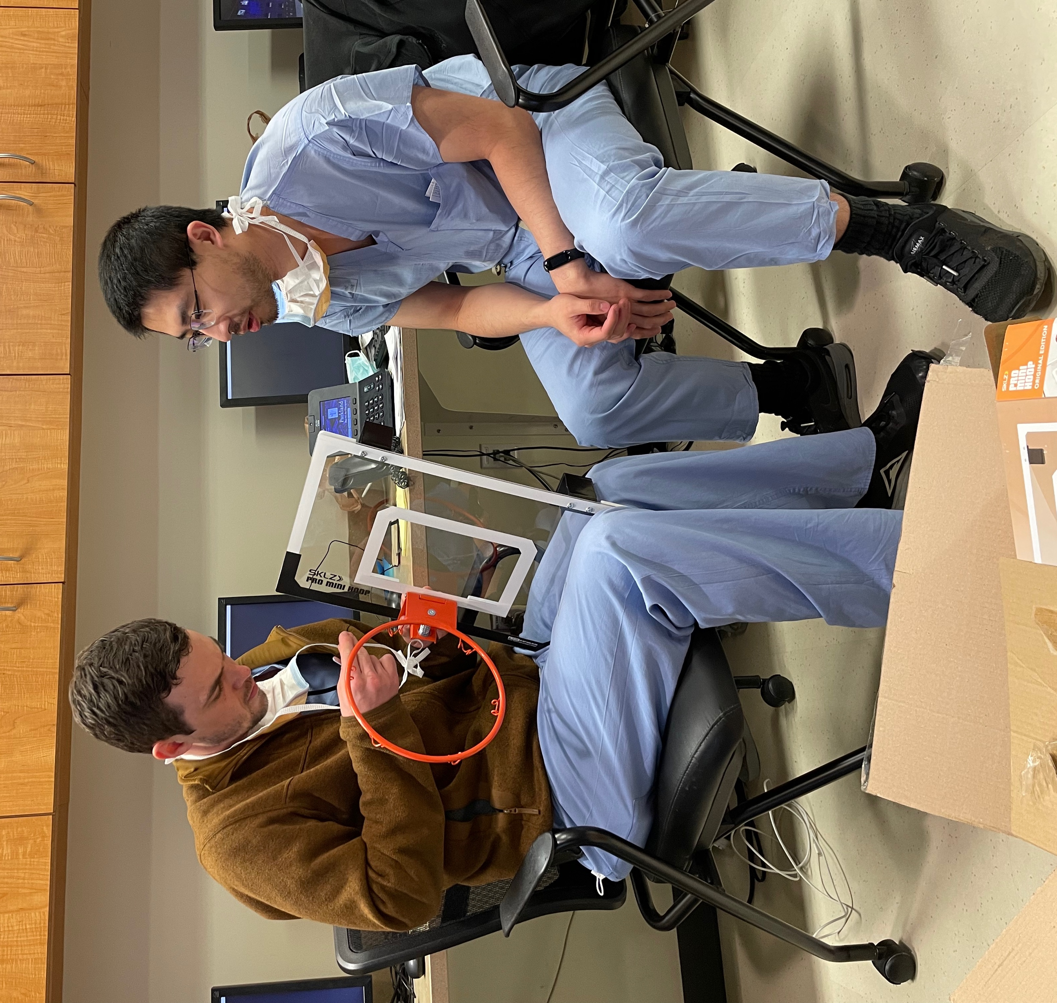
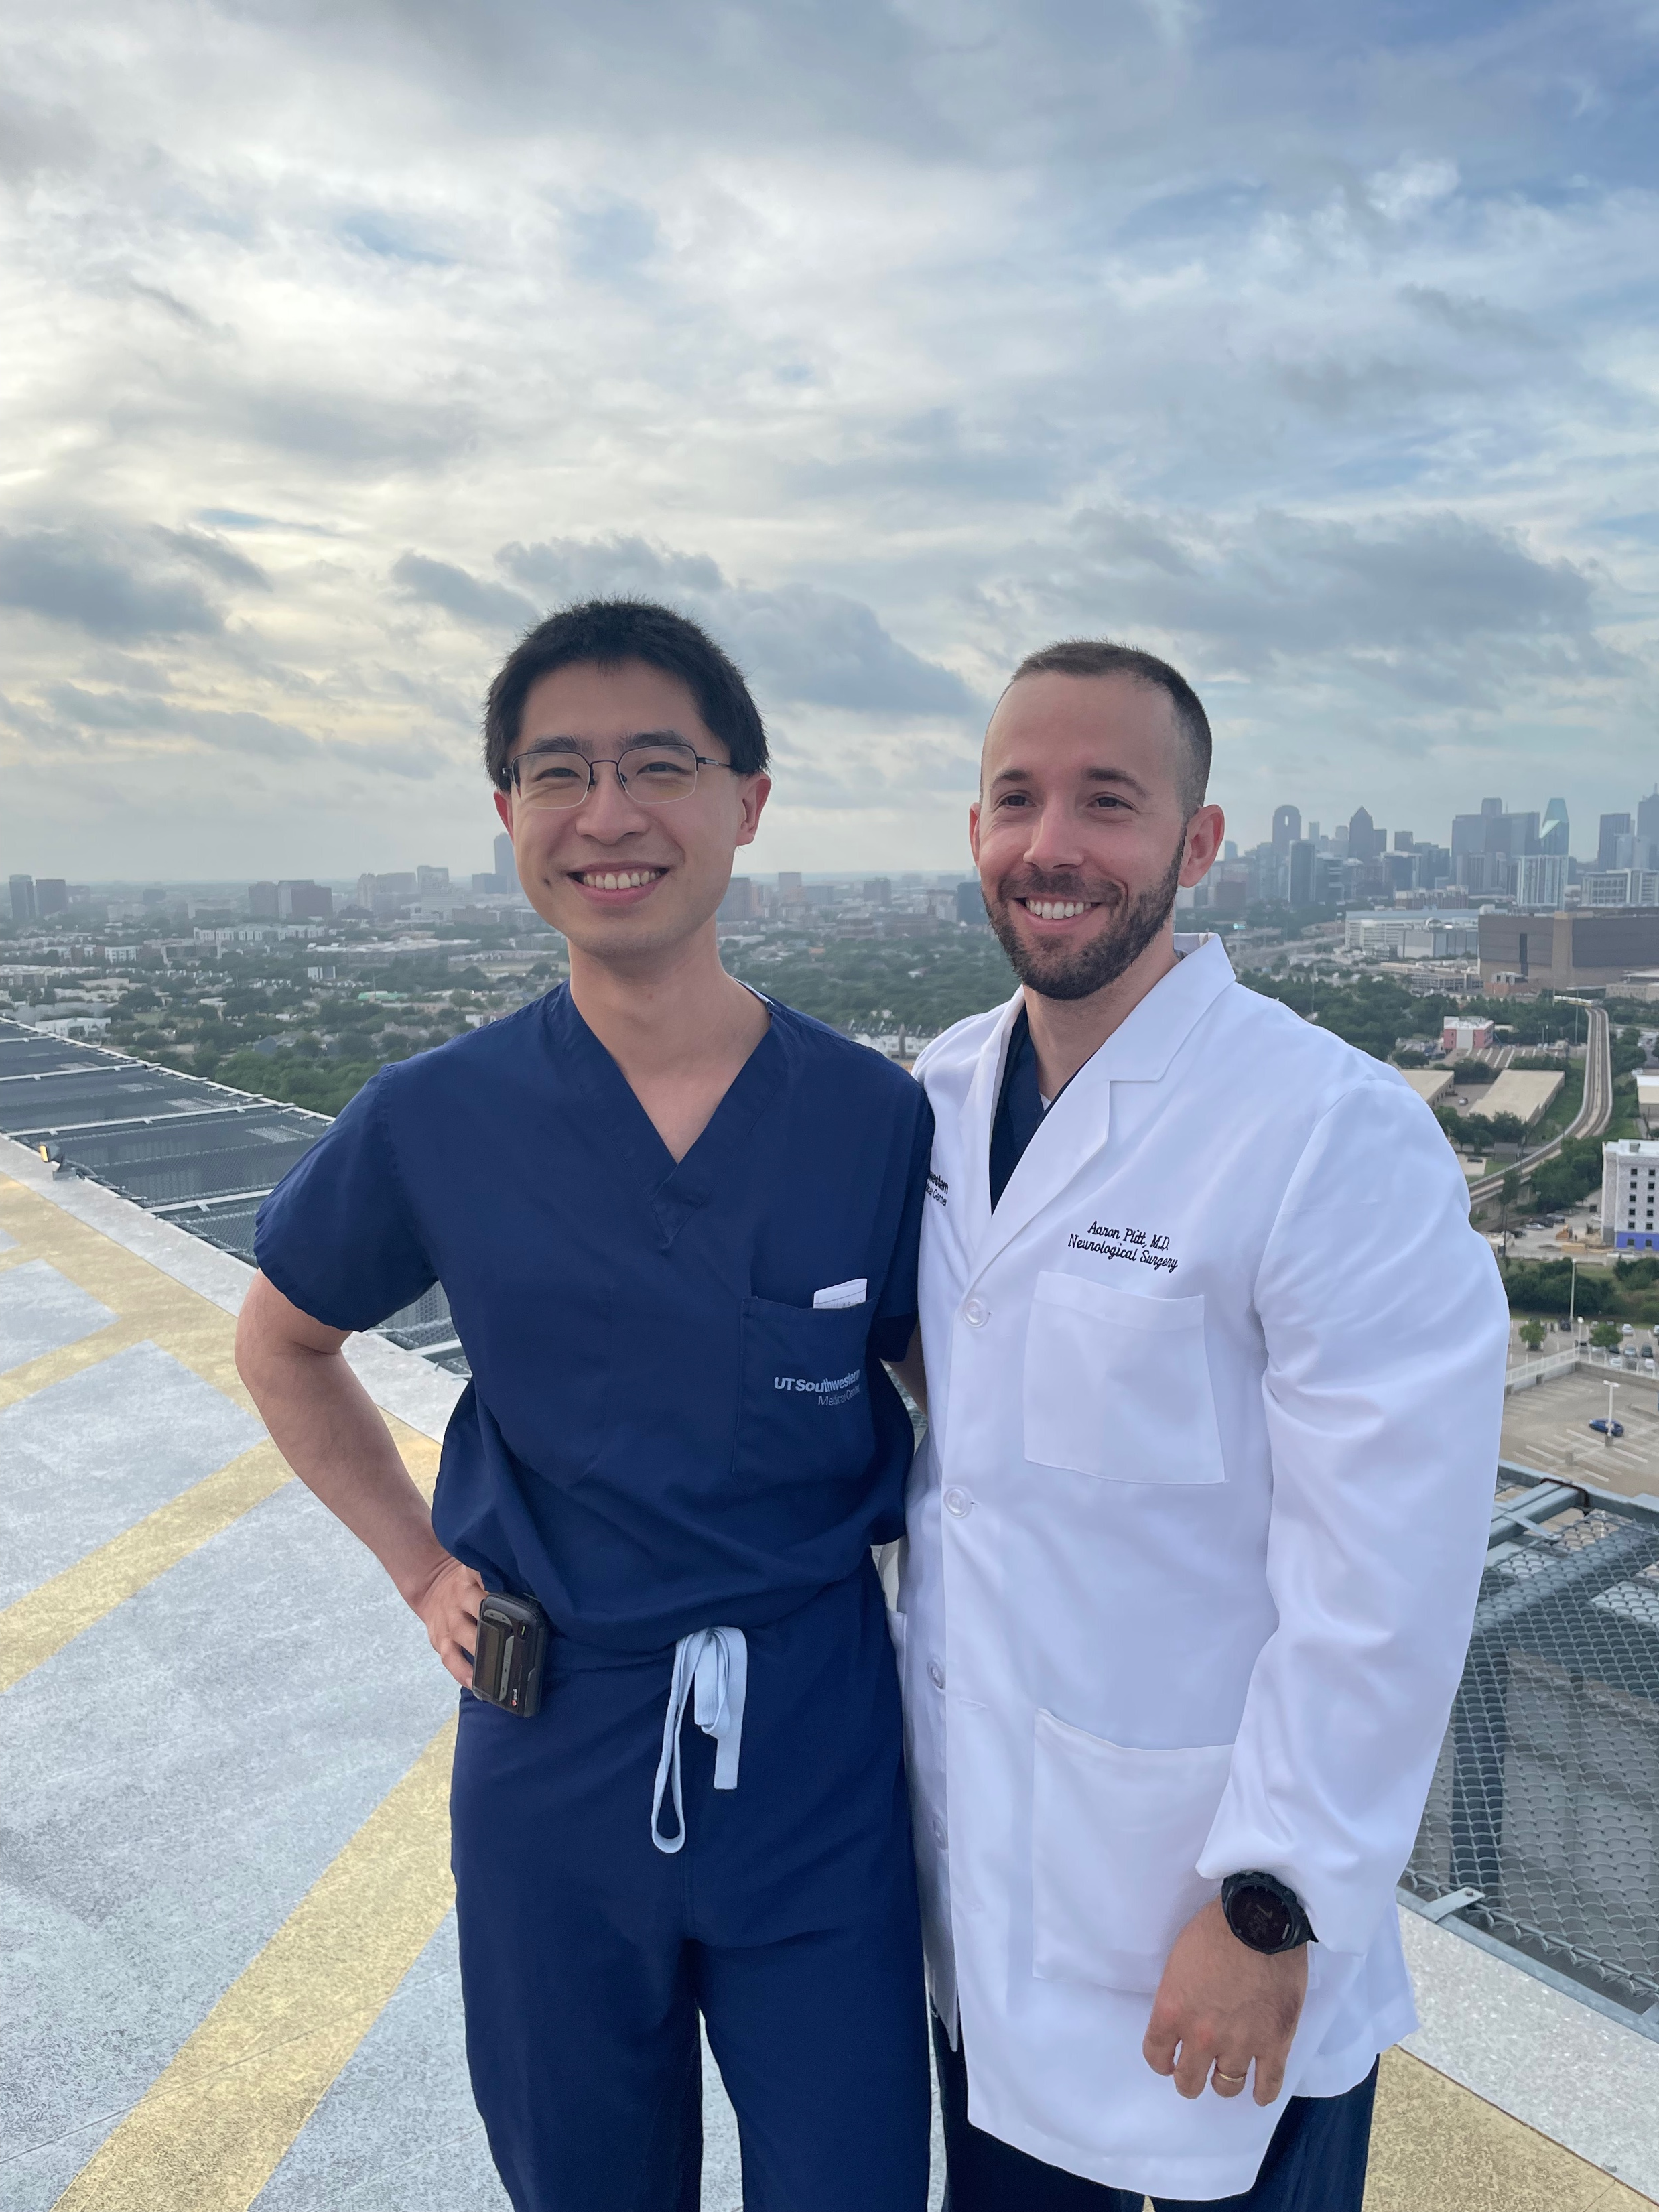
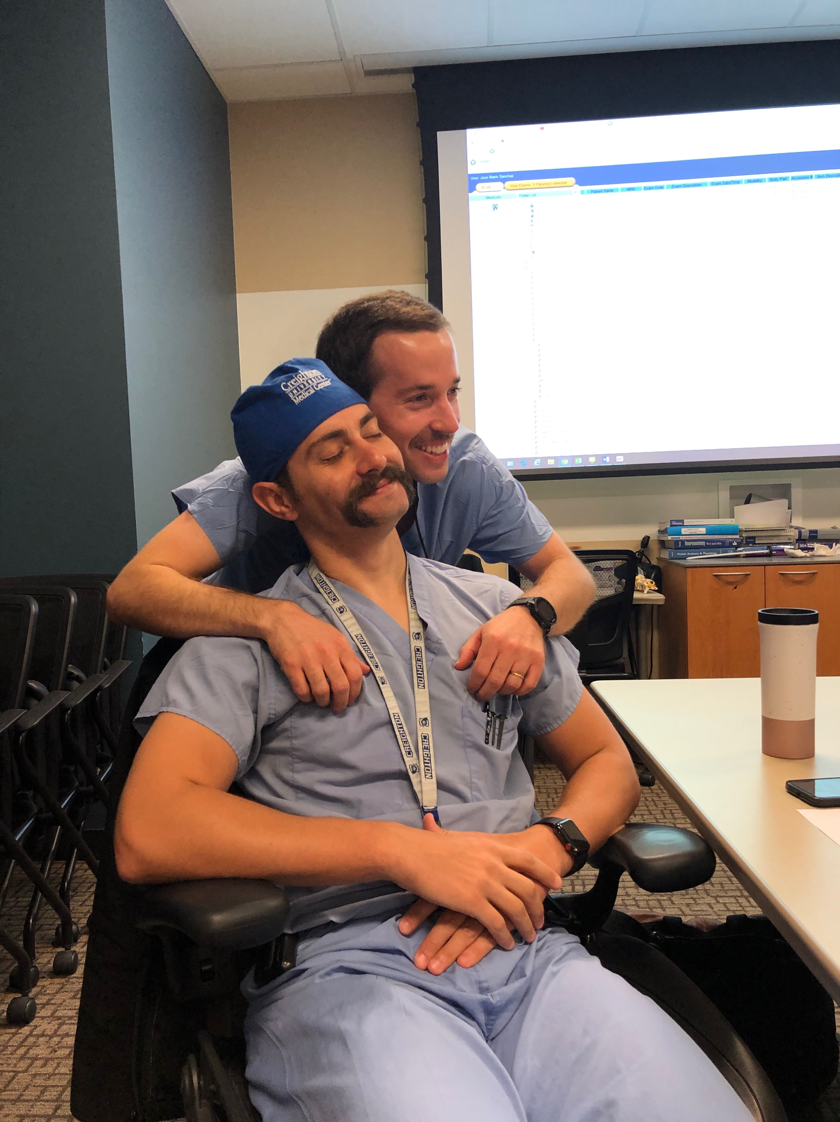
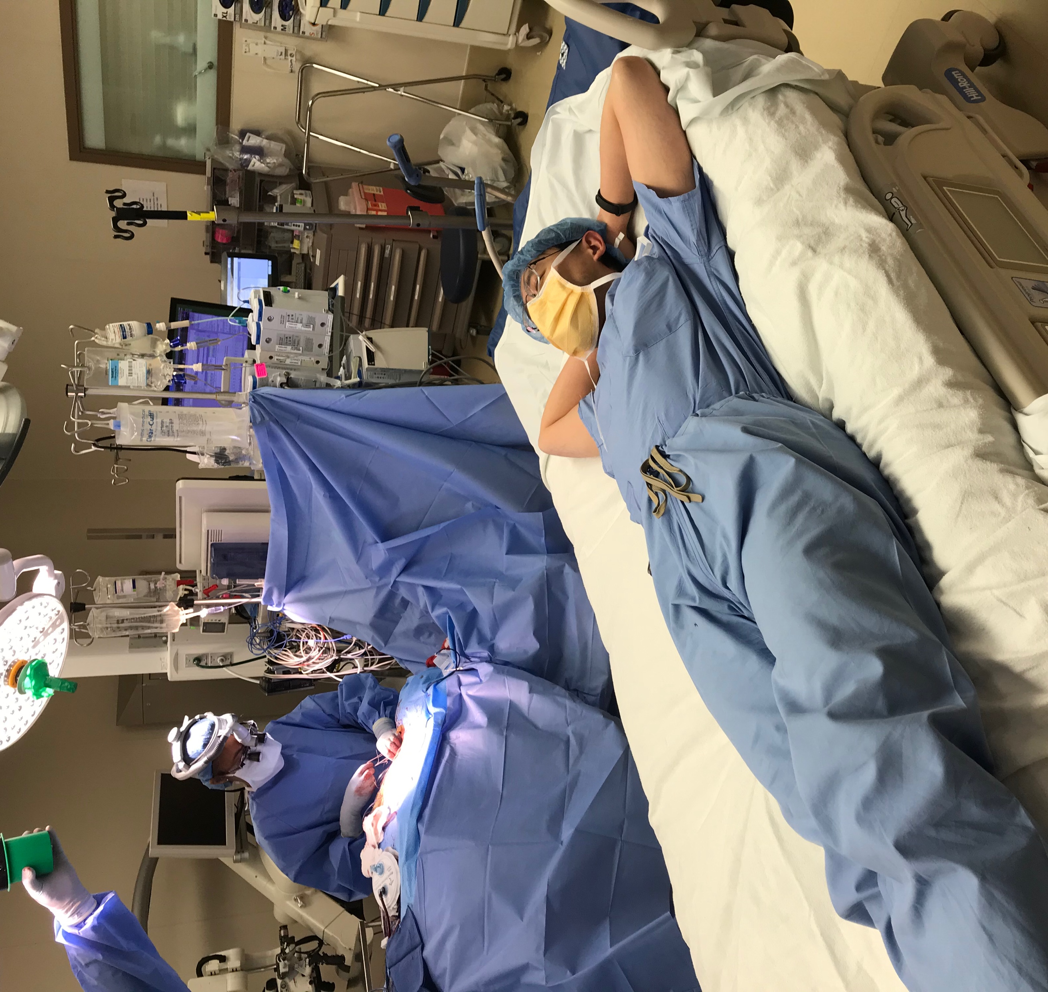
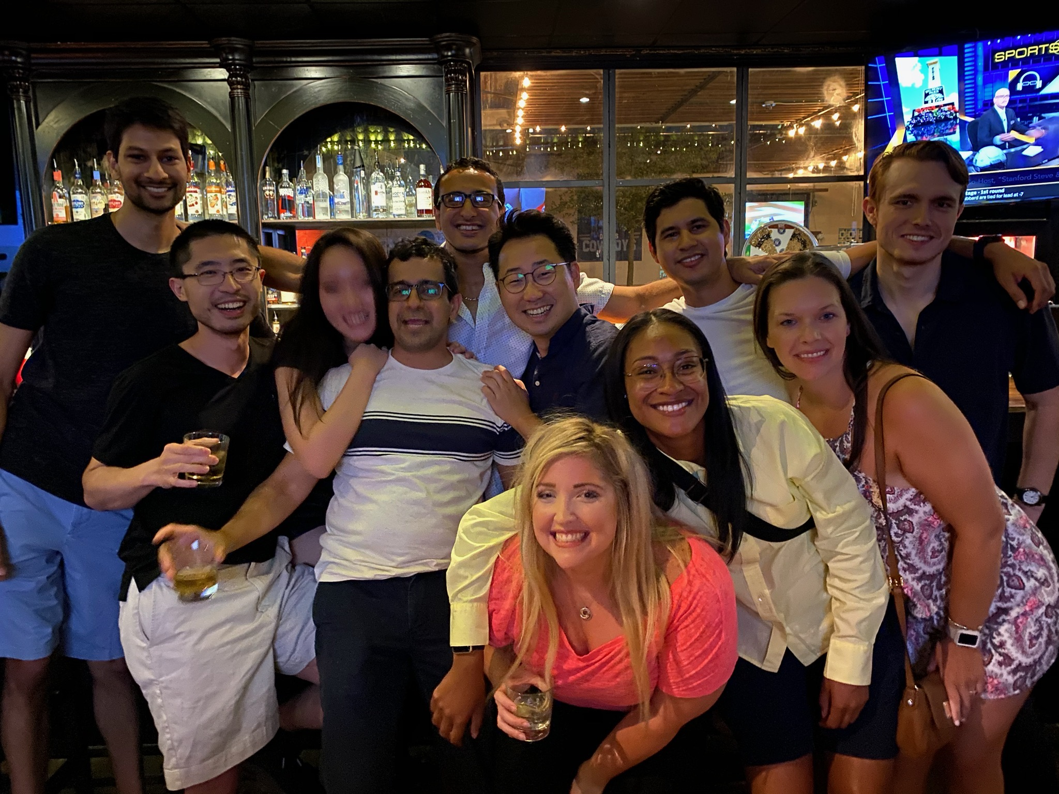
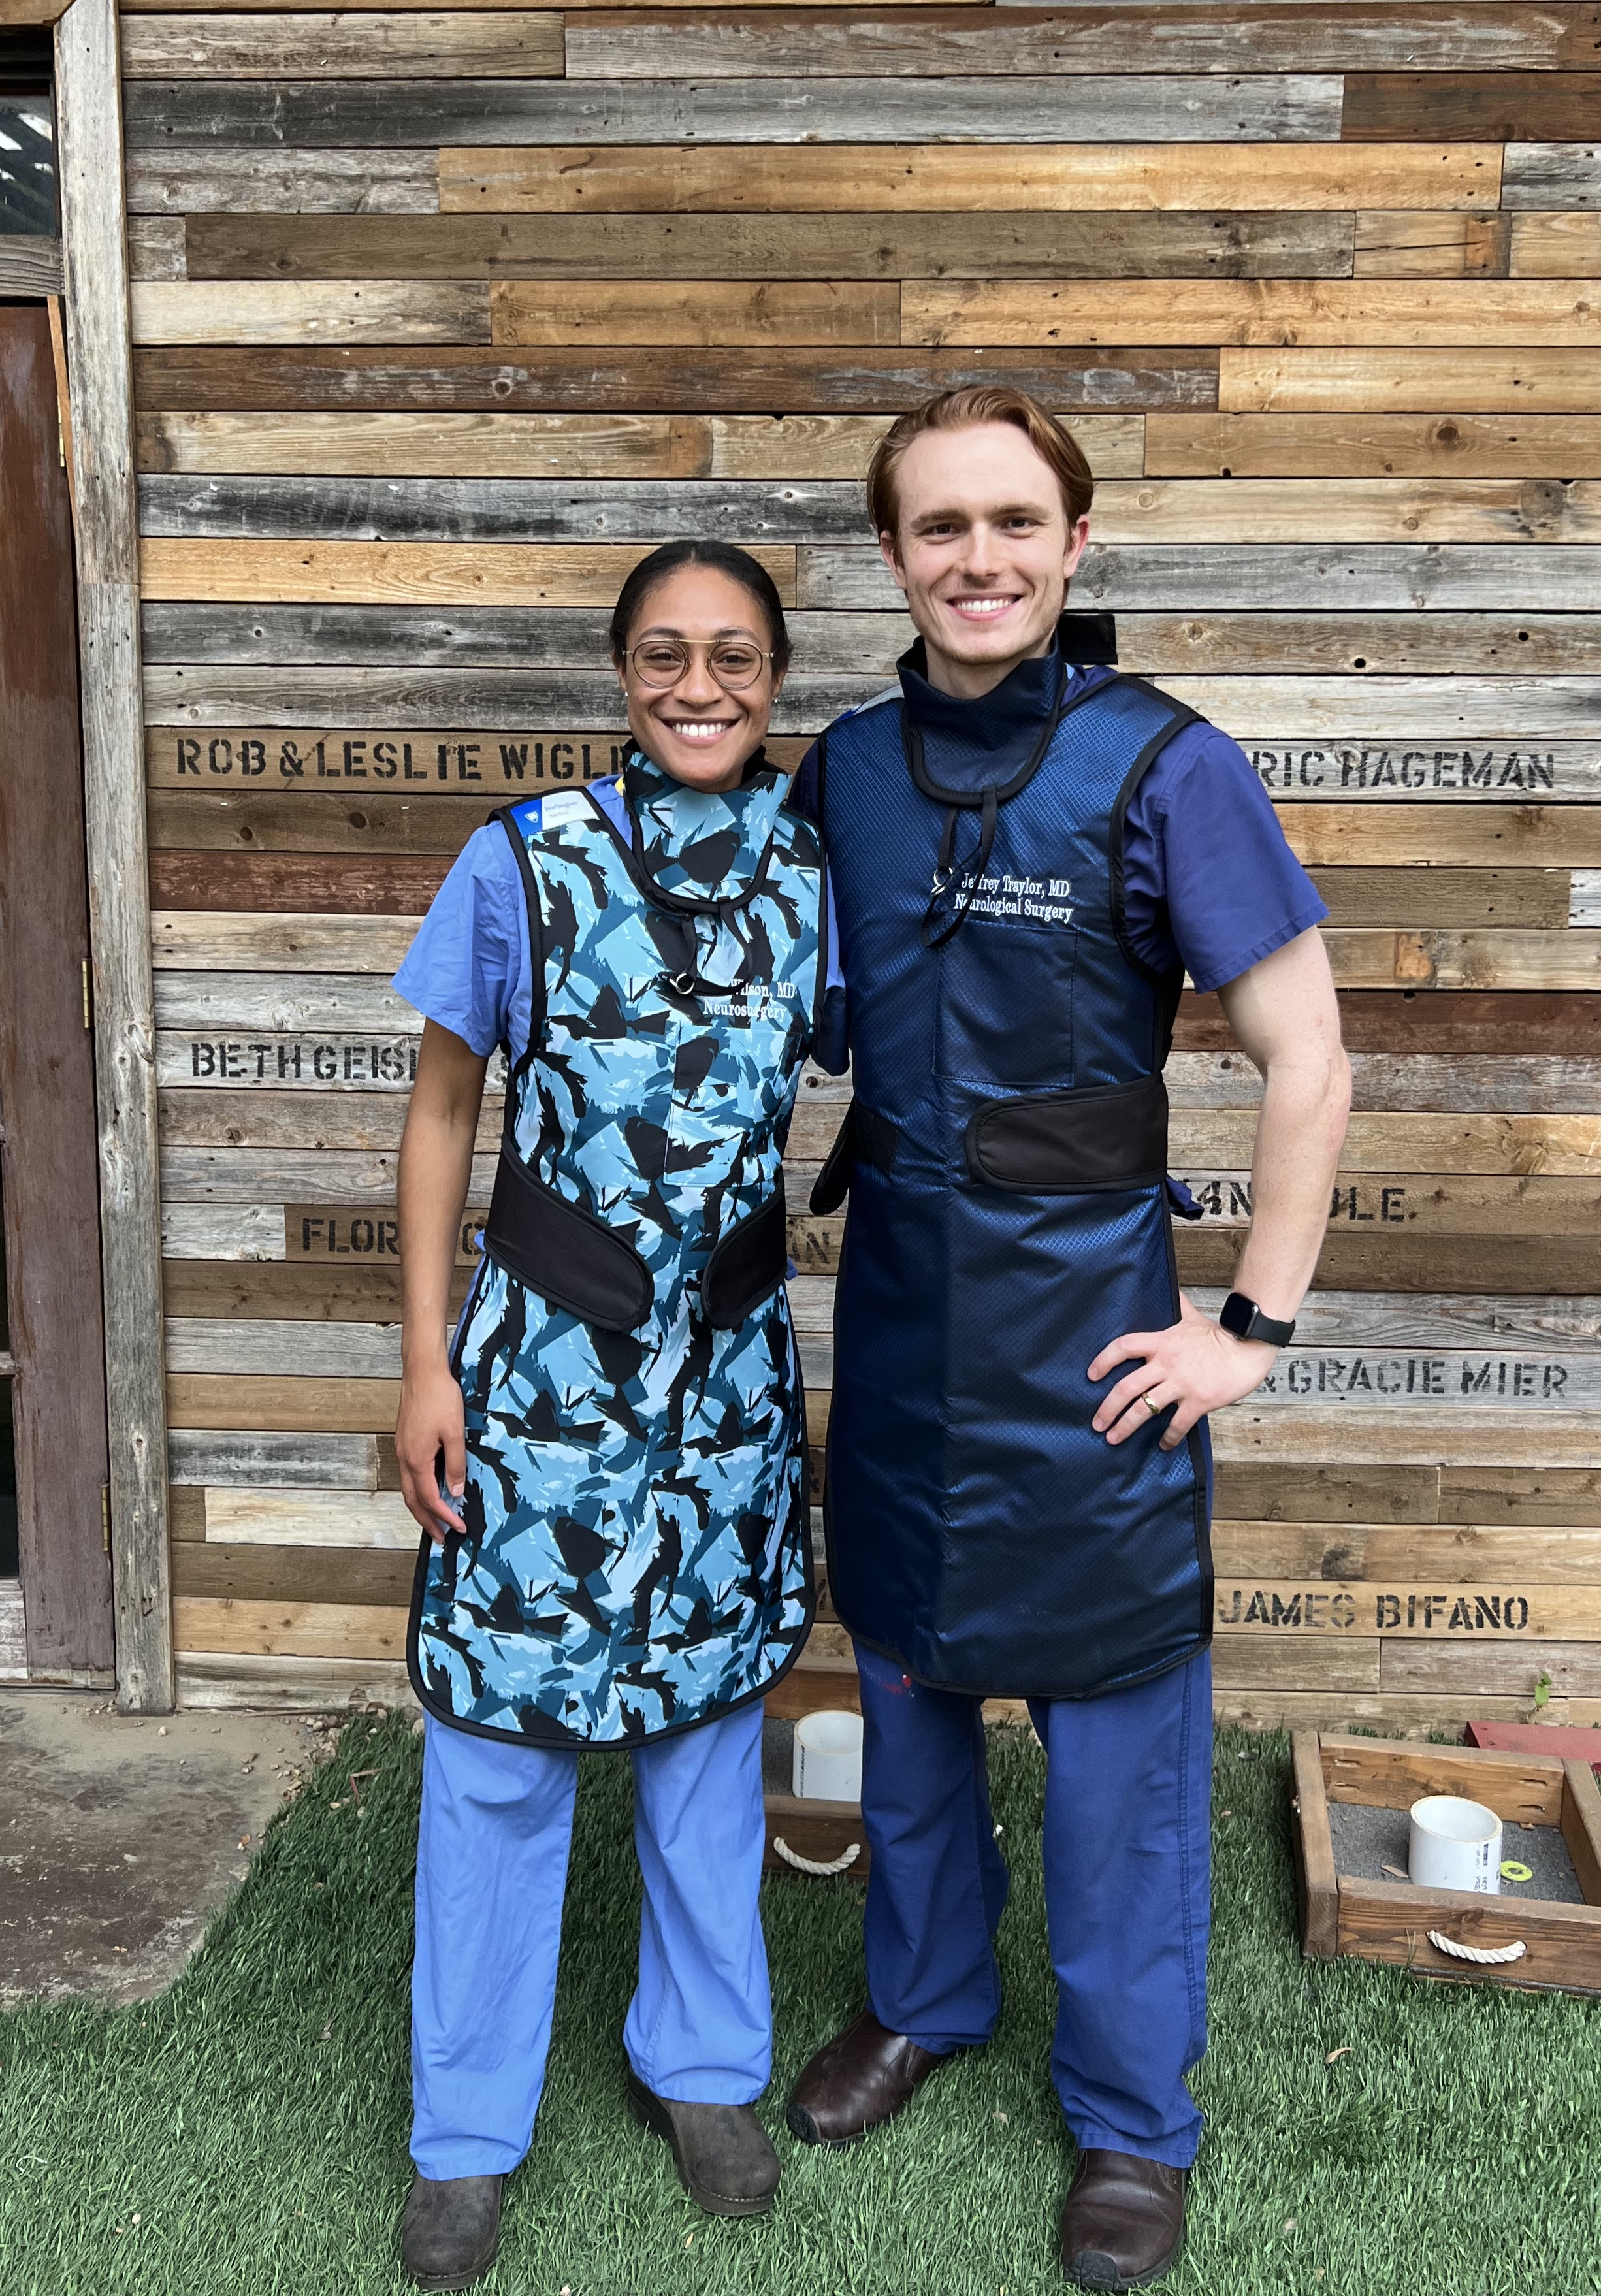
Work-Life Balance

Slide 15
Questions
@UTSWNSResidency

