Slide 1
The Department of Neurological Surgery
Advancing the Vision of the Neurological Institute

Slide 2
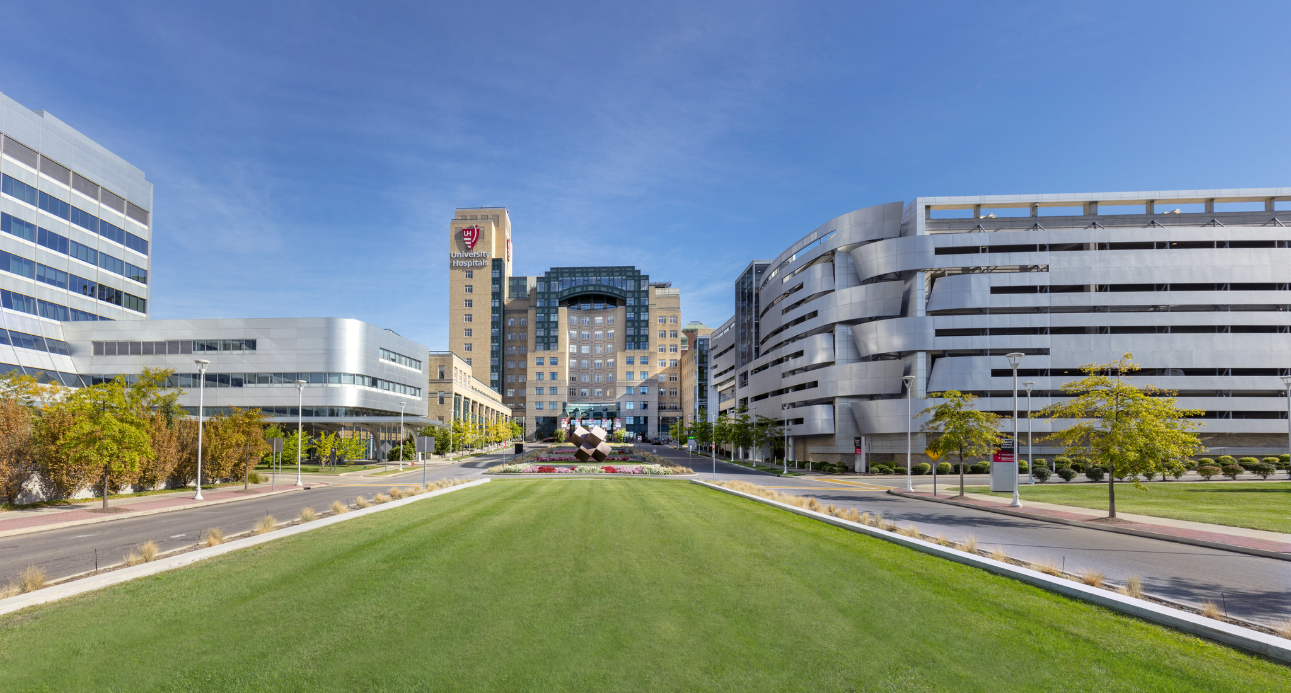
Welcome Neurosurgery Residency Applicants
Notes:
1032 beds; 138M for 144 research studies

Slide 3
Neurological Surgery Residency
17 faculty, 16 residents
Exposure to all subspecialties across 5 clinical environments
Average 1500-1800 cases per graduating resident
Access to clinical and basic science mentored research ($2 million dollars of federal support annually)
Research database of every admission for past 15 years
Flexibility and opportunity for enfolded fellowships, advanced degree, leadership training, basic science/clinical research
Over 50% of graduates complete fellowships and enter academic practice

Slide 4
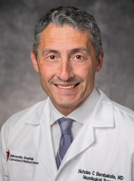
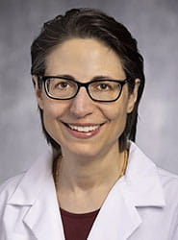
Department Leadership
Nicholas Bambakidis, M.D
Chair, Department of Neurological Surgery
Director, UH Neurological Institute
Harvey Huntington Brown Jr. Professor and Chair in Neurological Surgery
Professor of Neurosurgery
Skull base, Cerebrovascular, Endovascular, Complex Spine
Sepideh Amin-Hanjani, MD
Vice-Chair, Department of Neurological Surgery
Director, Cerebrovascular and Skull Base Surgery
Warren R. Selman Endowed Chair of Neurological Surgery
Professor of Neurosurgery
Skull base, Cerebrovascular

Slide 5
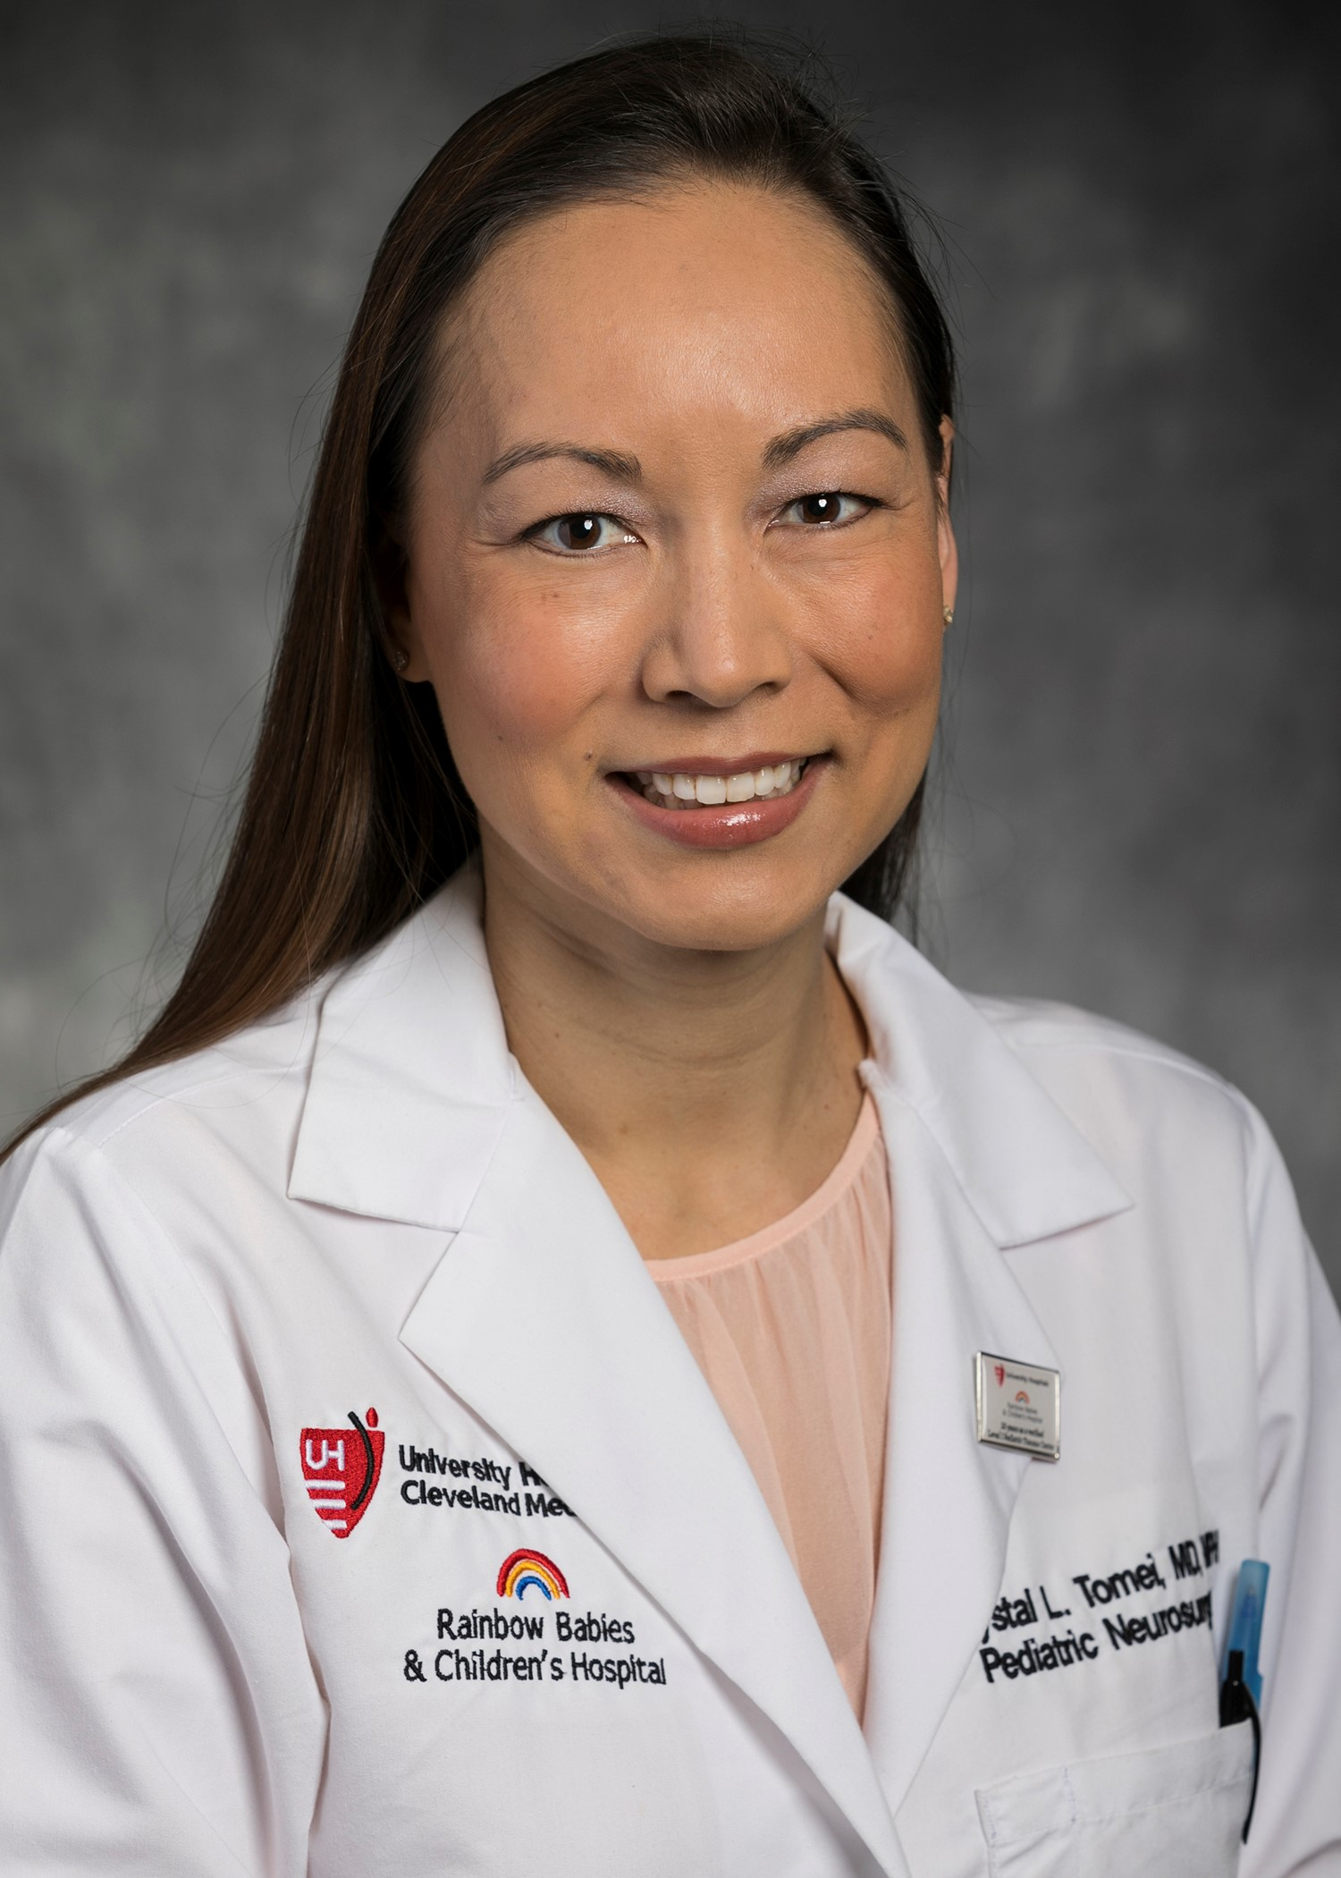
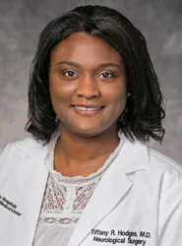
Residency Program Leadership
Krystal Tomei, MD, MPH
Program Director, Neurosurgery Residency
Reinberger Endowed Director in Pediatric Neurological Surgery – Rainbow Babies & Children’s Hospital
Associate Professor of Neurosurgery
Pediatrics
Tiffany R. Hodges, MD
Associate Program Director, Neurosurgery Residency
Assistant Professor of Neurosurgery
Neurosurgical Oncology

Slide 6
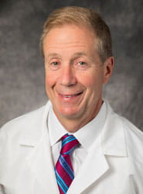
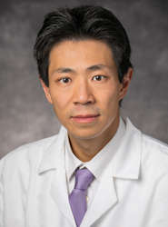
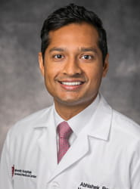
UHCMC Faculty – Vascular, Skull Base
Warren Selman, MD
Harvey Huntington Brown Jr Emeritus Chair
Professor of Neurosurgery
Pituitary Surgery, Cerebrovascular & Skull Base
Yin C. Hu, MD
Director of Neurosurgery, Ahuja Medical Center
Fellowship Director, Endovascular Neurosurgery
Associate Professor of Neurosurgery
Endovascular and Cerebrovascular
Abhishek Ray, MD
Assistant Professor of Neurosurgery
Endovascular, Cerebrovascular,
Endoscopic/Endonasal Skull Base Approaches

Slide 7
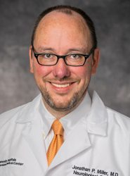
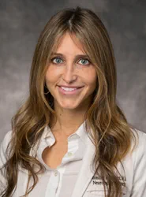
UHCMC Faculty – Functional, Stereotactic, Epilepsy, Peripheral Nerve
Jonathan Miller, MD
George R. and Constance P. Lincoln Professor
Vice Chair of Education, Dept of Neurosurgery
Director of Functional & Restorative Neurosurgery
Functional, Stereotactic, Peripheral Nerve, and Epilepsy
Jennifer Sweet, MD
Sheila & Sandy Fox Master Clinician in Neurosurgery
Associate Professor of Neurosurgery
Functional, Stereotactic, and Epilepsy

Slide 8
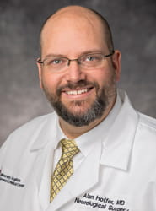
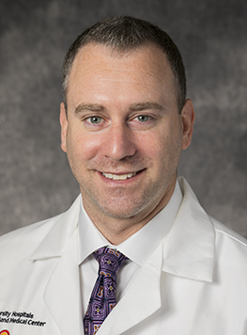
UH CMC Faculty –Trauma, Critical Care, Pediatric
Alan Hoffer, MD
Director, Traumatic Brain Injury Center
Co-Director Neurocritical Care Center
Associate Professor of Neurosurgery
Critical Care, Neurotrauma
Brian Rothstein, MD
Chief Medical Officer, UH Ventures
Assistant Professor of Neurosurgery
Pediatric Neurosurgery

Slide 9
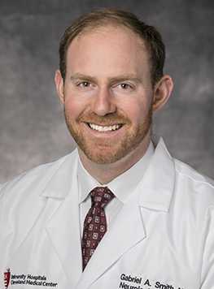
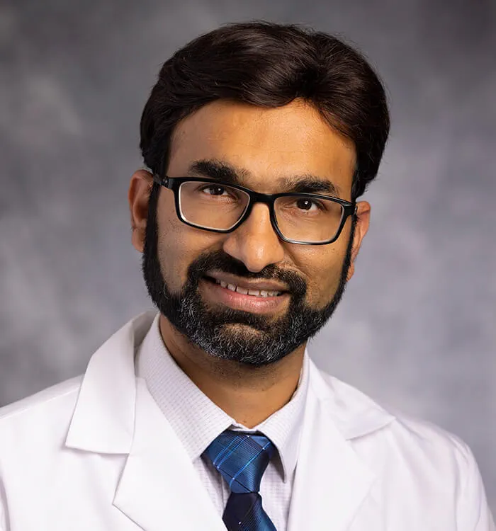
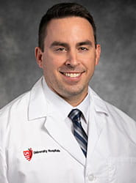
UH Faculty - Spine
Gabriel Smith, MD
Co-Director, University Hospitals Spine Institute
Division Chief, Neurosurgery – UH St John and Southwest Medical Center
Assistant Professor of Neurosurgery
Manish Kasliwal, MD
Director Minimally Invasive Spine Surgery
Associate Professor of Neurosurgery
Dustin Donnelly, MD
Assistant Professor of Neurosurgery
Xiaofei “Sophie” Zhou, MD
Assistant Professor of Neurosurgery

Slide 10
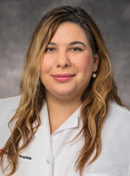
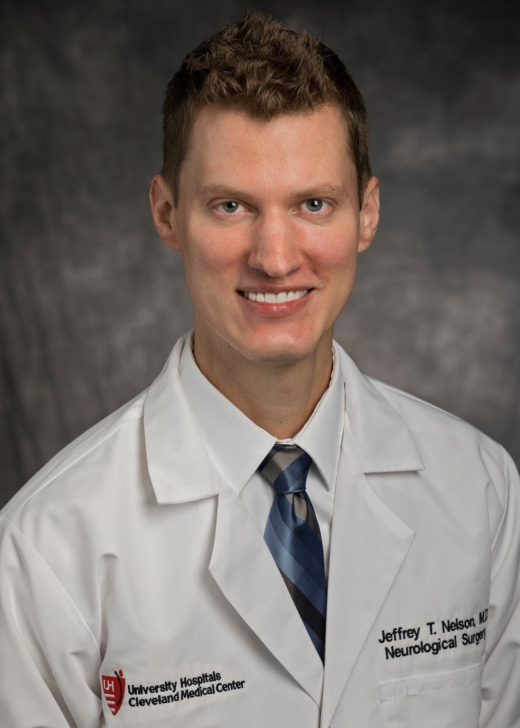
UH VA Hospital Faculty
Alia Hdeib, MD
Assistant Professor of Neurosurgery
Director of Neurosurgery, Louis Stokes Cleveland VA Medical Center
Spine
Jeffery Nelson, MD
Assistant Professor of Neurosurgery
Endovascular, Cerebrovascular, Spine

Slide 11
Faculty As A Whole
Vascular/Skull Base/Endovascular
Functional
Critical Care
Spine
VA
Oncology
Pediatrics

Slide 12
Recent Graduates
2023
Jessey Chugh: enfolded endovascular fellowship, private practice in AZ
Sophie Zhou: enfolded spine and critical care fellowships, academic practice at UHCMC
2022
Yifei Duan: enfolded endovascular fellowship, private practice in MO
2021
Berje Shammassian: enfolded critical care fellowship, post graduate trauma/critical care fellowship at the University of Miami, academic practice at LSU
Byron Hills: enfolded spine fellowship, private practice in VA
2020
Christina Wright: enfolded spine and critical care fellowships, academic practice at OHSU
James Wright: enfolded spine and critical care fellowships, academic practice at OHSU
Mickey Smith: enfolded endovascular fellowship, academic practice at Houston Methodist
Jonathan Pace: enfolded endovascular fellowship, academic practice at Allegheny

Slide 13
PGY 6 and 7
Mohit Patel, MD
Medical School: Medical College of Wisconsin
Completing an enfolded spine fellowship with plans to complete an additional post graduate spine fellowship
Rohit Mauria, MD
Medical School: Creighton University
Plans to complete an enfolded spine fellowship

Slide 14
PGY5
Olindi Wijesekera, MD
Medical School: Boston University
Completed an enfolded critical care fellowship, plans to complete a post graduate spine fellowship
Dana Defta, MD
Medical School: Wright State University
Completing an enfolded endovascular fellowship
Eric Herring, MD
Medical School: Case Western Reserve University
Plans to complete an enfolded peripheral nerve fellowship and a post graduate spine fellowship
Collin Labak, MD
Medical School: University of Illinois
Plans to complete an enfolded spine fellowship

Slide 15
PGY4
Quang Nguyen, MD
Medical School: Texas Tech University
Plans to complete an enfolded endovascular fellowship
Theresa Elder, MD
Medical School: Central Michigan University
Plans to complete an enfolded endovascular fellowship
Sebastian Norrdahl, MD
Medical School: University of Tennessee
Plans to complete an enfolded spine fellowship

Slide 16
PGY3
Arpan Chakraborty, MD
Medical School: University of Oklahoma
Clinical interests: oncology, critical care
Adel Azghadi, MD
Medical School: Virginia Commonwealth University
Clinical interests: skull base, open and endovascular
Kerrin Sunshine, MD
Medical School: Case Western Reserve University
Clinical interests: pediatrics
Varun Shah, MD
Medical School: Ohio State University
Clinical interests: skull base, open and endovascular

Slide 17
PGY2
Jitsupa Sirinit, MD
Medical School: Medical College of Wisconsin
Clinical interests: pediatrics

Slide 18
PGY1
Busha Hika, MD
Medical School: University of Misouri
Clinical interests: everything
Mina Huerta, MD
Medical School: Case Western Reserve University
Clinical interests: everything

Slide 19
UH - Academic Health System
Multiple Hospitals and Centers of Excellence across Northeast Ohio
Partnership and collaboration with multiple medical schools:
Case Western Reserve University SOM
Northeast Ohio Medical University

Slide 20
Neurological Institute: Hub Locations
1
3
2
Key:
Cleveland Medical Center; Rainbow Babies & Children’s Hospital; Louis Stokes VA Medical Center
Ahuja Medical Center
St. John Medical Center, a Catholic Hospital; Southwest Medical Center

Slide 21
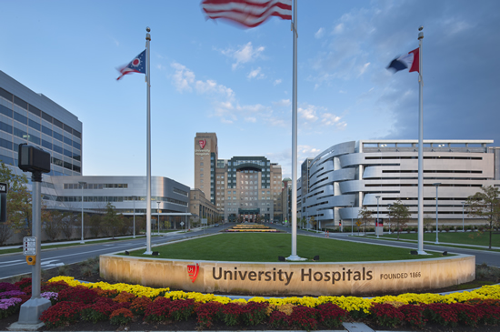
UH Cleveland Medical Center
19 bed dedicated Neurosurgical ICU
40 bed Neurologic Institute
8 bed dedicated adult Epilepsy Monitoring Unit
Intraoperative 3T MRI
Gamma knife, proton beam, stereotactic body radiosurgery
Level 1 Trauma Center
Level 4 Epilepsy Center
Comprehensive Stroke Center

Slide 22
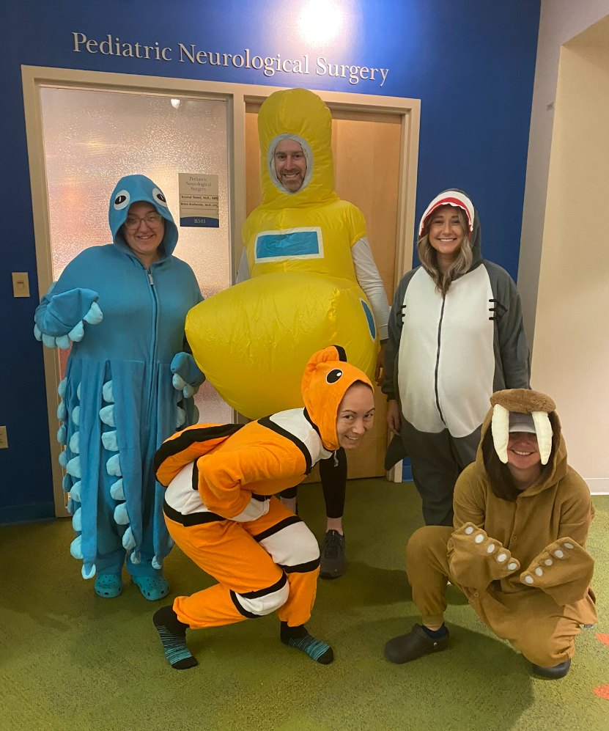
UH Rainbow Babies & Children’s Hospital
Level 1 Pediatric Trauma Center
20 bed Pediatric Intensive Care Unit
8 bed pediatric epilepsy monitoring unit
Full spectrum of cranial and spinal neurosurgery

Slide 23
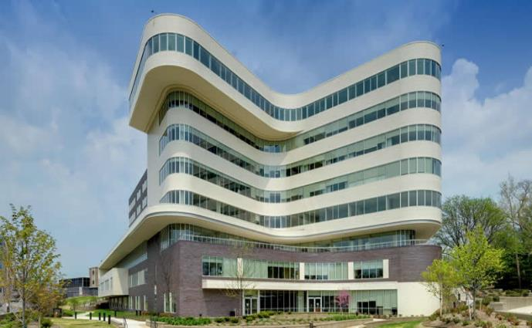
Cleveland VA Medical Center
Third largest VA in the US
111,901 veterans covered
Neurosurgery currently covers spine and peripheral nerve
Cranial program pending

Slide 24
UH Ahuja Medical Center UH St. John Medical Center Southwest Medical Center
Complex spine
Functional Neurosurgery
DBS/pain
General Neurosurgery
Cerebrovascular
Neurooncology

Slide 25
Research
Several current NIH funded grants, multiple other grant funding sources
Research opportunities in:
Brain Tumors and Neurooncology
Skull Base and Cerebrovascular Disorders
Movement Disorders
Traumatic Brain Injury
Spinal Disorders
IRB, statistical, and grant preparation support through the UH Clinical Research Center

Slide 26
Research Mentoring Program
Mentorship program designed to foster research and scholarship among trainees and junior faculty.
The U.H. Neurological and Behavioral Outcomes Center (NBOC), Dr. Martha Sajatovic, was tasked to guide trainees and junior faculty through specific research objectives.
Specific goals included increasing:
research projects being conducted by neurosurgery trainees and junior faculty
scholarly publications by neurosurgery trainees and junior faculty
presentations at the regional, national and international level.

Slide 27
PGY 1
UHCMC Neurosurgery
NeuroRads/Neuro/NSU
ENT
PGY 2
UHCMC Neurosurgery
Pediatric Neurosurgery
PGY 3
UHCMC Neurosurgery
Endovasc
VA Hospital
PGY 4
UHCMC Neurosurgery
UH Ahuja
West Side
PGY 5
Academic Chief/Research/Fellowship
PGY 6
Academic Chief/Research/Fellowship
PGY 7
Chief Resident
PGY 5-6:
Academic Chief (Arranging Clinical/Teaching Conferences, Clinical Skills Lab, Clinical Chief Coverage)
Basic/Clinical Research
Enfolded Fellowship Opportunities (Endovascular, Spine, ICU)
Opportunity for PGY-6 year for those opting for enfolded CAST fellowships

Slide 28
Fellowship Opportunities
Cerebrovascular and Skull Base
Complex Spine (CAST)
Endovascular (CAST)
Functional and Stereotactic (CAST)
Neurocritical Care (CAST)
Neurosurgical Oncology
Peripheral Nerve (CAST)

Slide 29
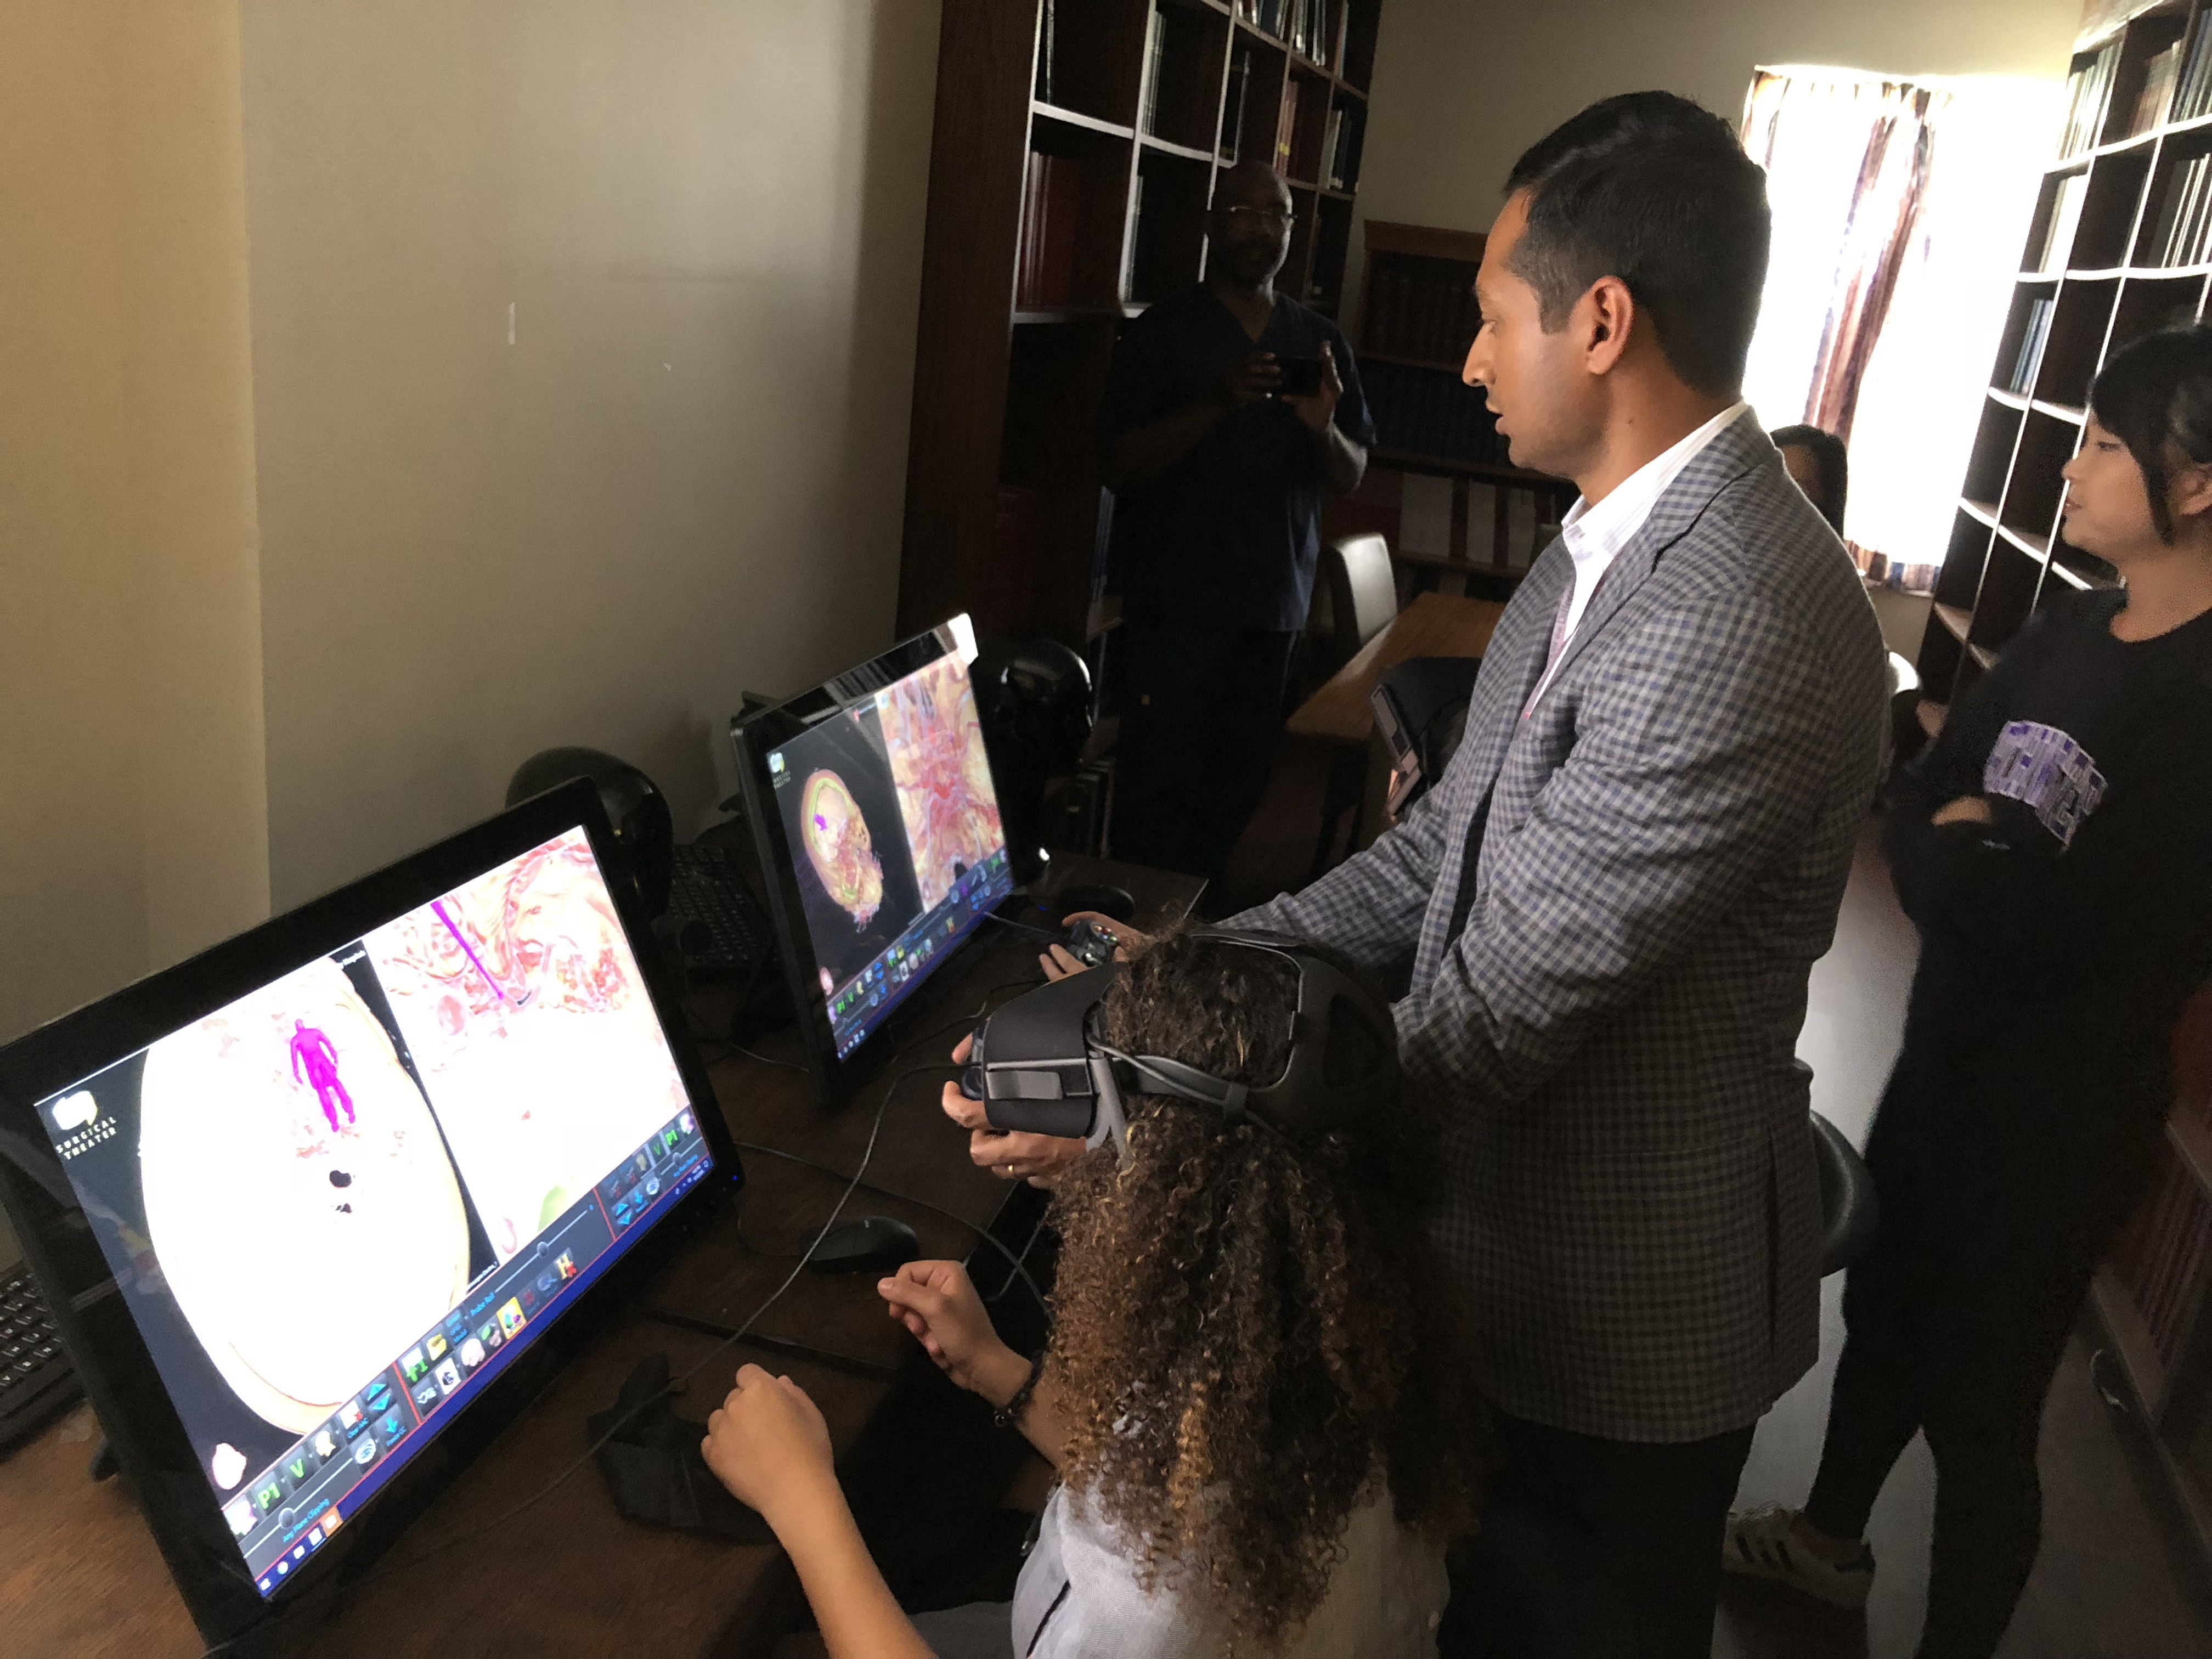
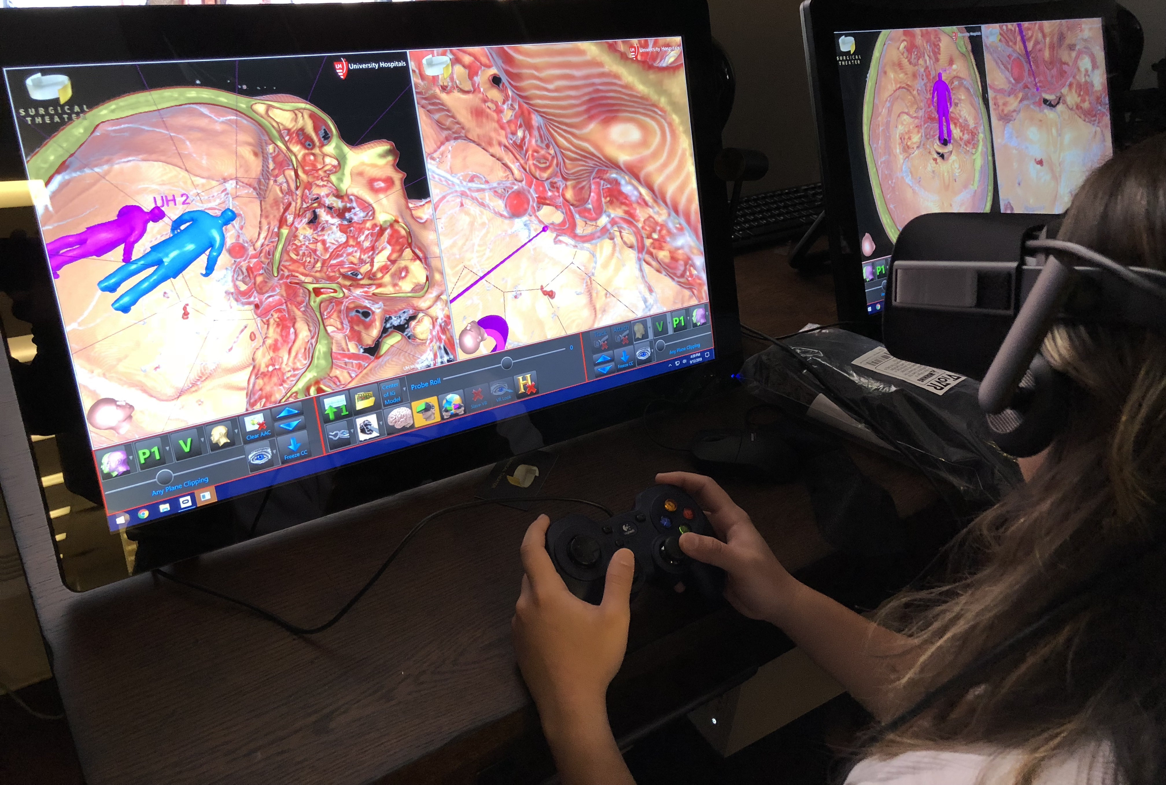
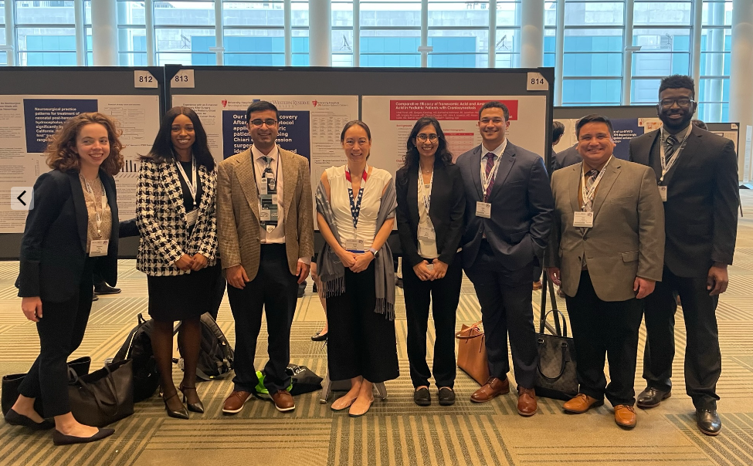
Medical Student Education
AANS Medical Student Neurosurgery Interest Group
Medical Student Research Group
Preclinical Elective
Clinical Rotations

Slide 30
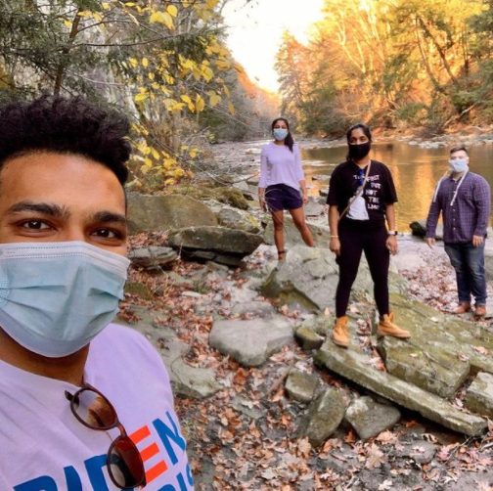
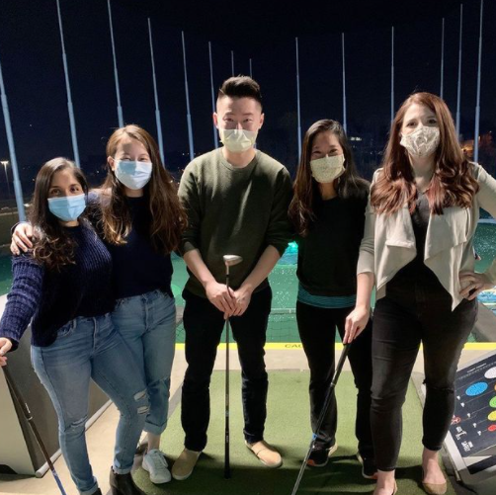
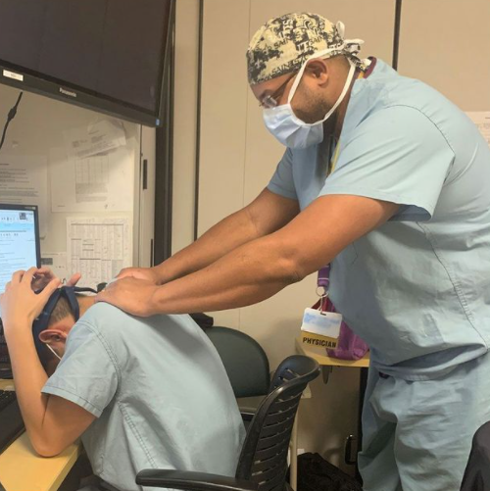
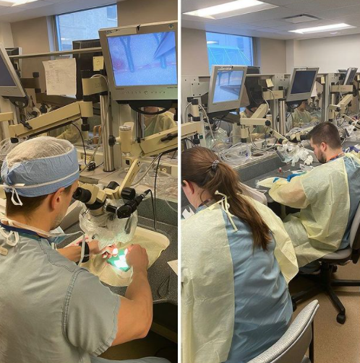
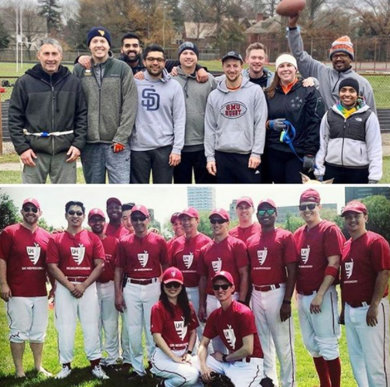
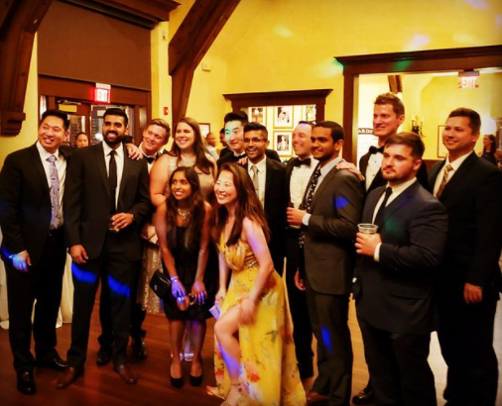
Neurological Surgery Residency

Slide 31
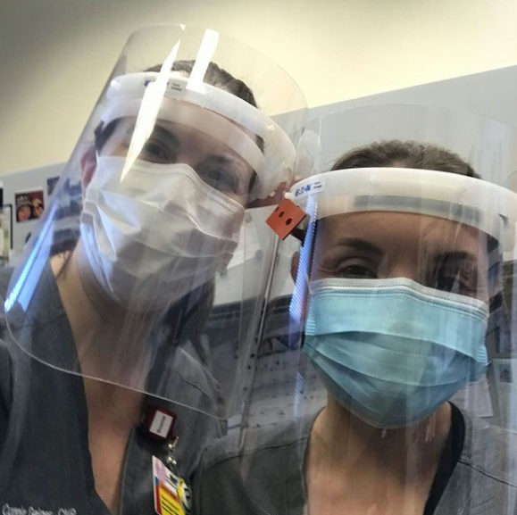
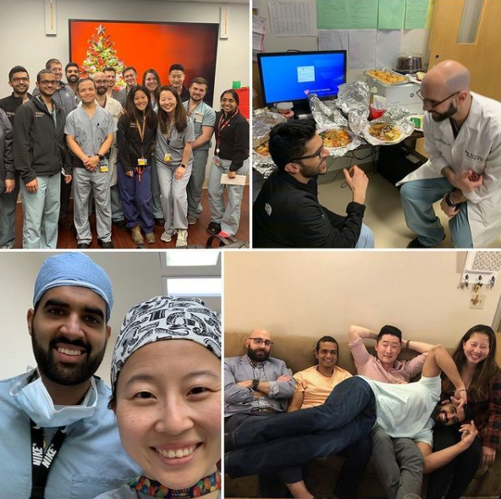
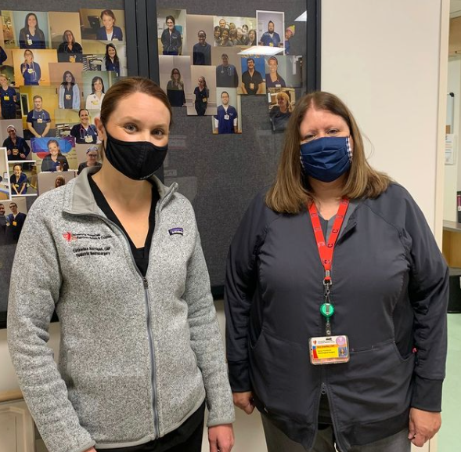
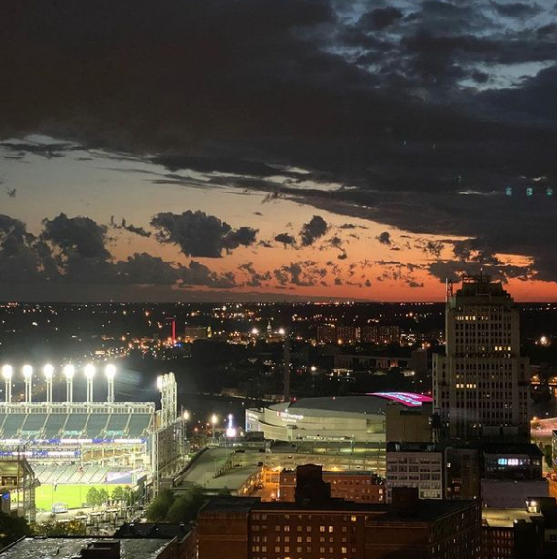
Neurological Surgery Residency

Slide 32
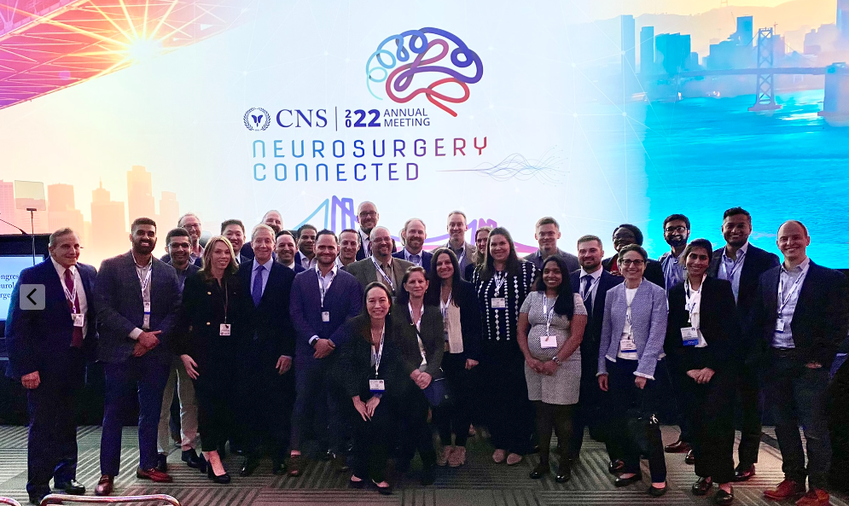
Neurological Surgery Residency

