Slide 1
NIH Neurological Surgery Residency Training Program
Program Director: Dr. John Heiss
Presented by: Dr. Joshua Diamond (PGY-5)

Slide 2
Program Overview
The Surgical Neurology Branch of the National Institutes of Neurological Disorders and Stroke at the National Institutes of Health (NIH) offers an innovative 7-year, ACGME-accredited Neurological Surgery Residency Training Program in collaboration with the MedStar Georgetown University Hospital (GUH), MedStar Washington Hospital Center (WHC), and Children’s National Medical Center (CNMC).
This program is designed to foster the application of basic science research to clinical neurosurgical problems and is intended for those wishing to pursue careers as independent physician-scientists.

Slide 3
Core Facilities
National Institutes of Health Clinical Center
Clinical Training
Training and mentoring by 4 full-time clinical faculty
1 ½ years of clinical experience
Research Training
2 years of protected research time
Receive NIH Intramural funding (No grants required)
Training and mentoring by 3 full-time senior research faculty members
Opportunity to collaborate with scientists throughout NINDS (200 neuroscience labs on NIH campus) and other NIH institutes
MedStar Georgetown University Hospital
Training and mentoring by 8 full-time senior faculty in all neurosurgical subspecialties
MedStar Washington Hospital Center
Training and mentoring by 4 full-time senior faculty with a broad range of expertise
Children’s National Medical Center
Training and mentoring by 5 full-time pediatric neurosurgeon faculty members

Slide 4
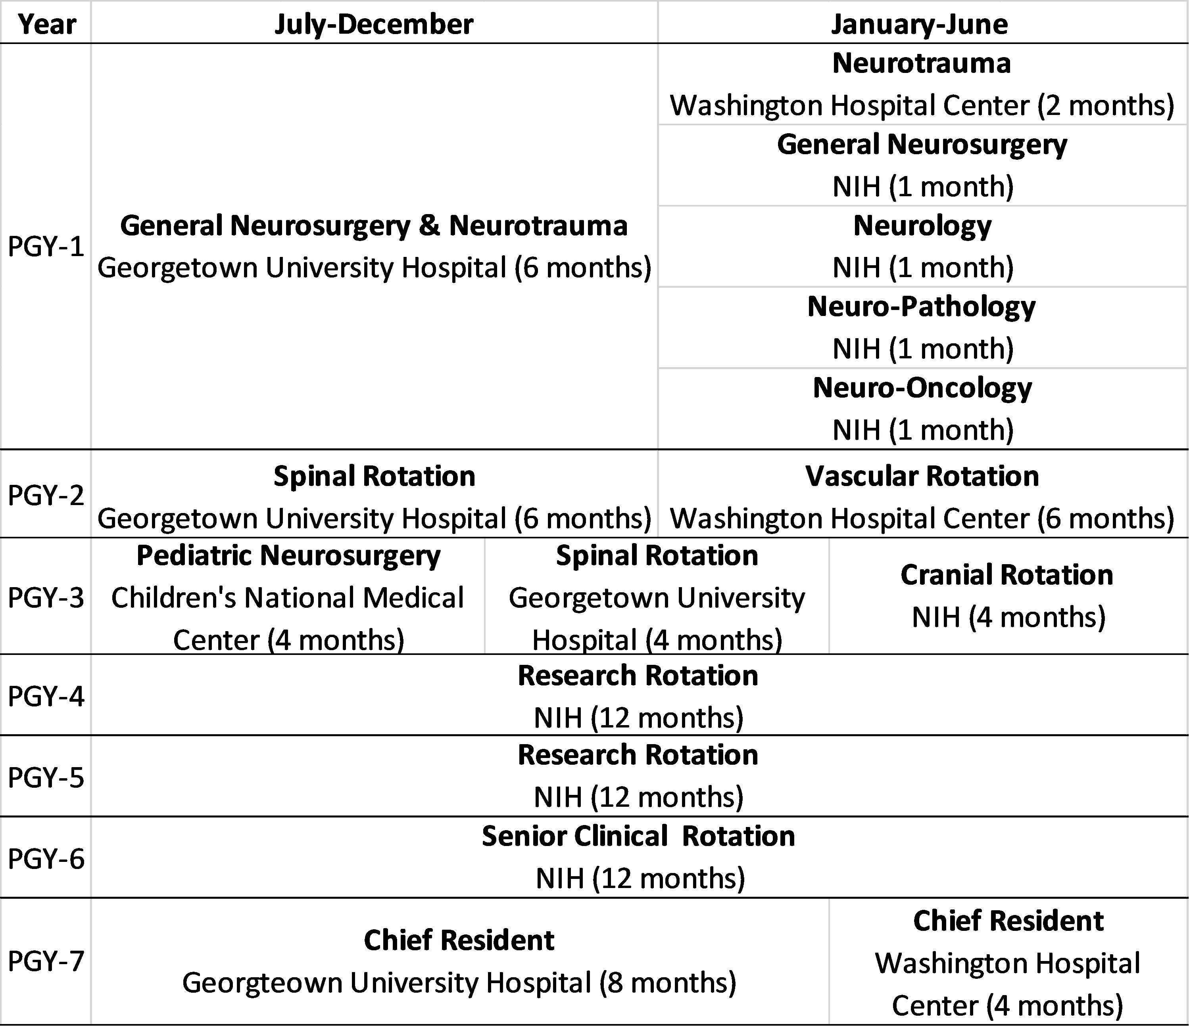
Block Schedule

Slide 5
Benefits
Residents enrolled in ACGME-accredited training programs at the NIH can apply to receive loan repayment (LRP):
Non-competitive program: receive $20,000 per year, up to 3 years, of qualified educational debt
Competitive program: receive $50,000 per year, up to 3 years, of qualified education debt
Competitive pay
Funds for training courses, board review, education material, conference travel, etc.

Slide 6
How to Apply
The NIH residency program participates in the National Residency Match Program (NRMP) and receives applications through the Electronic Residency Application Service (ERAS).
Applicants apply to both the NIH and GUH residency programs.
The NIH Program interviews applicants with demonstrated interest in and aptitude for careers in academic neurosurgery.
The NIH program enrolls one PGY1 candidate each year.
Application deadline: 10/14/2023

Slide 7
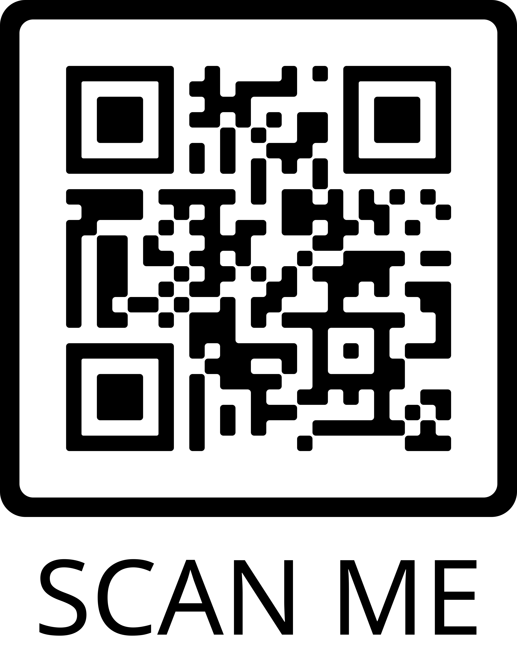
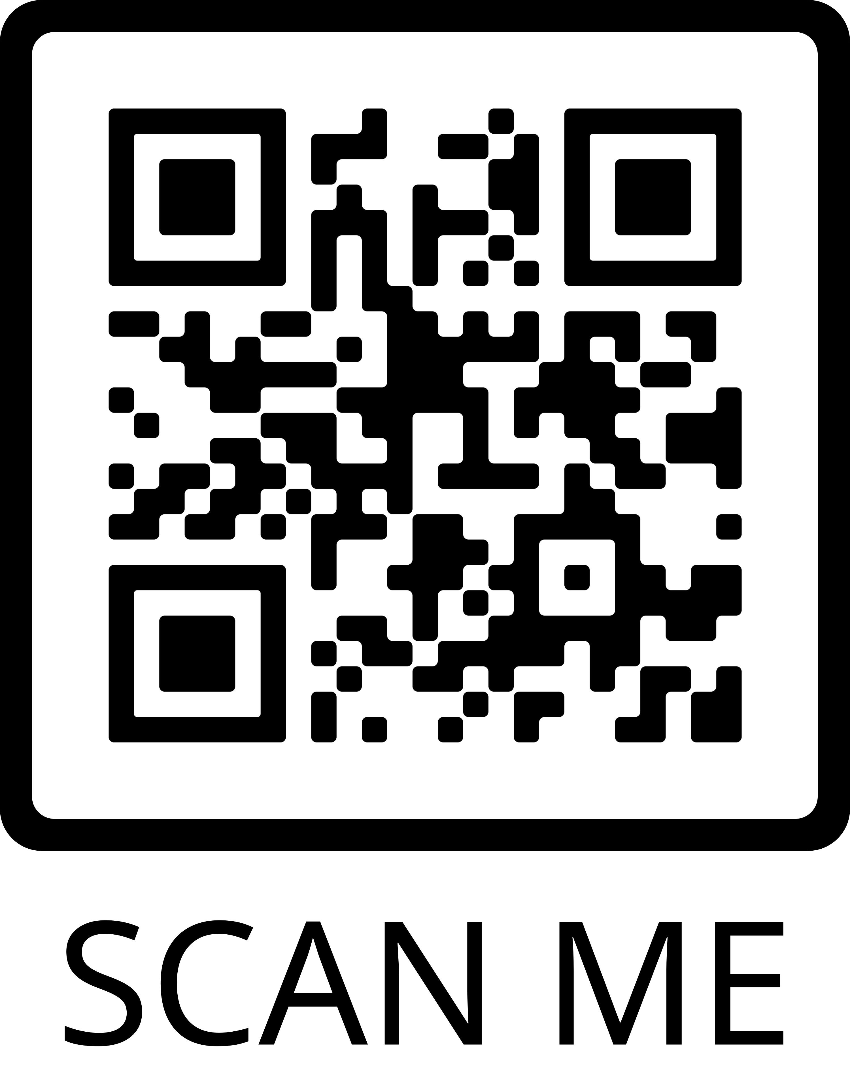
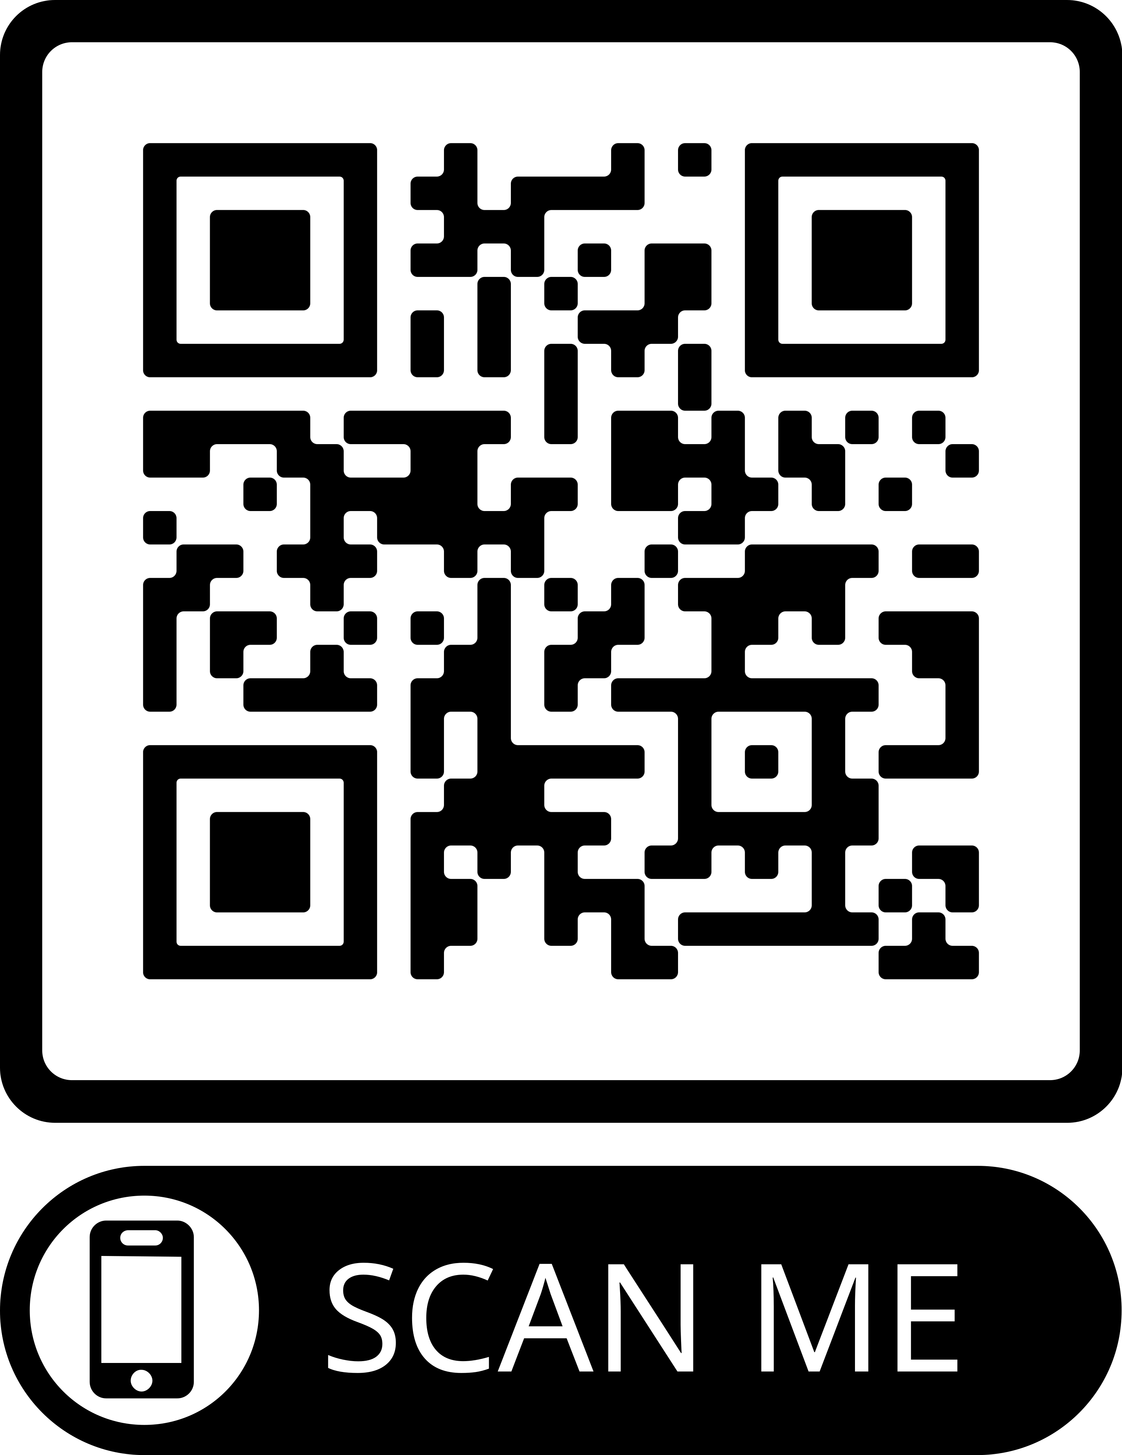
Program Contacts
Program Director
Dr. John Heiss
heissj@ninds.nih.gov
Program Coordinator
Ana Garcia
ana.garciaorellana@nih.gov
Visit our Website!

Slide 8
