Slide 2
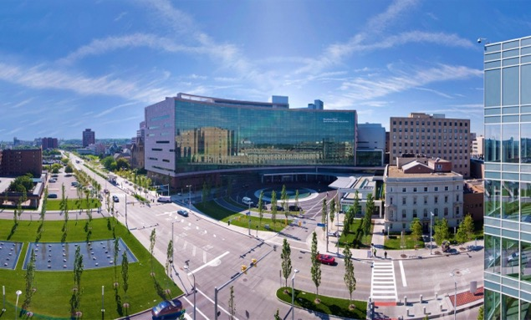
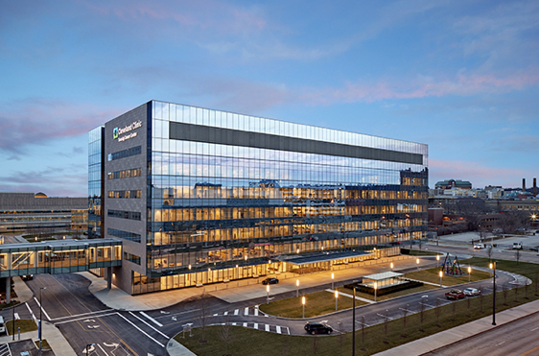
WHY CLEVELAND CLINIC?
Operative Experience
~4500 open cases/year
Breadth of cases and expertise of staff
Academics
Protected research time (2 years)
Daily didactic conferences
Mentorship
Multiple in every field, multiple hospitals
Excellent teachers
Residents
Strong work-ethic, collegiality, desire to better one another
‘Down-to-earth’ and kind

Slide 3
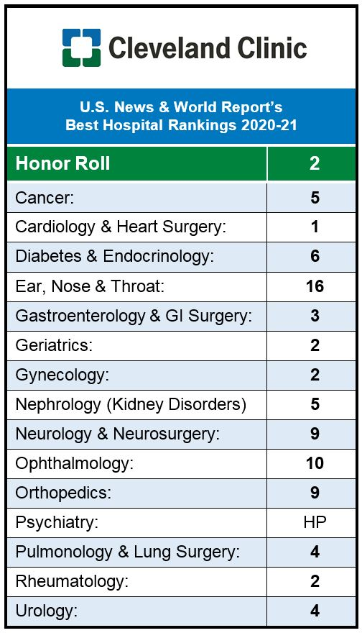
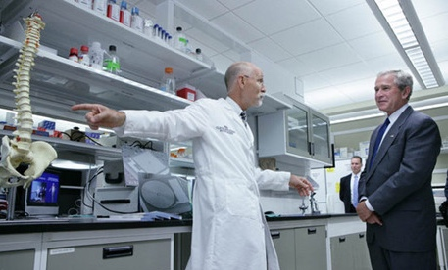
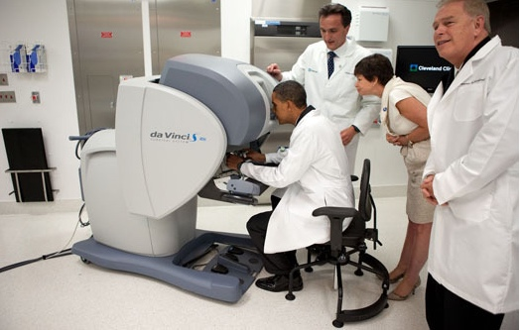
CCF AS AN INSTITUTION
Multispecialty, tertiary, not-for-profit, academic hospital
Main campus occupies nearly 200 acres, with 2000+ full-time salaried physicians/researchers
~75,000 surgeries annually
Regional hospitals in Cleveland/Akron area
Hospitals outside Ohio, including Florida, Nevada, Canada, Abu Dhabi, London – large referral base
*** Collaboration, interprofessional relationships

Slide 4
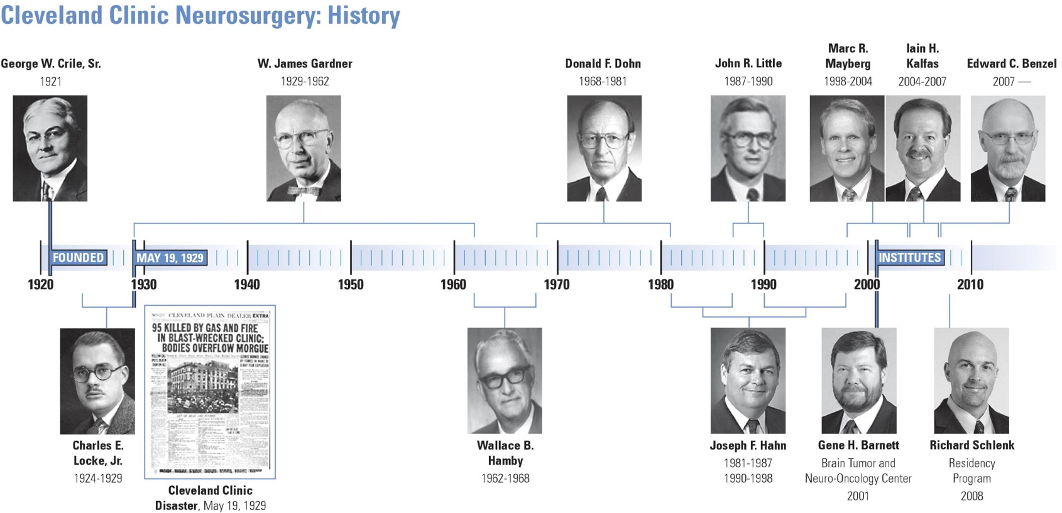
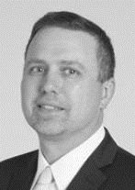
LONG TRADITION OF DISTINGUISHED LEADERS
2007-2016
Michael Steinmetz
Chairman
2016

Slide 5
NEUROSURGERY Faculty/MENTORS
TUMOR Angelov Barnett Grabowski Mohammadi Vorster Soni (skull base) P. Recinos (skull base) Kshettry (skull base) | VASCULAR Bain (O, E) Rasmussen (O,E) Kshettry (O) Krishnaney (O) N. Moore (O,E) Hussain (E) Toth (E) | SPINE/PN Benzel Benzil Bingaman Clifton Habboub Jack (PN) Kalfas Krishnaney Mroz Orr Pelle Savage Schlenk Spiessberger Steinmetz | FUNCTIONAL, EPILEPSY Bingaman Machado Nagel Rammo Serletis
PEDS V. Recinos Bingaman Vorster | TRAUMA Kelly Reddy Belding T. Moore | NICU Gomes Lynch Dani Abubakr Newey
Notes:
Comprehensive practice and hence training: GKRS, Endoscopic/skull base, open/endovascular; spine (combined)
Unique staff:
Spine: Benzel, Benzil, Habboub, Jack, Kalfas, Krishnaney, Mroz, Orr, Pelle, Savage, Schlenk, Steinmetz (12)
Functional/Epilepsy: Bingaman, Machado, Nagel, Rammo (4)
Tumor: Angelov, Barnett, Grabowski, Mohammadi, P Recinos, Kshettry, Vorster (7)
Vascular: Bain, Rasmussen, Moore (3)
Peds: V Recinos (1)
Metro:
Kelly, Geertman, Roitberg, Reddy
Belding, Moore
(6)
Between CCF/Metro (main campuses full time only)
11.5 spine (or 12 if you include Bingaman 0.5)
18.5 cranial (or 18 if you include Bingaman 0.5)l

Slide 6
HOSPITAL STRUCTURE
CLEVELAND CLINIC
Neurological Institute:
Dr. Andre Machado (chair)
Department of
Neurological Surgery:
Dr. Michael Steinmetz (chair)
Orthopedic and Rheumatologic Institute:
Dr. Thomas Mroz (chair)

Slide 7
Flow of residency (3 residents/yr)
PGY-1 INTERN
4 Months Neurosurgery at Main Campus
4 Months Trauma Neurosurgery (Metro)
3 Months NICU
1 Month Neuro-Anesthesia
PGY-2 JUNIOR
9 Months Neurosurgery at Main Campus
3 Months NIGHT FLOAT (1 month at a time)
PGY-3 JUNIOR
1 Month NIGHT FLOAT
7 Months Neurosurgery at Main Campus
4 Months Trauma Neurosurgery Chief (Metro)
PGY-4 SENIOR
12 Months Neurosurgery at Main Campus
PGY-5 & PGY-6 RESEARCH (PROTECTED)
PGY-7 CHIEF
NSG
Trauma NSG
NICU/Anes
NSG
NSG
NSG
NF
NSG
Trauma Chief
NF
NSG
Elective
Elective
Chief

Slide 8
Flow of residency (3 residents/yr)
PGY-1 INTERN
4 Months Neurosurgery at Main Campus
4 Months Trauma Neurosurgery (Metro)
3 Months NICU
1 Month Neuro-Anesthesia
PGY-2 JUNIOR
9 Months Neurosurgery at Main Campus
3 Months NIGHT FLOAT (1 month at a time)
PGY-3 JUNIOR
1 Month NIGHT FLOAT
7 Months Neurosurgery at Main Campus
4 Months Trauma Neurosurgery Chief (Metro)
PGY-4 SENIOR
12 Months Neurosurgery at Main Campus
PGY-5 & PGY-6 RESEARCH (PROTECTED)
PGY-7 CHIEF
Separate night float resident rotation – 6 nights/week, 4 months total
PA/NP 24/7 coverage
7 M-F daytime
1-2 nighttime/weekends
Cover Cleveland Clinic Main Campus & MetroHealth Medical Center

Slide 9
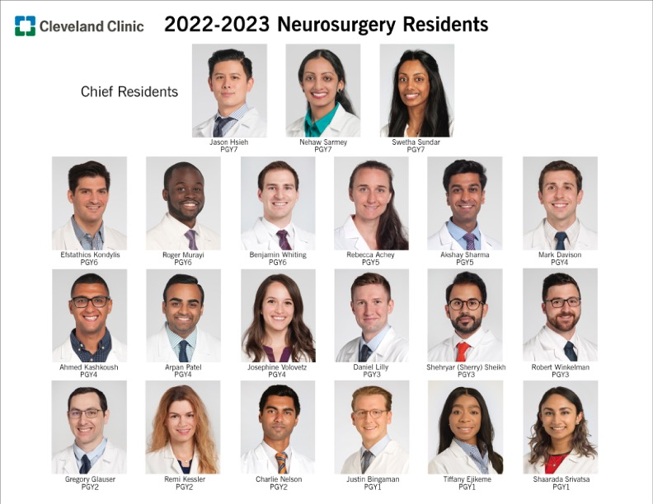
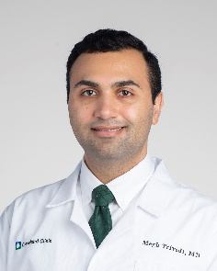
OUR RESIDENTS
Megh Trivedi
PGY2

Slide 10
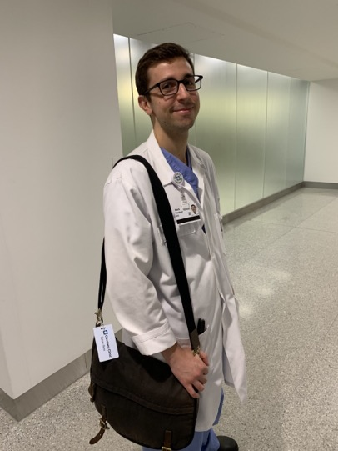
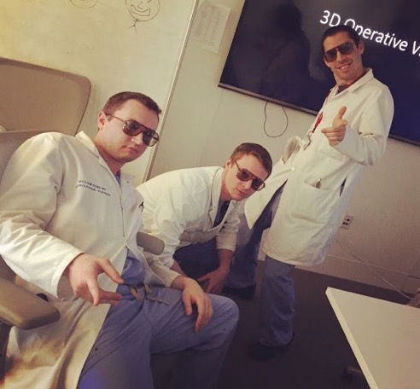
SERVICE BREAKDOWN
Patients organized into 3 services, residents rotate every 1-2 months
Tumor / Functional
Vascular / Pediatrics / Epilepsy
Spine
Each service consists of 1 chief, 1 senior, 1-2 juniors/interns and 2-3 NPs/PAs
Focus on specific pathologies and management plans while rotating on each service
Work closely with a group of staff
Cover surgical cases that correspond with service

Slide 11
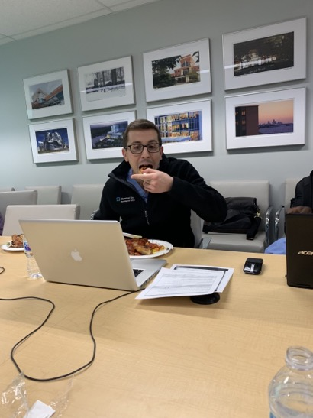
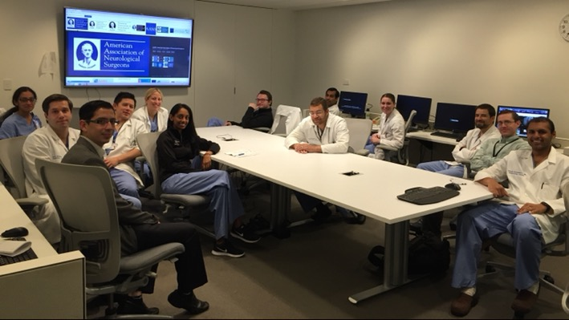
Residents daily schedule
Average:
5:30 AM – 6:30 PM
Team rounds:
6 – 6:30 AM
AM daily didactics:
6:30 – 7:15 AM
OR:
7:30 AM – whenever
Sign out:
6:00 PM
5:30-6:00 Arrive
6:00 Team Rounds
6:30 Morning Conference
7:30 OR start
6:00p signout

Slide 12
Residents daily schedule
One resident per Weekday assigned to call pager (7a-6p), typically PGY2 and 3.
Weekends:
3 Residents (PGY2-4)
Friday night call (1)
Saturday day call
Sunday round → home
Sunday day call
Saturday round → home
5:30-6:00 Arrive
6:00 Team Rounds
6:30 Morning Conference
7:30 OR start
6:00p signout

Slide 13
Residents daily schedule
All Primary Neurosurgery patients covered by APP during weekday hours.
Frees residents for OR and frees call resident for urgent issues and consults.
Nights/Weekends have APP coverage
Helps call residents focus on necessary service tasks, urgent issues, and consults.
5:30-6:00 Arrive
6:00 Team Rounds
6:30 Morning Conference
7:30 OR start
6:00p signout

Slide 14
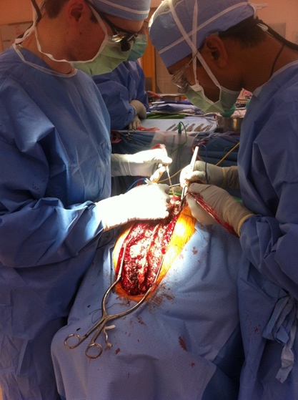
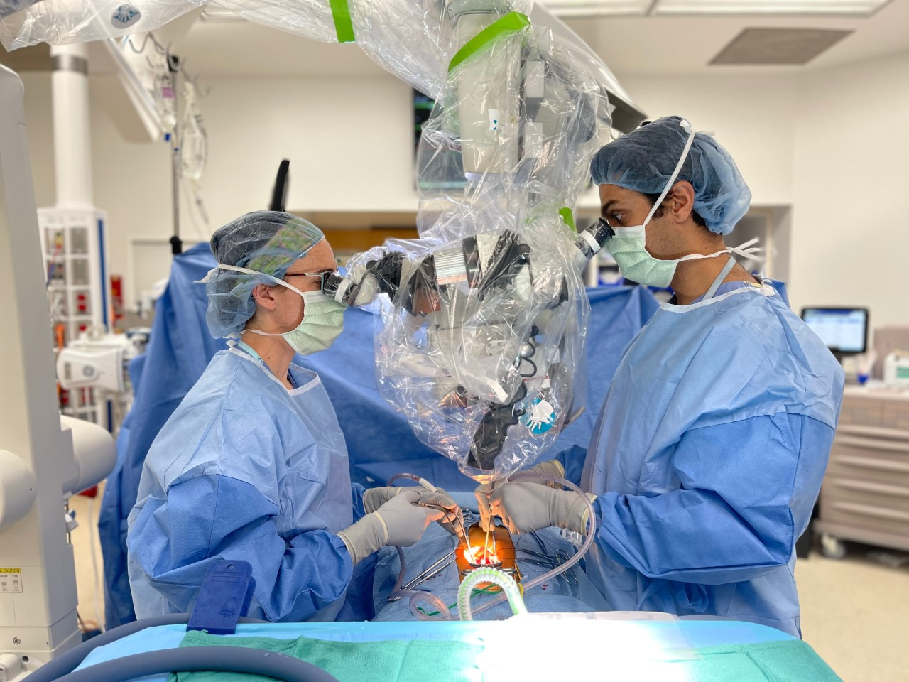
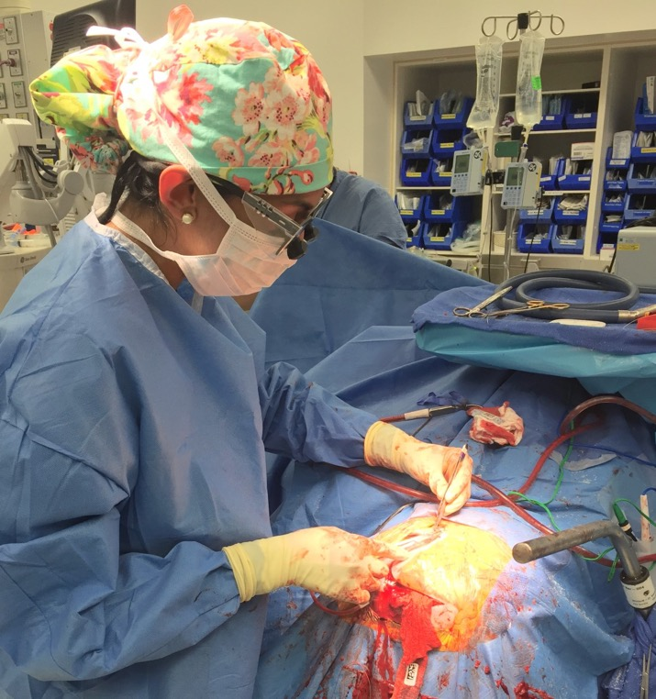
Being in the or

Slide 15
Breadth/volume of cases

Slide 16
A day in the OR…
Last Monday

Slide 17
A day in the OR…
Yesterday

Slide 19
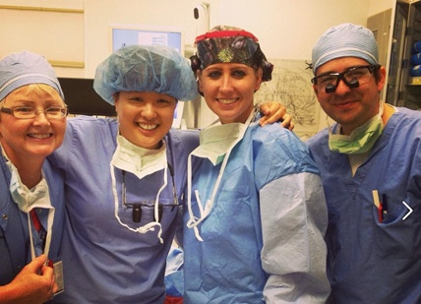
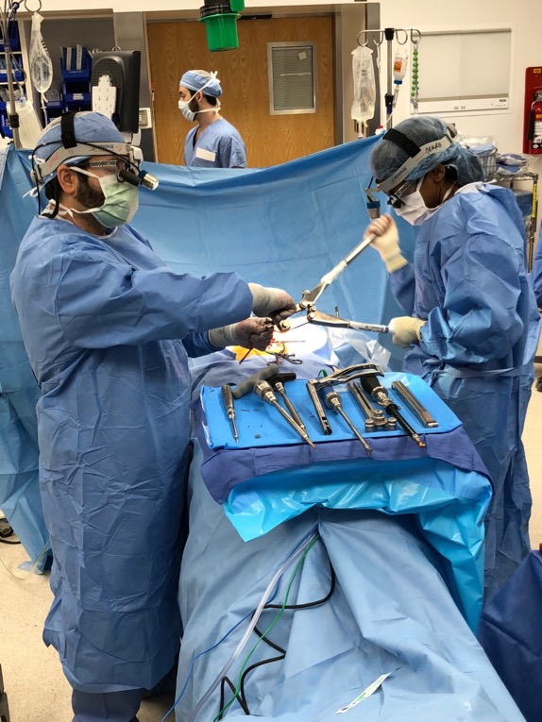
operative experience
Start PGY1 → graduated autonomy
Avg 8-12 rooms each day
+ GKRS + IMRIS + 3 ANGIO SUITES
OR schedule created by NSGY chiefs
Need fellows to help cover volume, boosts resident experience
PAs and NPs free up residents for OR
Approx 1-2 clinic days per month

Slide 20
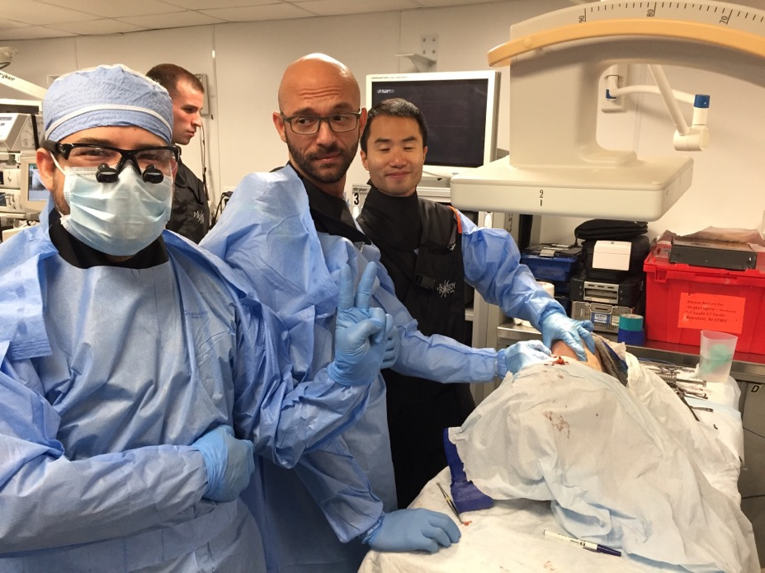
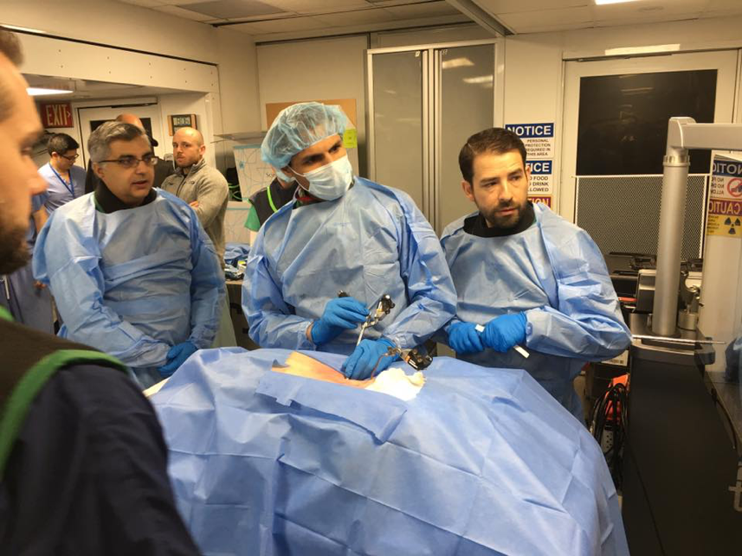
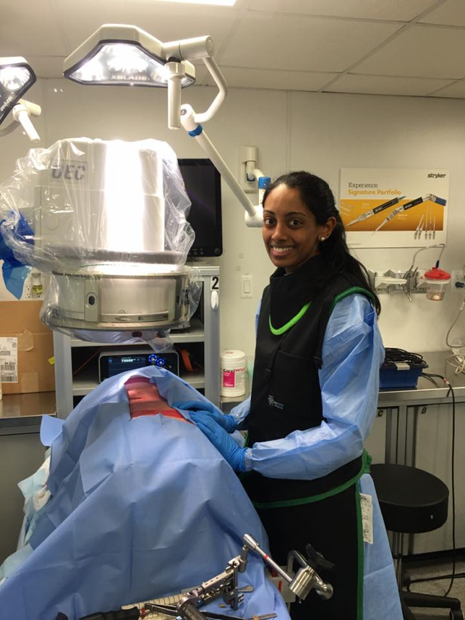
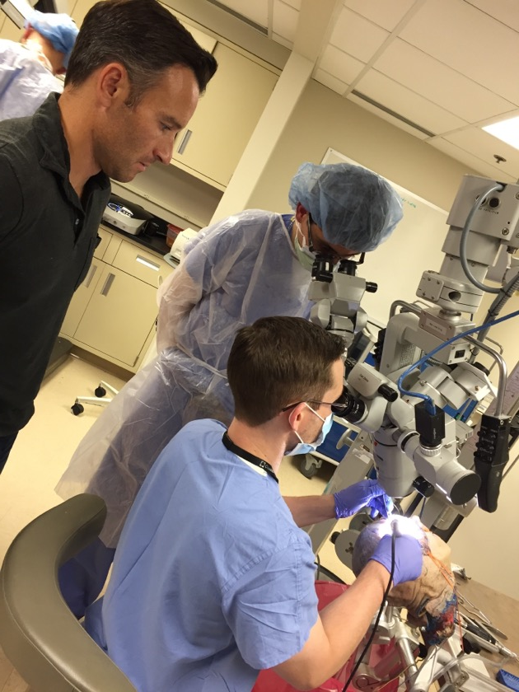
SPINE/CRANIAL LABS
Notes:
Mandatory Friday afternoon, exempted from clinical duties -> picked up by fellows (OR) and PA’s (floor work). Faculty Advisor: Dr. Kshettry
Faculty at each session
1-2 x per month

Slide 21
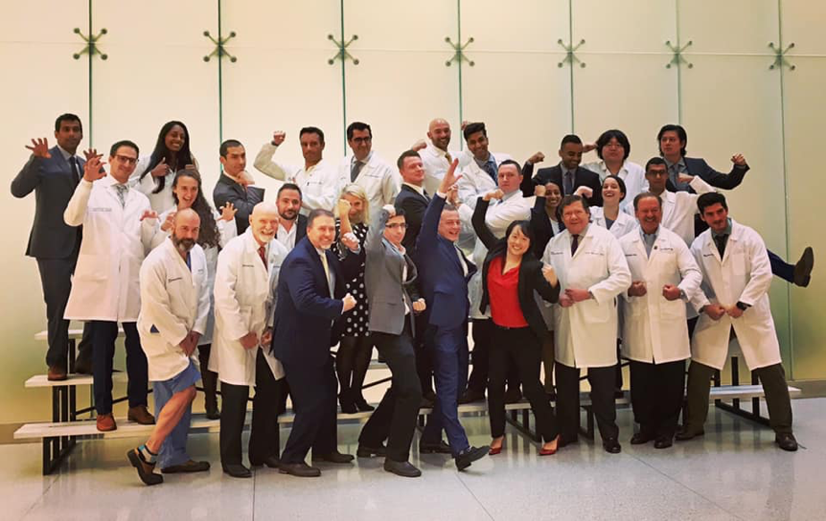
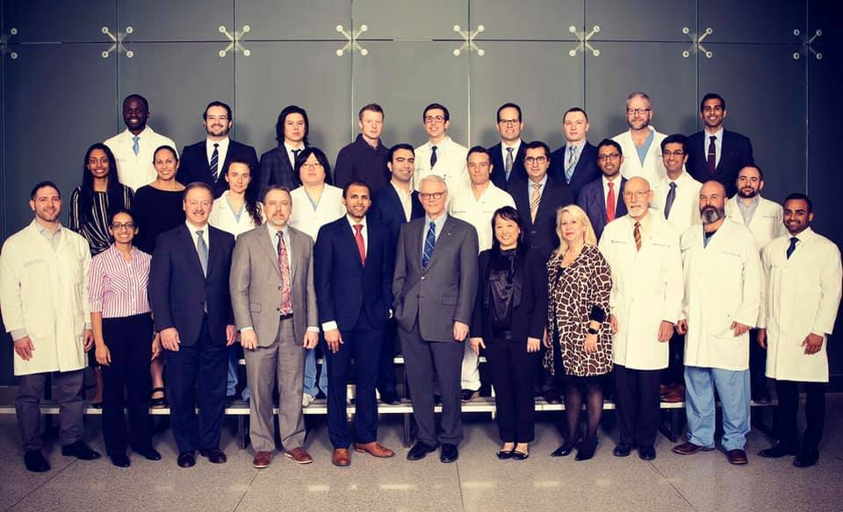
lecture series/visiting professors
Dr. James Gardner Lecture Series
Initiated in 1985
Dr. Charles Locke Lecture Series
Initiated in 2013
Dr. Edward Benzel Lecture Series
Initiated in 2016
Apart from daily morning resident didactics, monthly grand rounds, case management conferences, bimonthly journal clubs, trauma journal clubs, CV rounds

Slide 22
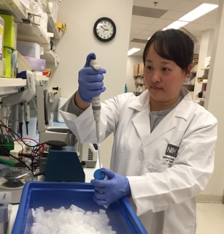
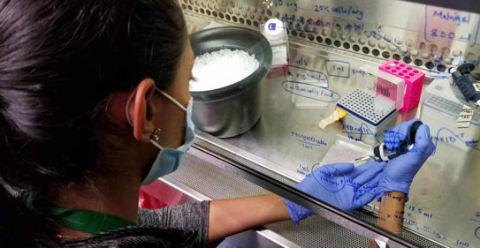
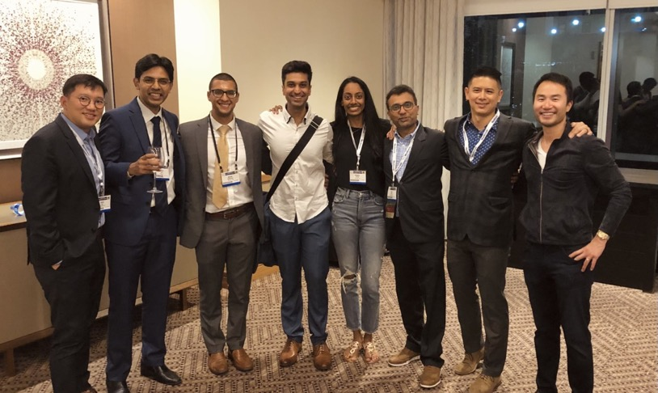
RESEARCH
Emphasis on building academic neurosurgeons
2 full years protected time
Collaborate with neurosurgery and other dept staff on basic, clinical, translational projects
Access to Lerner Research Institute, Case Western faculty/labs/resources

Slide 23
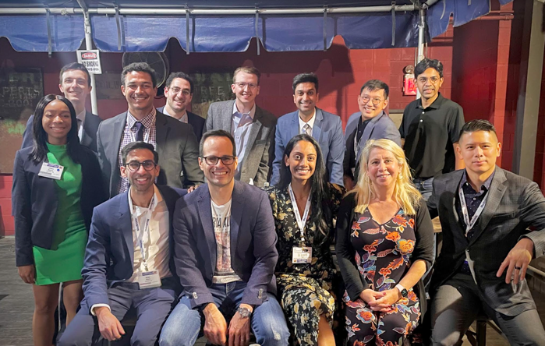
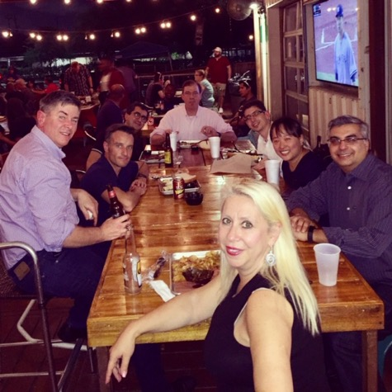
RESEARCH
Option to pursue other degrees, including PhD
Innovations Office and Fellowship – designed specifically for neurosurgery residents
Junior years: 2 days per month dedicated to research while on service

Slide 24
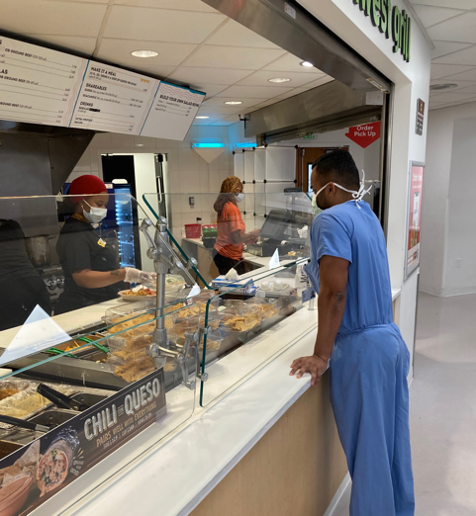
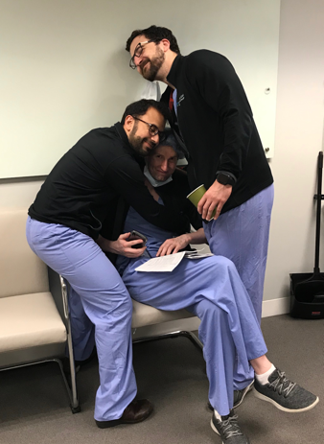
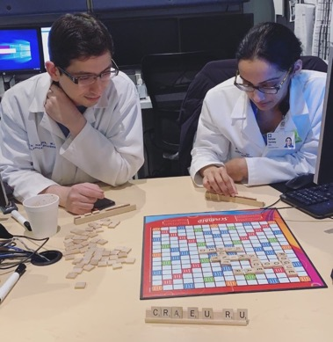
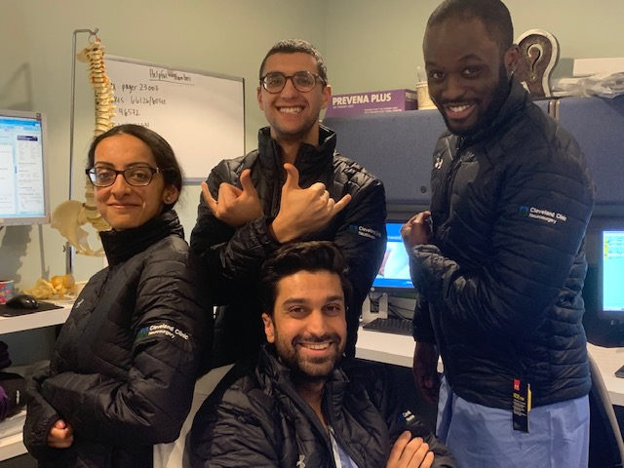
Other resources
Courses
Epilepsy, Gamma knife, Spine Review, Stryker labs, etc.
Food (Subway, Moe’s, Aladdin’s, Panera, 3 Starbucks, multiple cafeterias)
Cafeteria, Panera, and Starbucks open 24 hours
Loupes provided
Annual book funds

Slide 25
WHERE WE GO FROM RESIDENCY…
Name (Year Graduated) | Private/Academic- Hospital
Pranay Soni (2022) | Academic – Cleveland Clinic Foundation, Skull Base
Amr Morsi (2022) | Academic – Mt. Sinai Hospital, Functional Neurosurgery Fellowship
Eric Schmidt (2022) | Private – Lexington Clinic, KY
Matt Grabowski (2021) | Academic – Cleveland Clinic Foundation Tumor
Balint Otvos (2021) | Academic - University of Miami, Endovascular Fellowship
Bill Kemp (2021) | Spine Fellowship – University of Wisconsin, Private – Virginia Spine Institute
Lee Hwang (2020) | Tumor Fellowship – Sloan Kettering, Private – St Luke University Health
Ghaith Habboub (2020) | Academic- Cleveland Clinic Foundation, Spine + Artificial Intelligence
Vikram Chakravarthy (2020) | Spine Fellowship – Cleveland Clinic Foundation, Spine oncology fellowship – Sloan Kettering, Academic – The Ohio State, Spine Surgery
Bryan Lee (2019) | Privademic - Barrow Neurologic Institute
Andres Maldonado (2019) | Academic- University of Illinois- Peoria
Alex Witek (2019) | Endovascular Fellowship - Cleveland Clinic Foundation, Private – Madison, WI

Slide 26
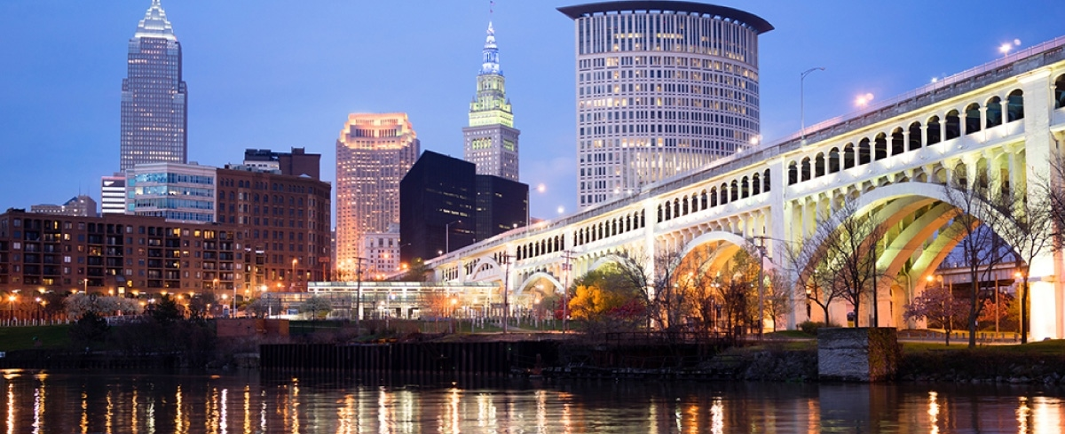
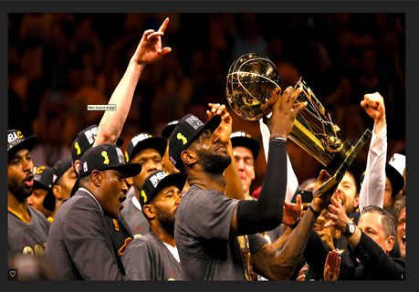
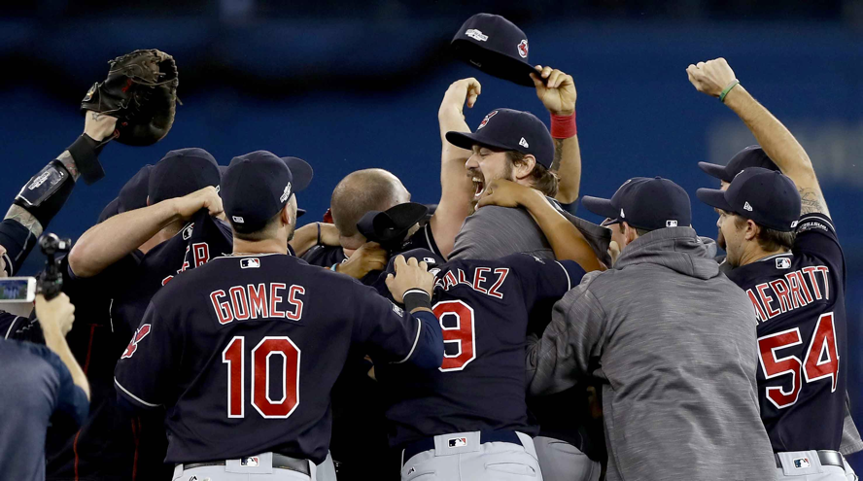
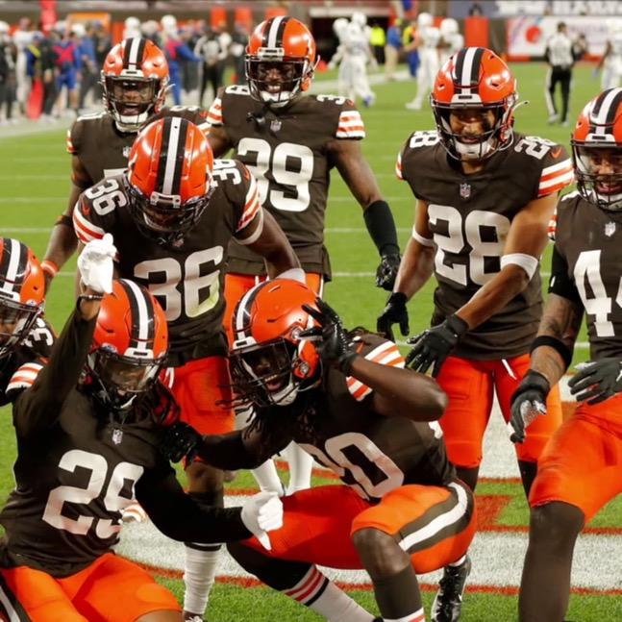
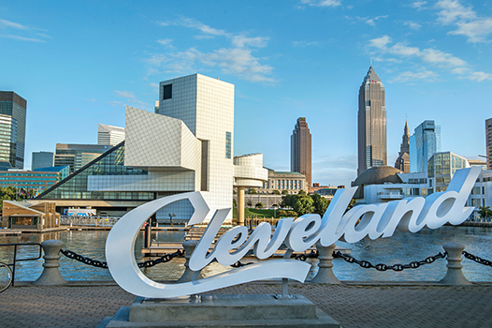
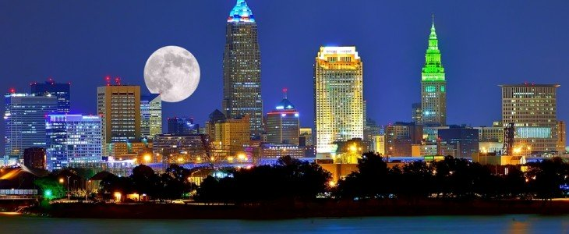
WHAT ABOUT CLEVELAND?

Slide 27
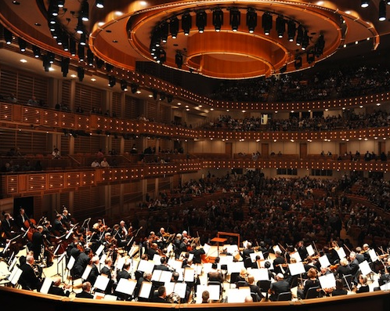
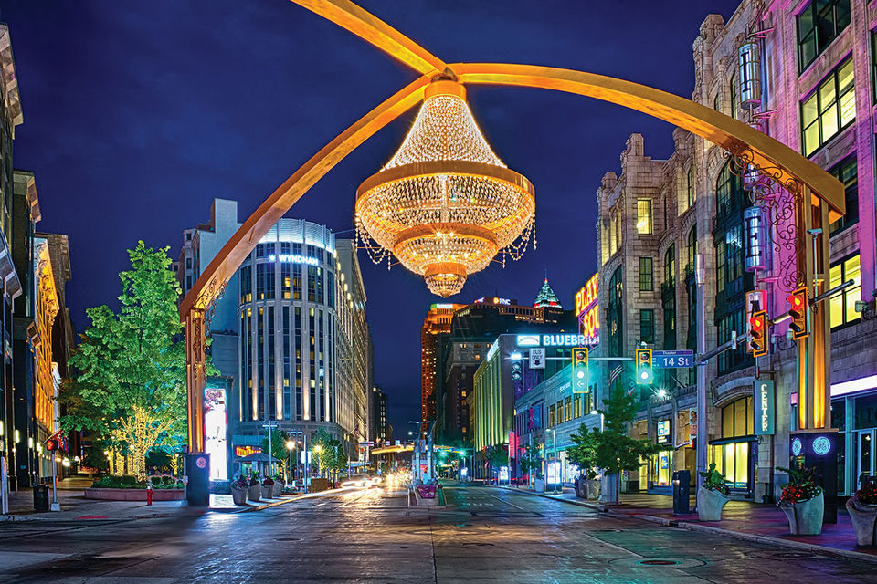
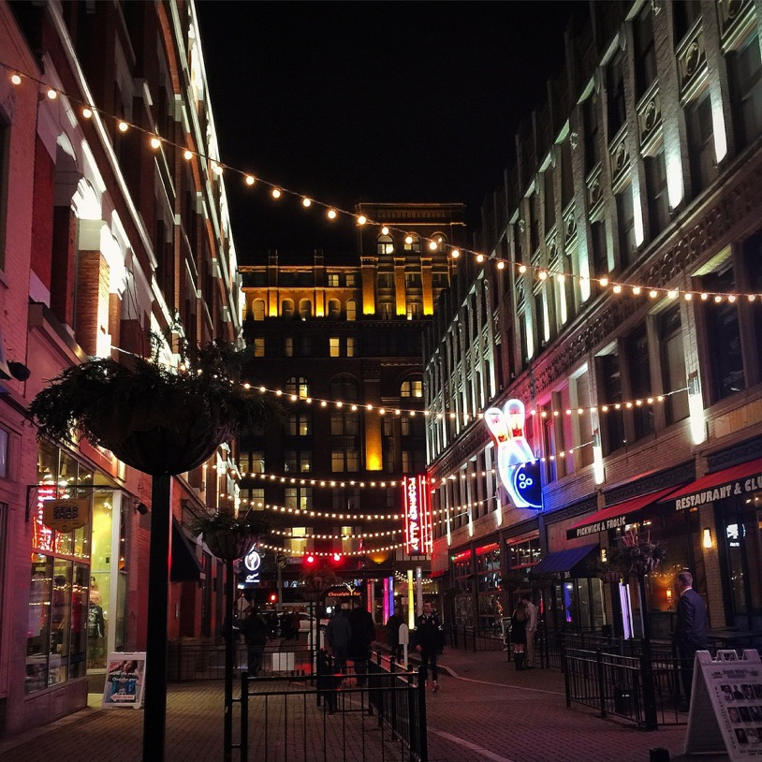
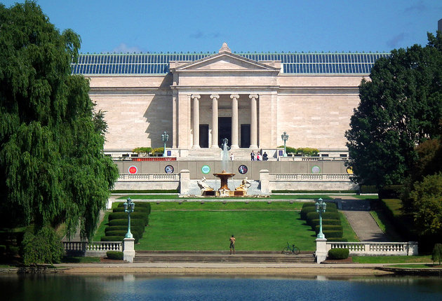
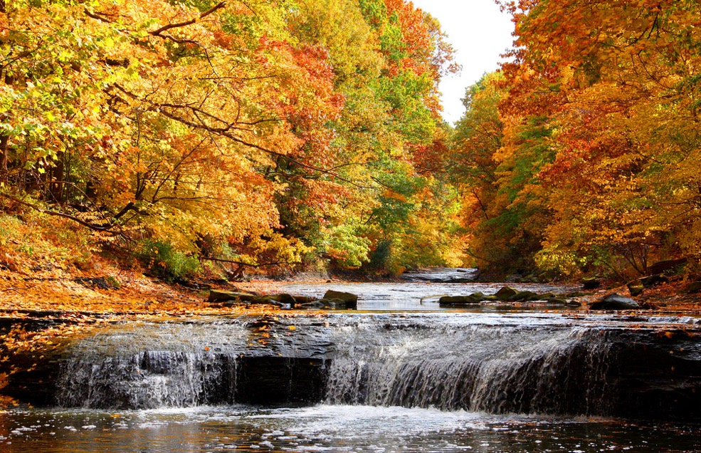
Notes:
Cleveland Orchestra. Consistently one of the worlds best.
PlayhouseSquare. The nation's largest performing-arts center outside New York.
Cleveland Metroparks. Kind of a hidden gem an Emerald Necklace, to be exact.
Rock and Roll Hall of Fame and Museum. Yes, we rock.
Cleveland Museum of Art. Almost 100 years old, with a legacy of expansive collections.
Downtown. Restaurants, bars, right by the sports stadiums

Slide 28
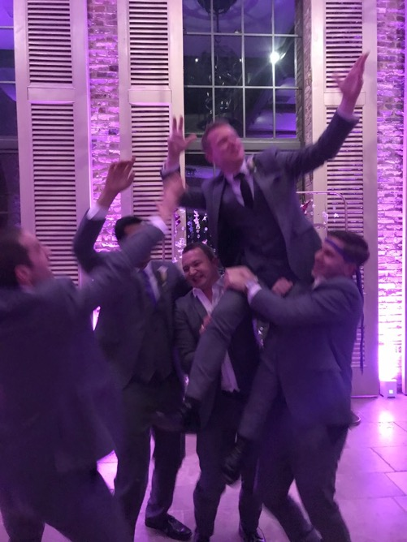
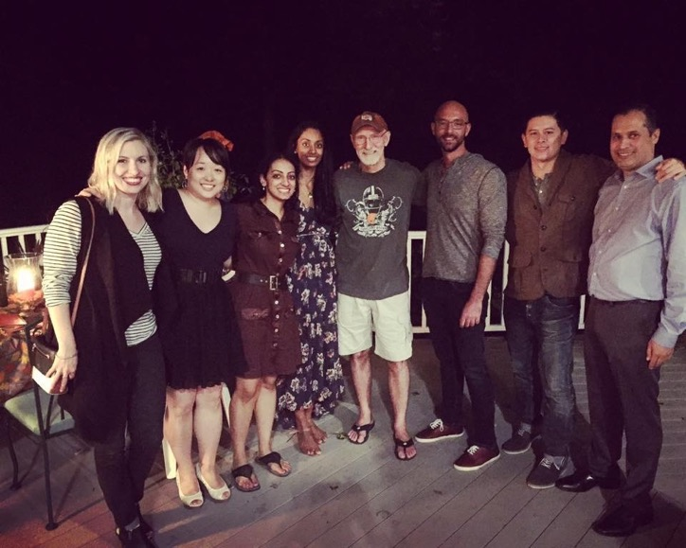
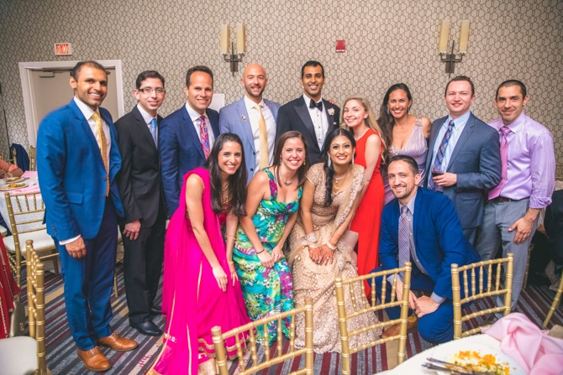
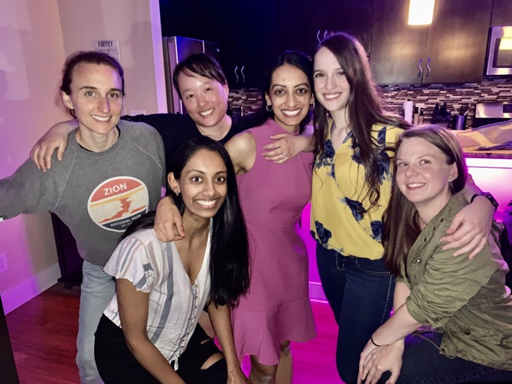
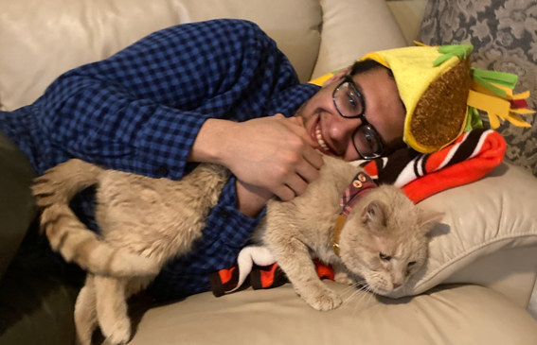
LIFE OUTSIDE OF WORK

Slide 29
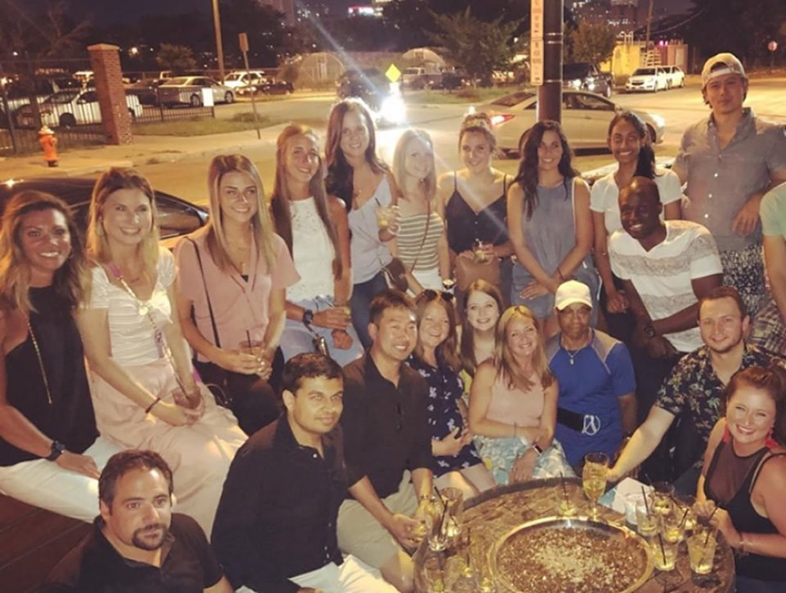
LIFE OUTSIDE OF WORK

Slide 31
LOOKING FORWARD TO MEETING YOU AT THE CLEVELAND CLINIC!

Slide 32
Program Contact
Beth Battisti, Program Manager
Email: battise@ccf.org

