Slide 1
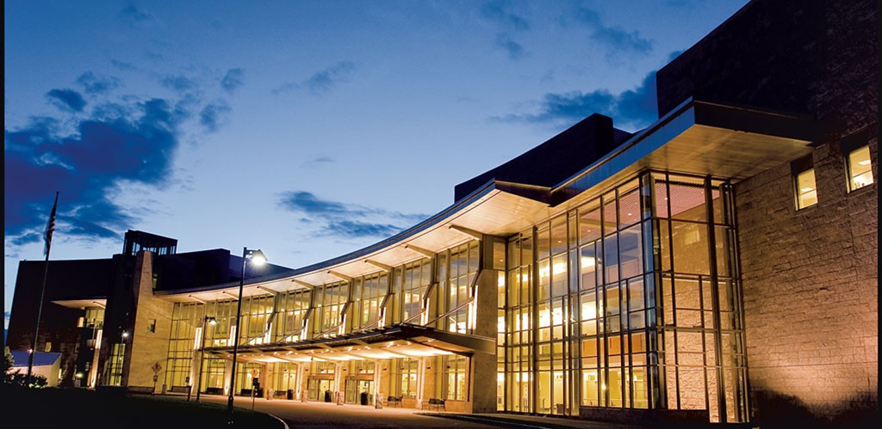
Welcome to University of Vermont
Neurosurgery

Slide 2
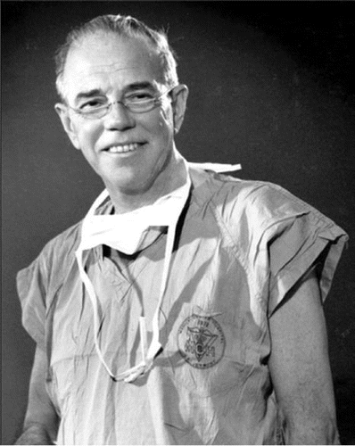
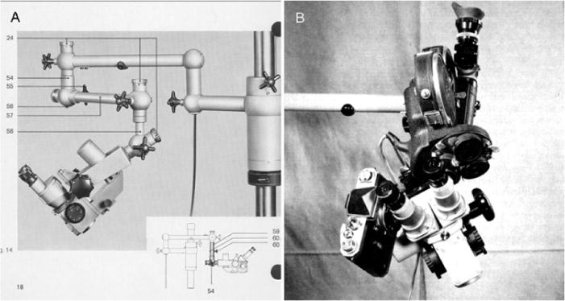
History of UVM Neurosurgery
Founded by Dr. Raymond M.P. (Pete) Donaghy in 1948
  Pioneer in vascular microneurosurgery
  Established the world’s first microsurgery research and training laboratory at UVM in 1958
  Adapted the ZEISS OPMI microscope for better use in neurosurgery (diploscope)

Slide 3
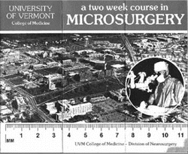
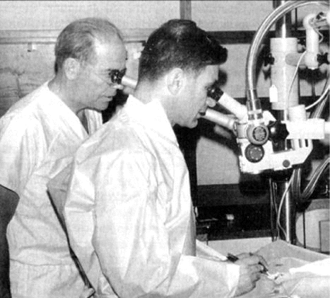
History of UVM Neurosurgery
Over 500 physicians studied in Dr. Donaghy’s lab
200 neurosurgeons completed his two-week course
  Dr. Gazi Yasargil
STA-MCA bypass (first EC-IC 1962)
  October 30, 1967 Zurich
    Yasargil
  October 31, 1967 Burlington
    Donaghy

Slide 4
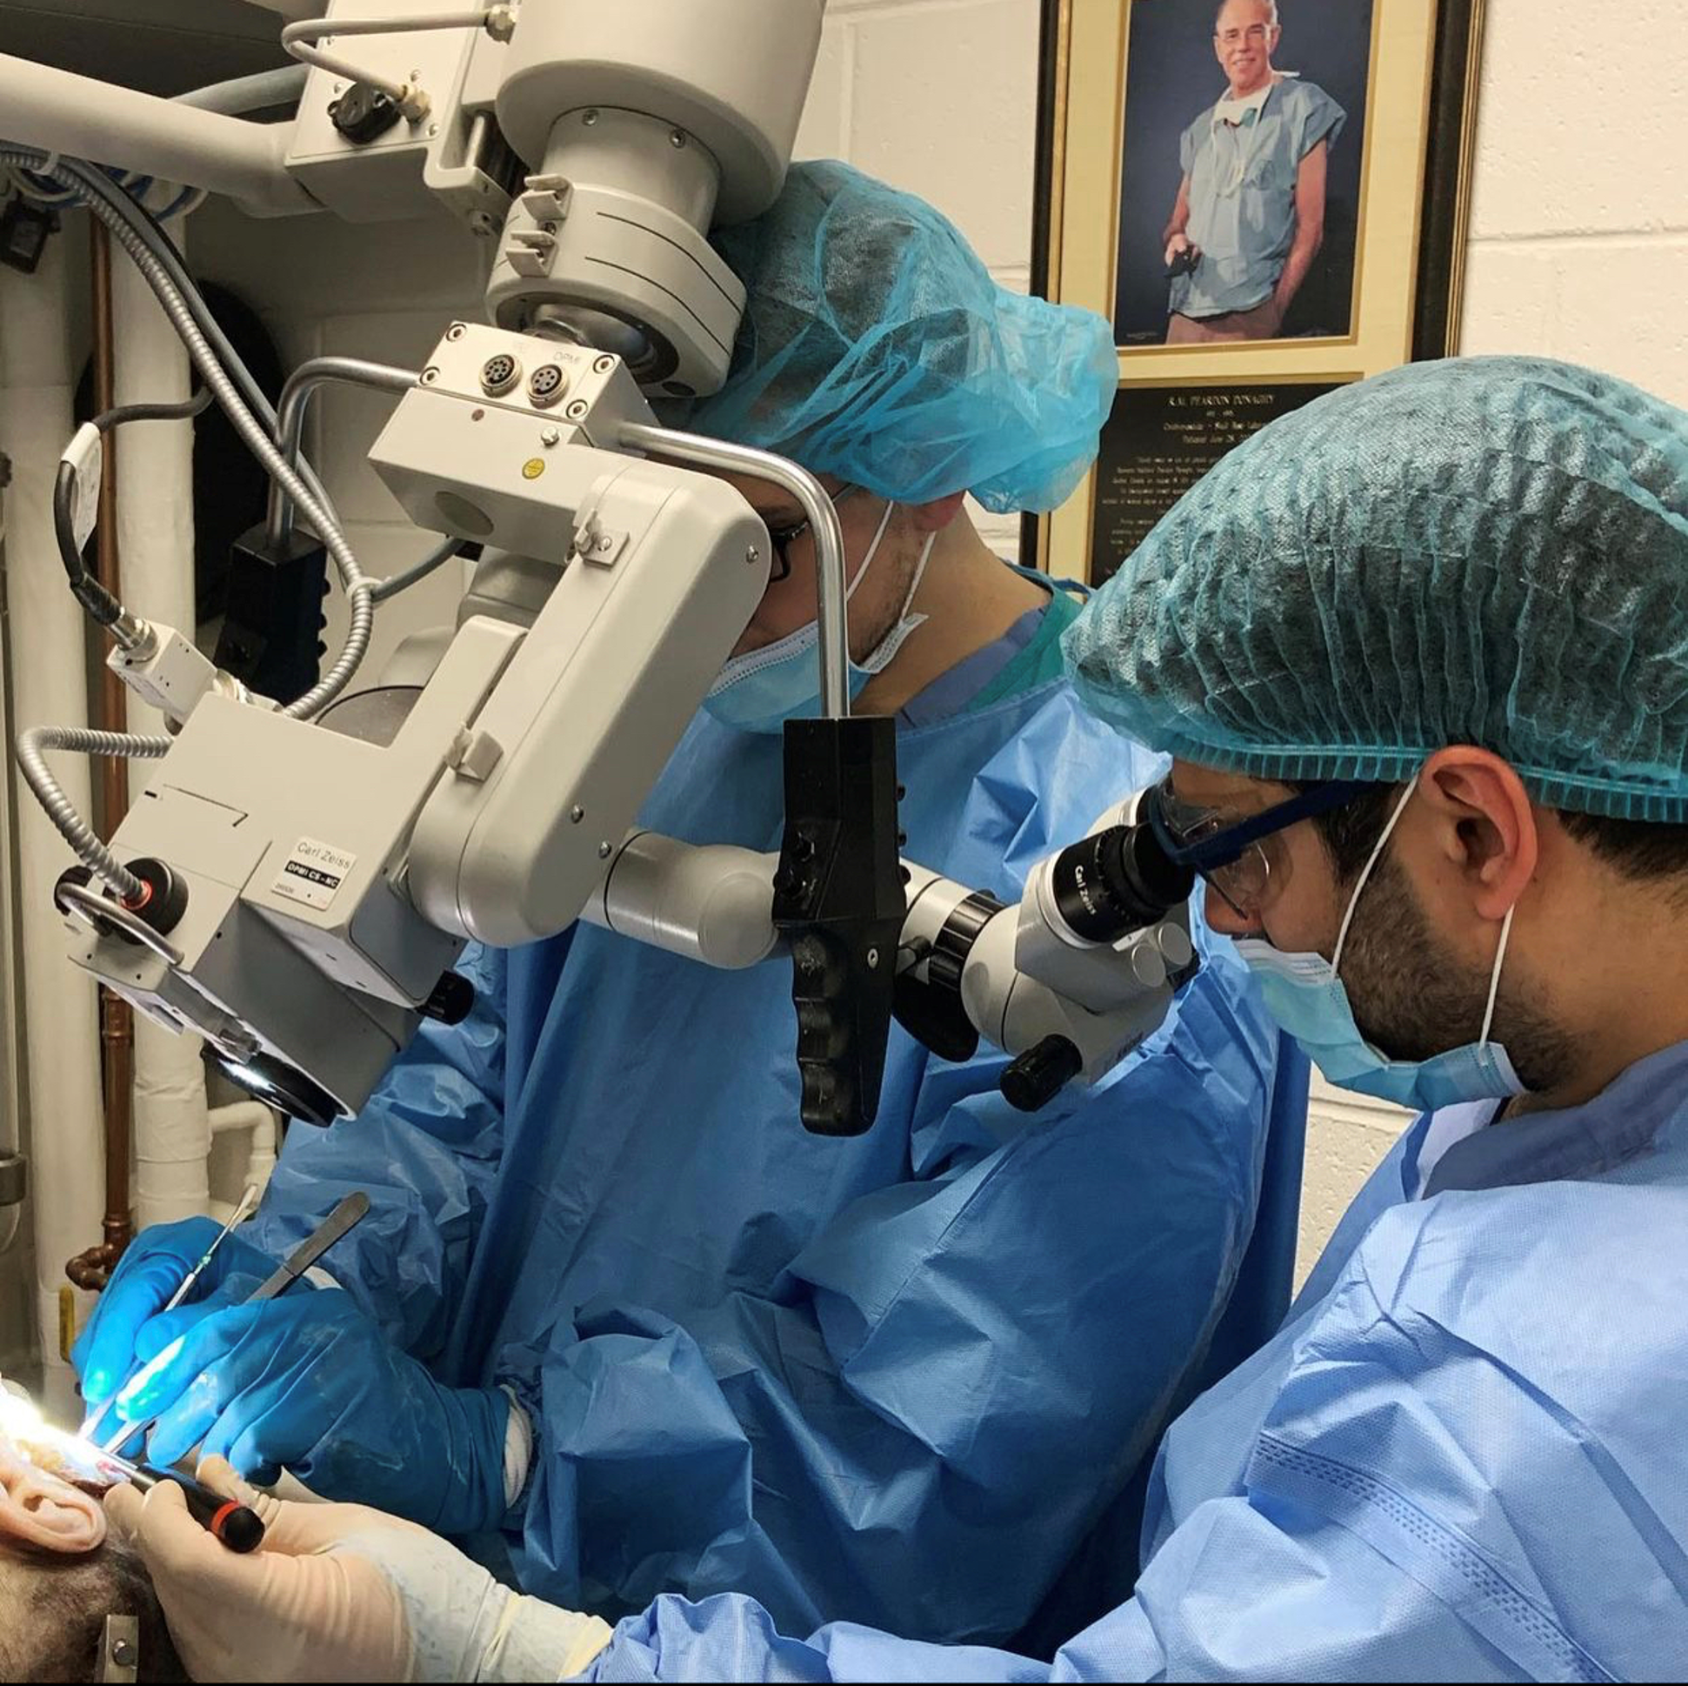
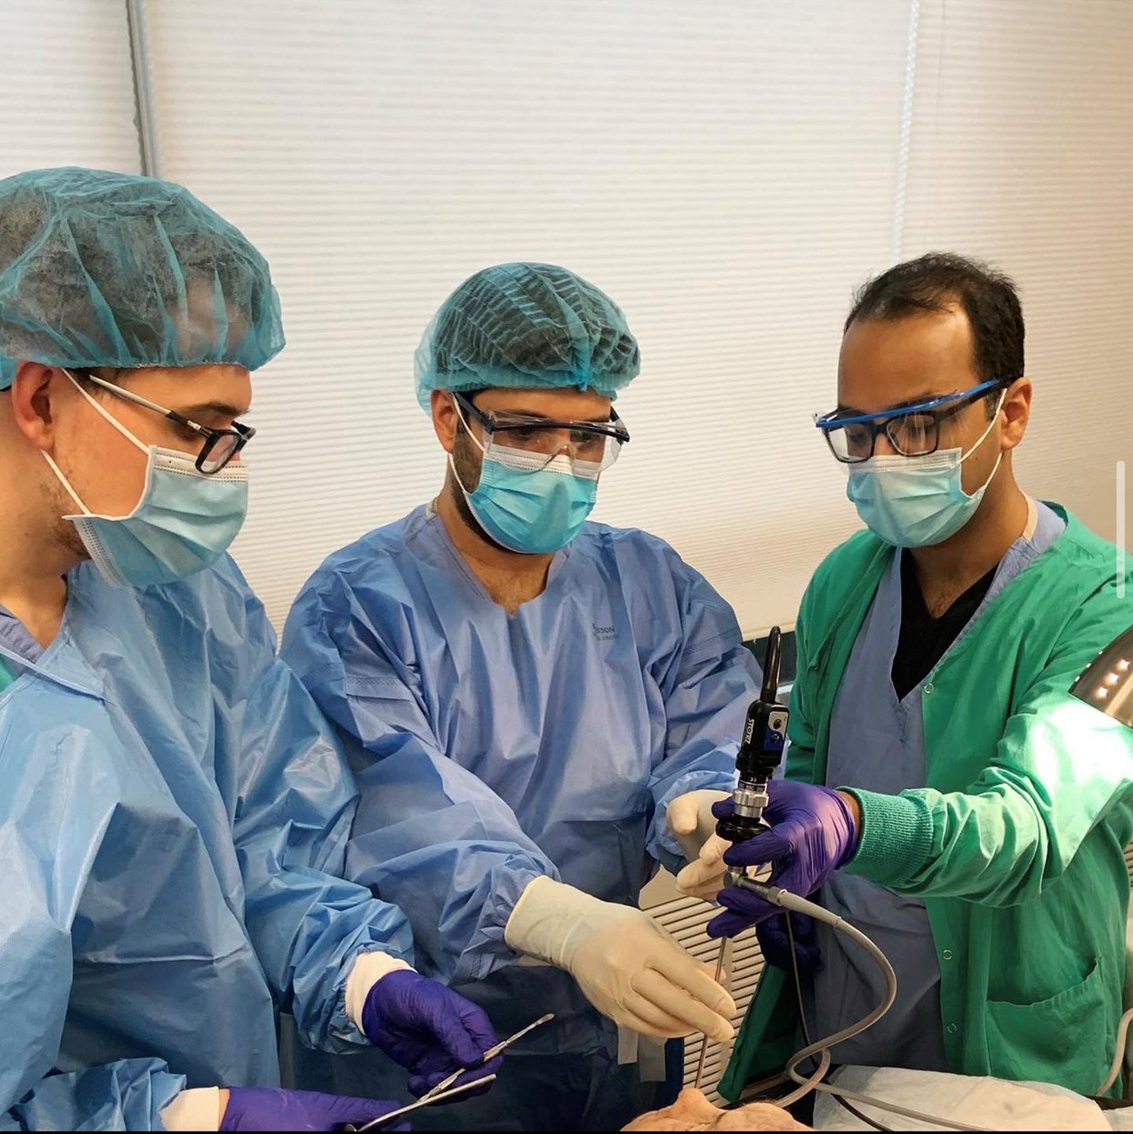
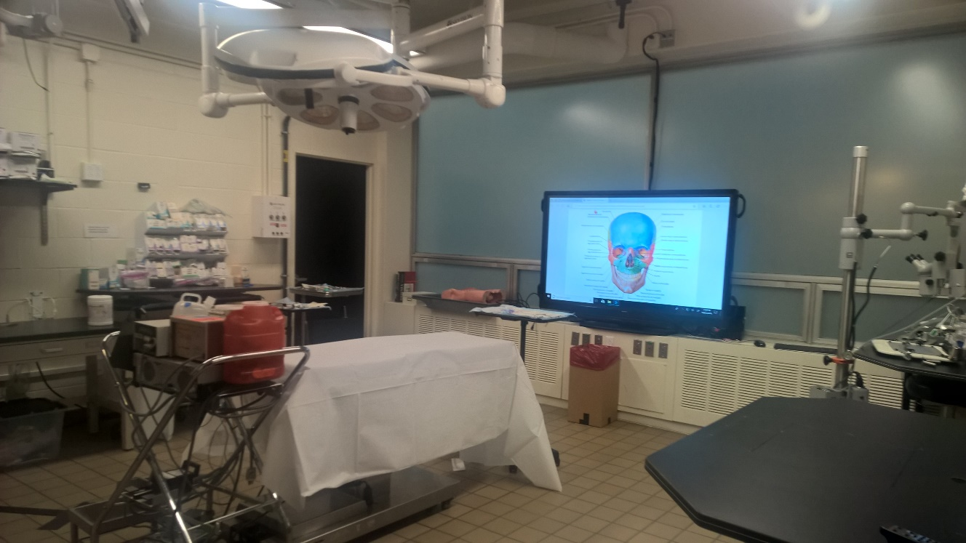
Raymond MP Donaghy Skull Base Lab
Excellent lab space
7 operative microscopes
Endoscopic equipment and instruments
Microsurgical instrument sets for microsuturing

Slide 5
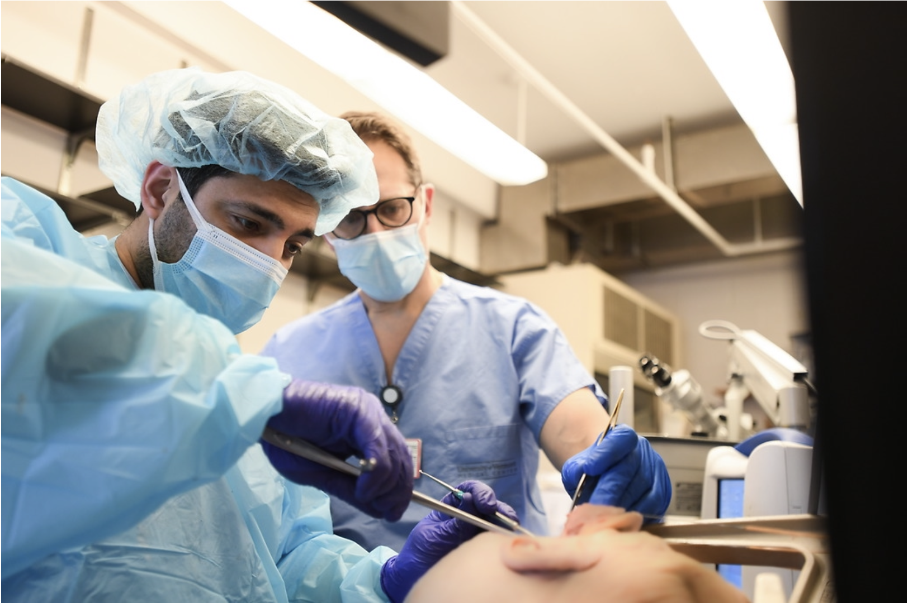
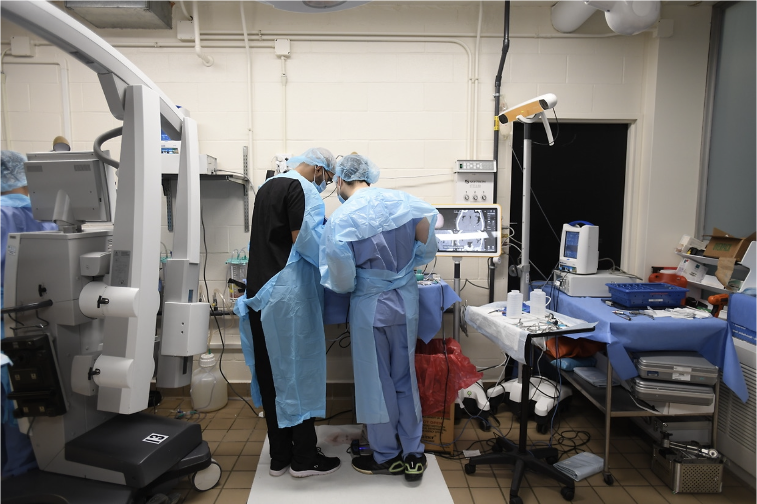
Raymond MP Donaghy Skull Base Lab
Annual Skull Base Course held for residents in New England
Lab based curriculum in development for resident practice
Monthly dissection with faculty guidance

Slide 6
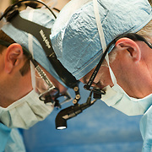
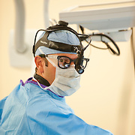
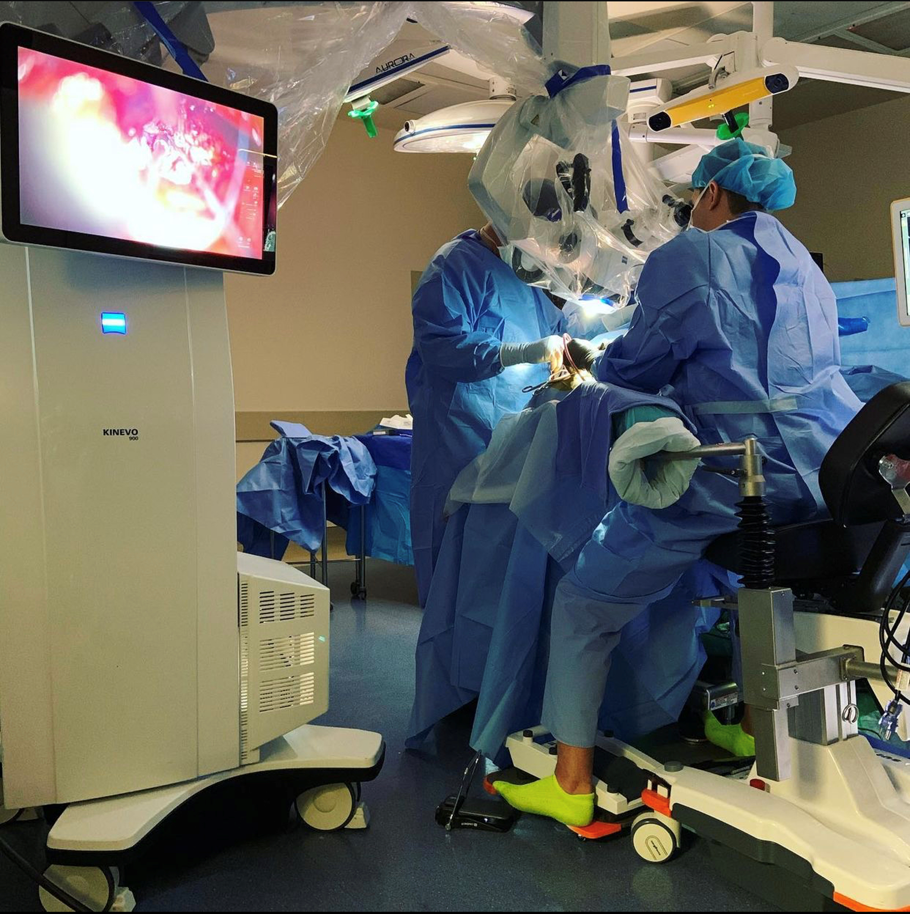
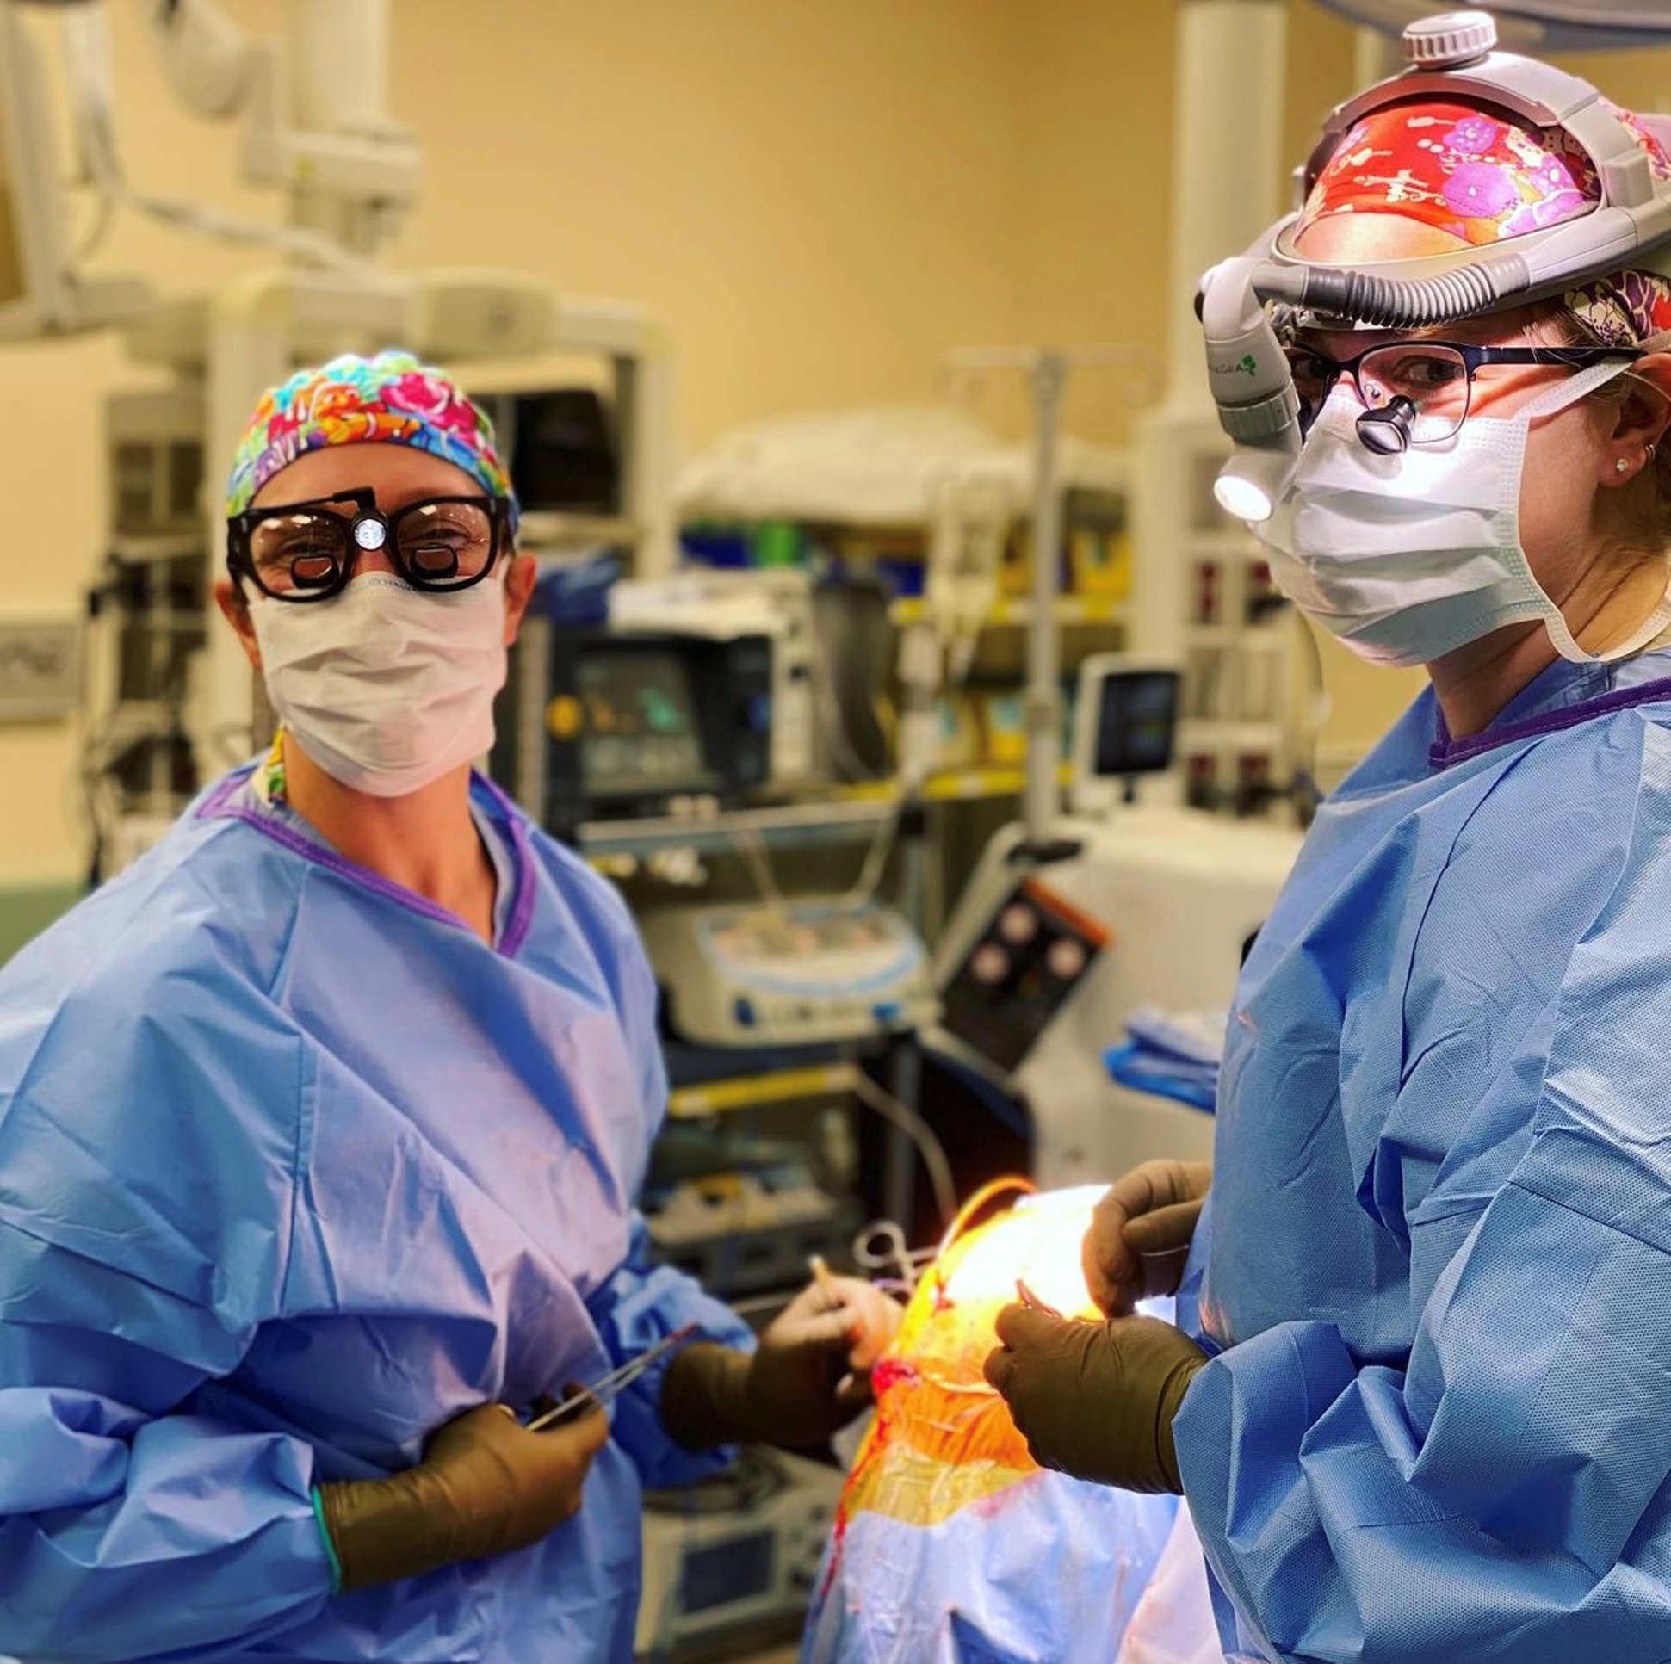
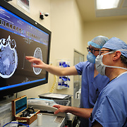
Faculty

Slide 7
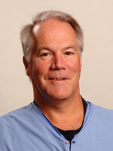
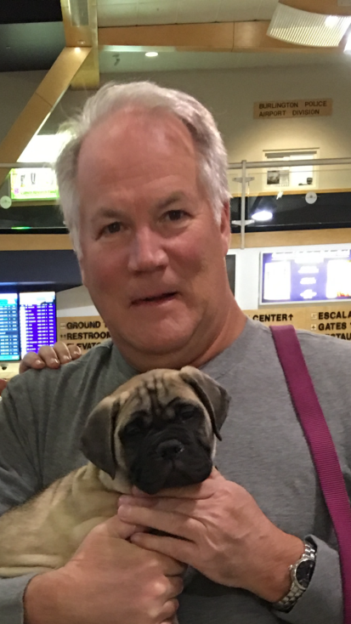
Bruce Tranmer, MD
Chief, Division of Neurosurgery
Professor of Neurosurgery
Undergraduate: Queen’s University, Kingston, Ontario
Major: Life Sciences (Pre-Med), 1973 – 75
Medical School: Queen’s University School of Medicine, MD 1979
Residency: General Surgical Resident, Kingston General Hospital, 1979– 1981
Neurosurgical Residency Training, University of Toronto, 1981 – 86
Fellowship: Neurovascular Fellowship, University of Colorado, 1984-85
McLaughlin Fellowship, University of Munich and University of Zurich, 1987-88
Sugita Fellowship, Nagoya Japan, 1991

Slide 8
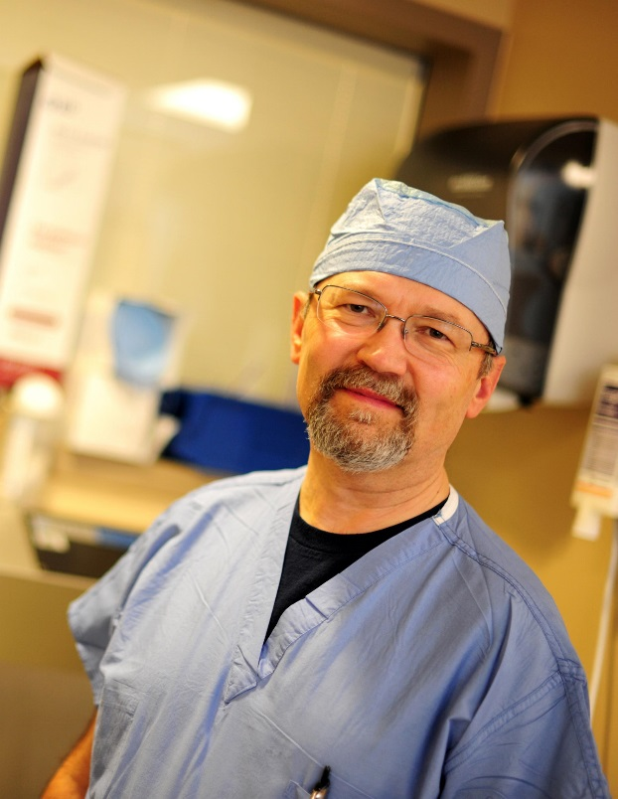
Paul Penar, MD, FACS, FAANS
Professor of Neurosurgery
Vice Chair – Quality, Dept. of Surgery
Undergraduate: University of Michigan, BS 1977
Medical School: University of Michigan, MD 1981
Residency: Yale New Haven Medical Center, 1981-87
Fellowship: ACS/AANS Health Policy Scholarship Leadership Program in Health Policy and Management, Brandeis University
Service: Chair, Neurosurgery Quality Council AANS/CNS Washington Committee

Slide 9
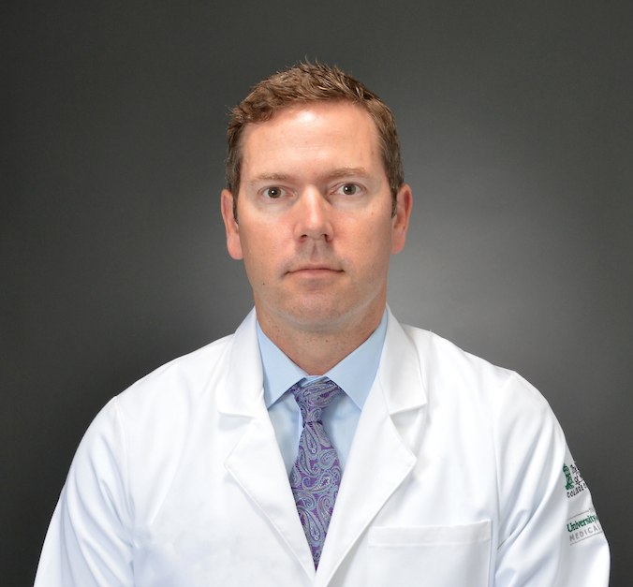
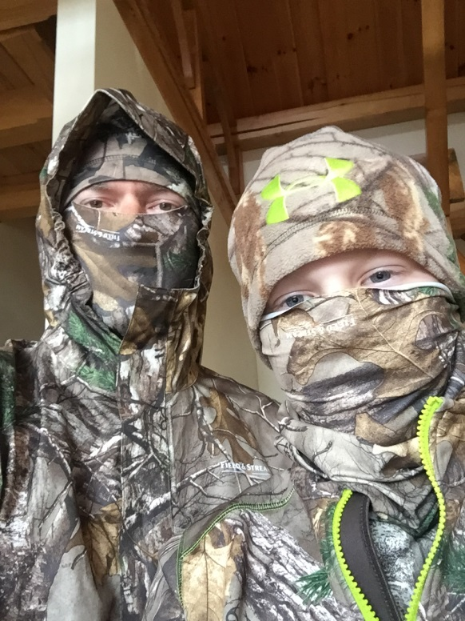
Ryan Jewell, MD
Associate Professor, Neurosurgery
Undergraduate: University of Notre Dame
  BS 1995
Medical School: University of Vermont School of Medicine,
MD 1999
Residency: University of Vermont Neurosurgery Residency
  1999-2006
Fellowship: Neurosurgical Spine Fellowship, University of Alabama at Birmingham, 2006-2007

Slide 10
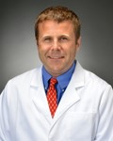
Scott Lollis, MD
Associate Professor, Neurosurgery
Undergraduate: Dartmouth College 1998
Medical School: Columbia University 2003
Residency: Dartmouth-Hitchcock Medical Center, Lebanon, NH, 2003-2010
Fellowship: Cleveland Clinic, Complex Spinal Surgery, 2010-2011

Slide 11
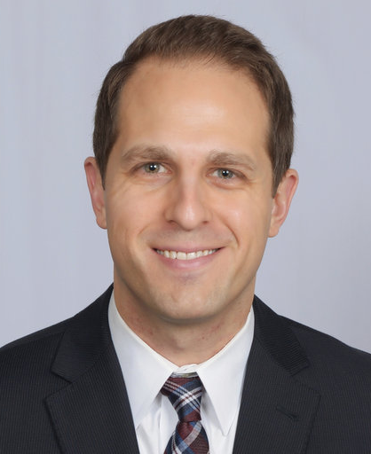
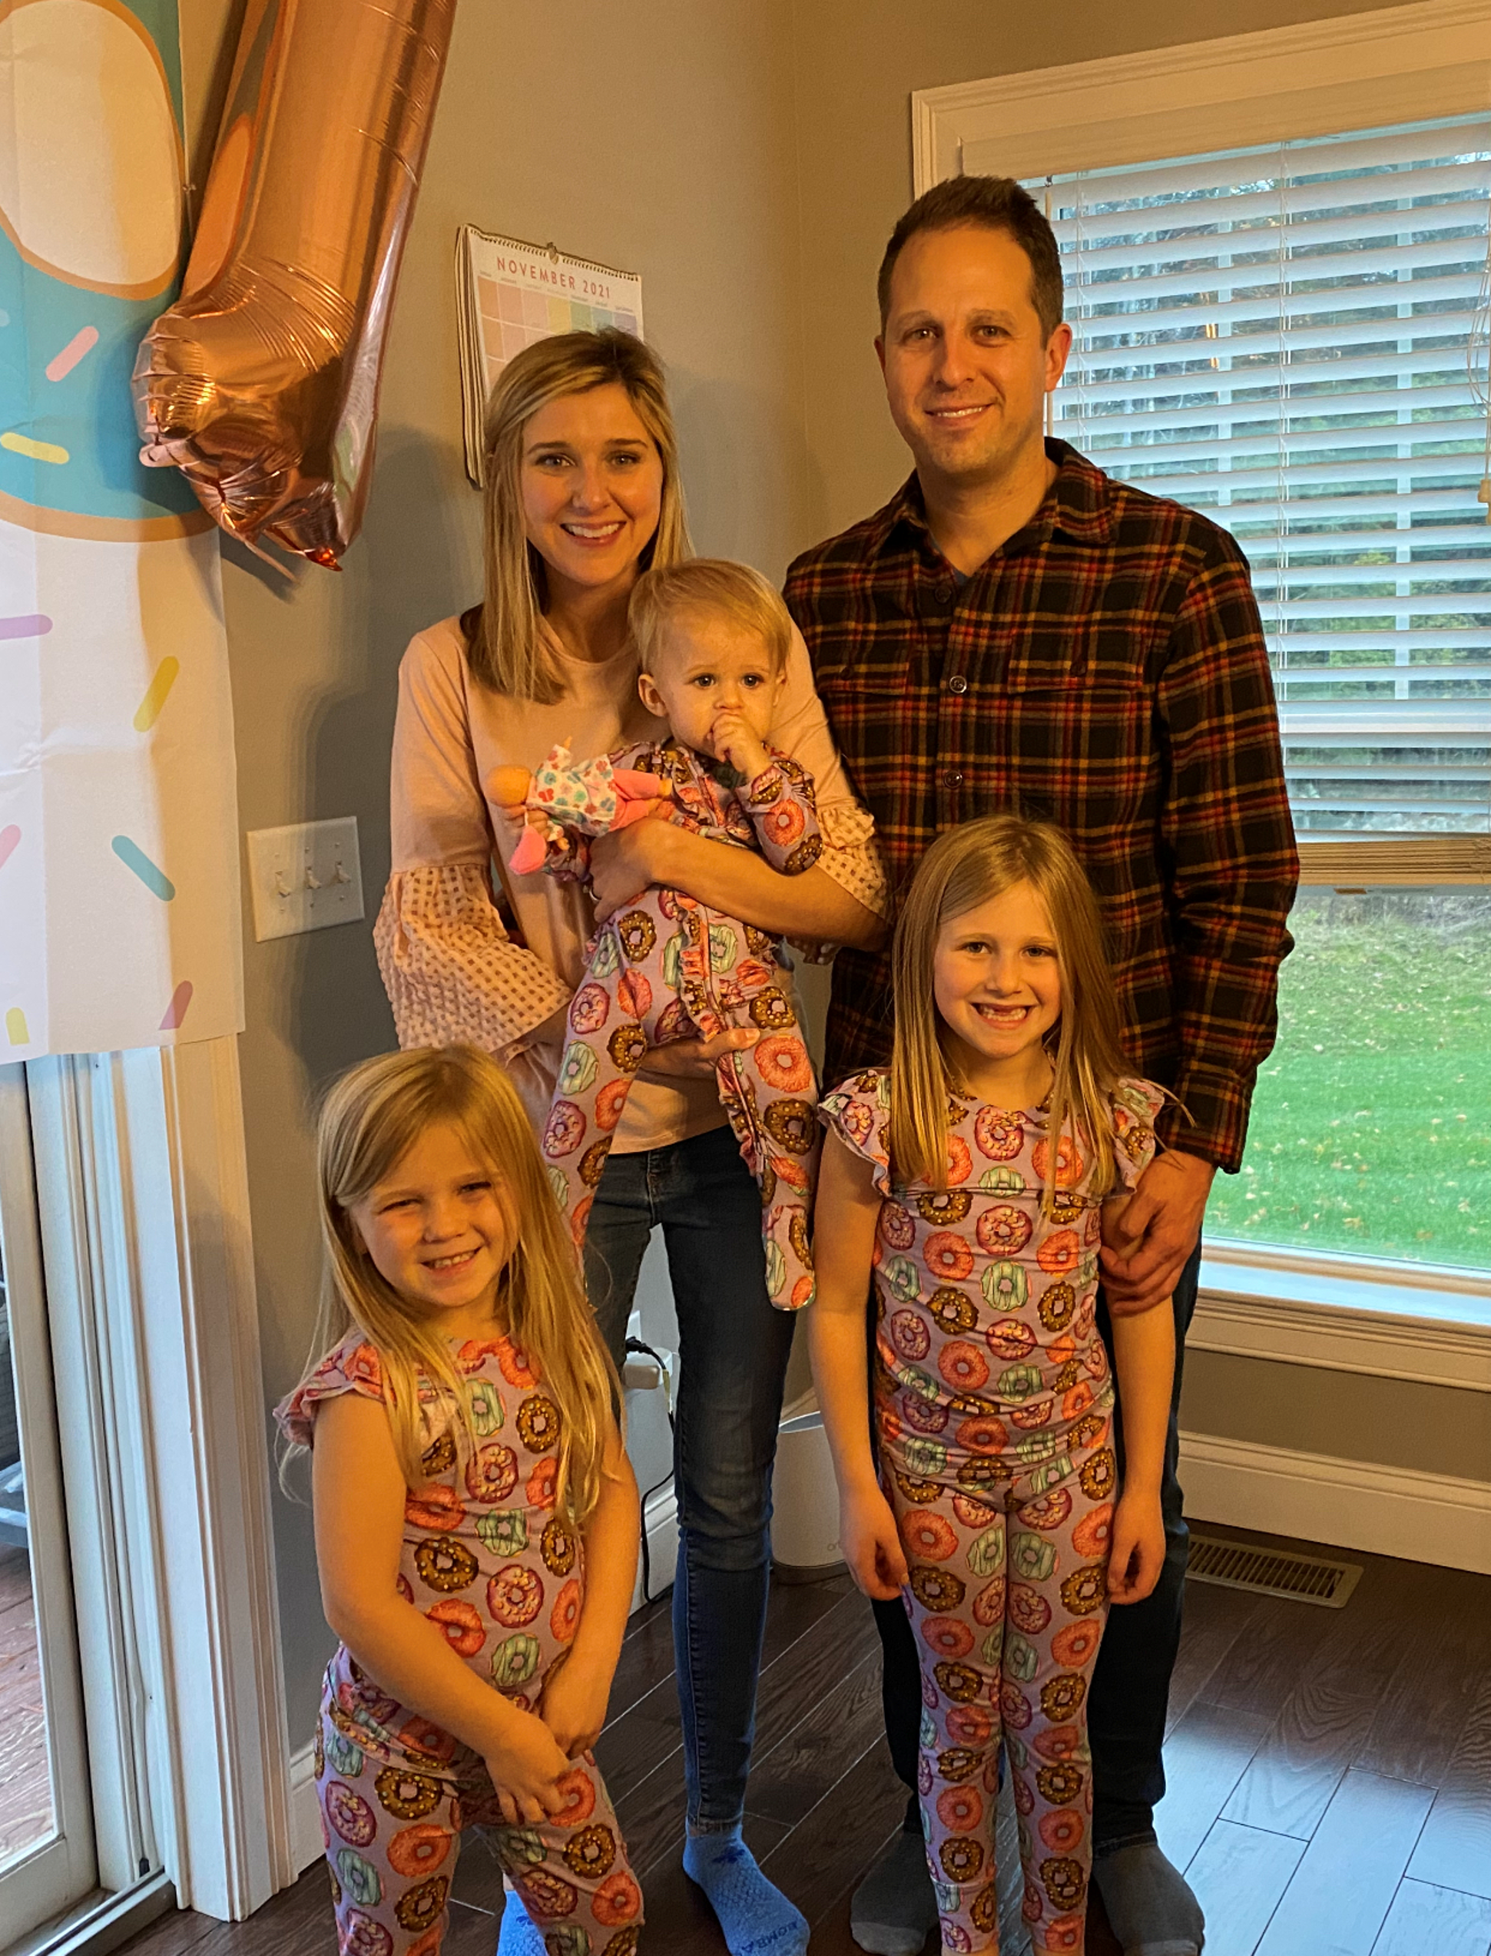
Brandon Liebelt, MD
Program Director, Neurosurgery Residency
Assistant Professor, Neurosurgery
Undergraduate: Texas A&M University 2006
Medical School: University of Texas Health Science Center – San Antonio 2010
Residency: Houston Methodist Neurologic Institute 2010-2017
Fellowship: Barrow Neurologic Institute Skull Base and Cerebrovascular Surgery 2017-2018

Slide 12
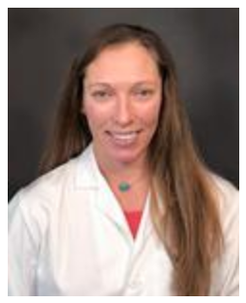
Katrina Ducis, MD
Assistant Professor, Neurosurgery
Medical School: University of Toledo 2011
Residency: University of Vermont 2018
Fellowship: Indiana University, Pediatric Neurosurgery 2019

Slide 13
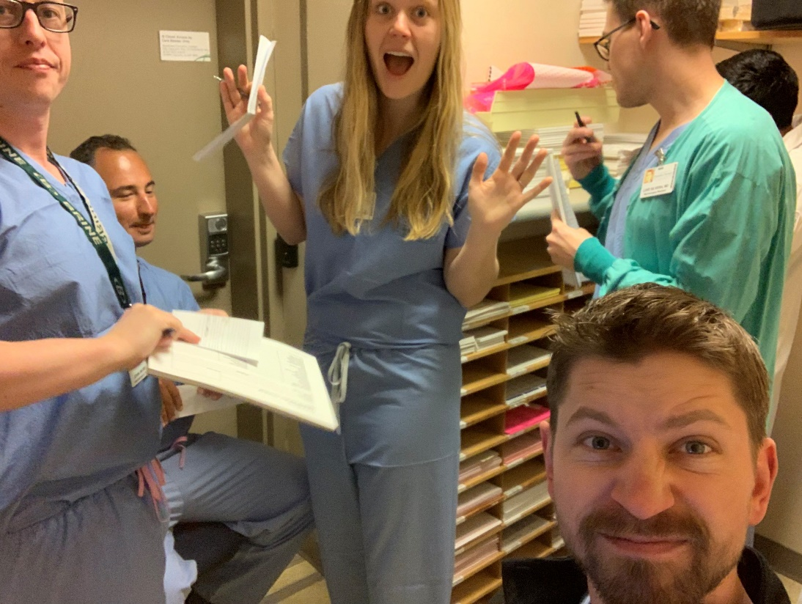
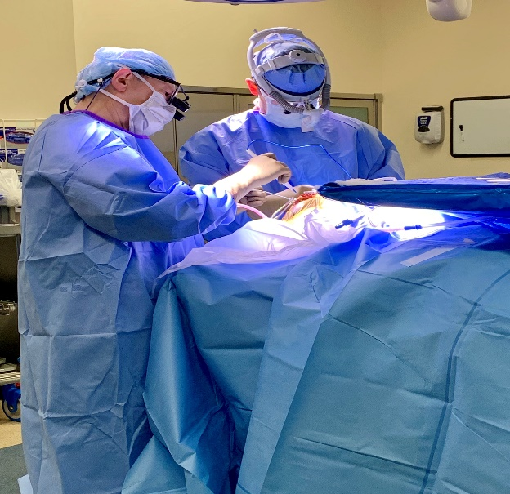
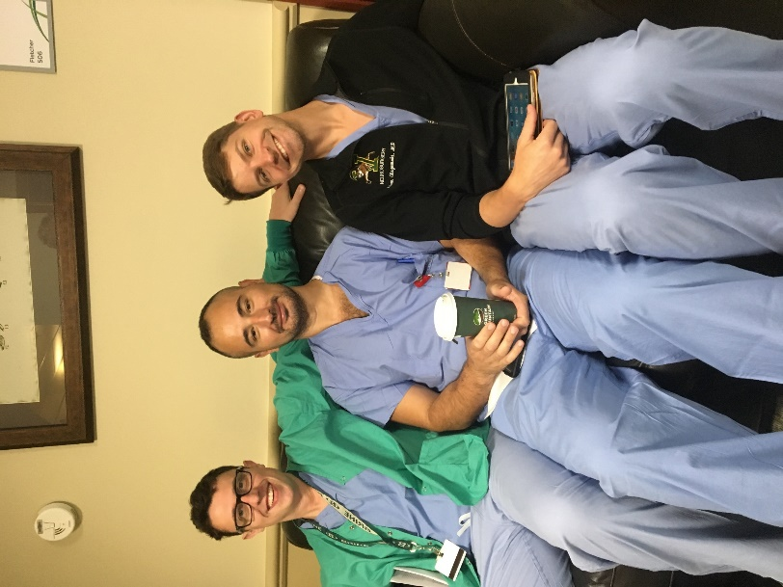
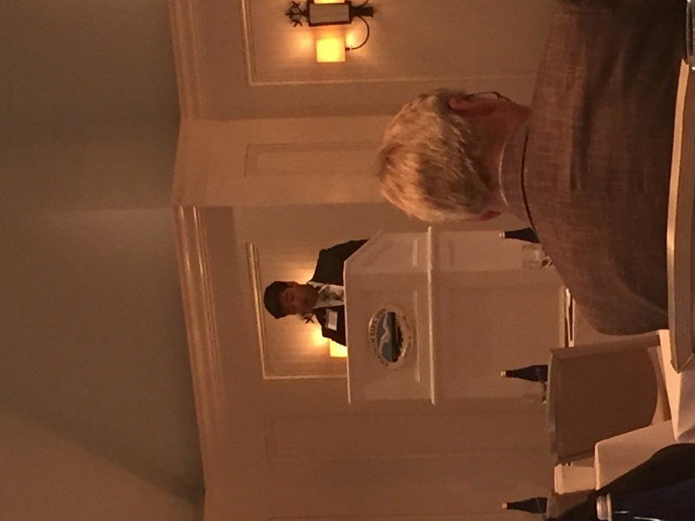
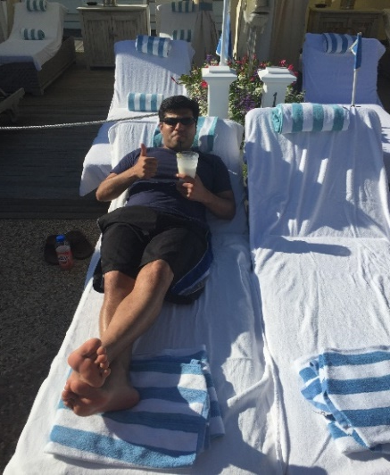
UVM Neurosurgery
Residents

Slide 14
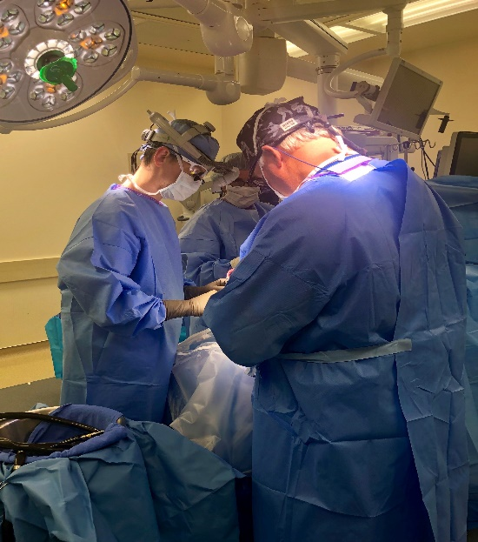
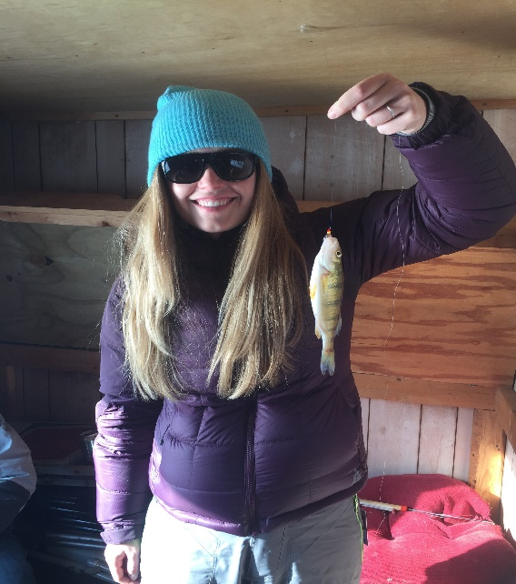
Resident Rotations
PGY-1 6 months Neurosurgery
2 months SICU/1 month ENT
3 months Neuroscience
PGY-2 Neurosurgery Junior Resident
PGY-3 Ortho spine 6 months
Endovascular 3 months
Radiosurgery/Neurosurgery 3 months
PGY-4 Research/Elective
PGY-5 Utah – 6 mo pediatrics/6 mo neurosurgery
PGY-6 Senior Resident/Administrative Chief
PGY-7 Chief Resident

Slide 15
Recent Graduates
2015 David Stockwell, MD
  Spine fellowship: University of Texas
  Goodman-Campbell, Indianapolis, IN
2016 Andrew Tsen, MD
  LeHigh Valley Health Network, Allentown, PA
  2017 Chih-Ta Lin, MD
  Goodman-Campbell Neurosurgery, Indianapolis, IN
  2018 Katrina Ducis, MD
  Pediatric Neurosurgery Fellow, Indiana University School of Medicine
  2019 Erinc Akture, MD
    Diagnostic Radiology – Endovascular Surgery Neuroradiology Fellowship, Baptist Neurologic Institute, Florida; Skull Base Surgery – OHSU; Portland, Oregon
  2022 Adam Olszewski, MD
    Skull Base Neurosurgery Fellow, House Clinic, Los Angeles, CA
  2022 Natalie Limoges, DO
    Pediatric Neurosurgery Fellow, Stanford University
  2023 John Muse, MD
    Endovascular Neurosurgery Fellow, Baptist Health, Jacksonville, FL

Slide 16
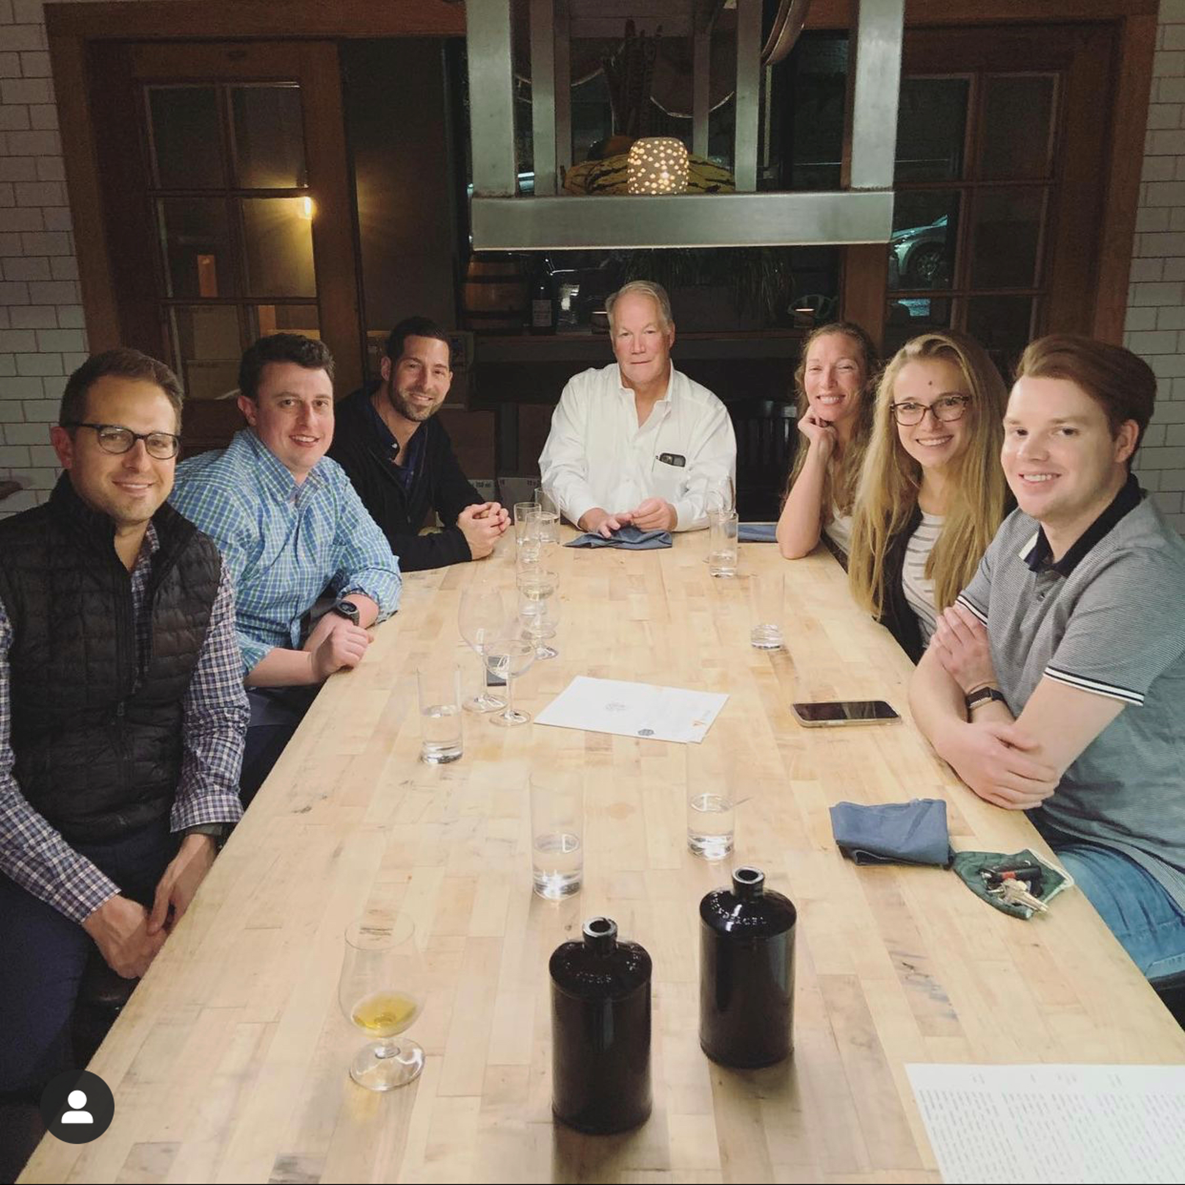
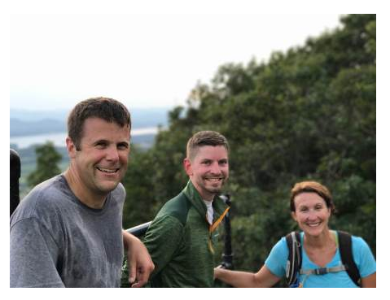
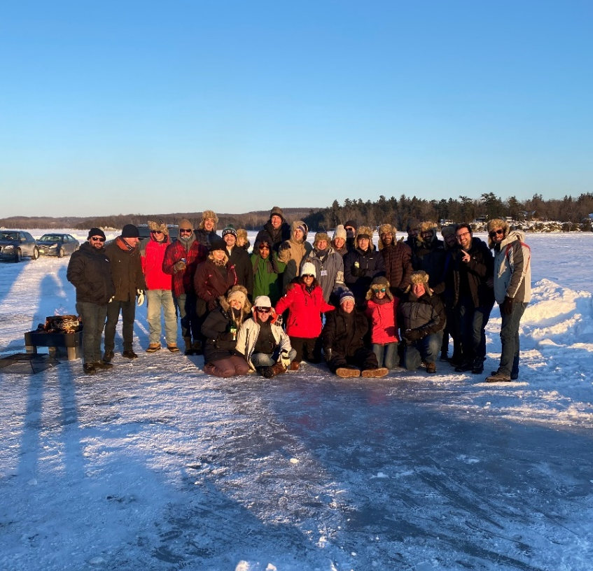
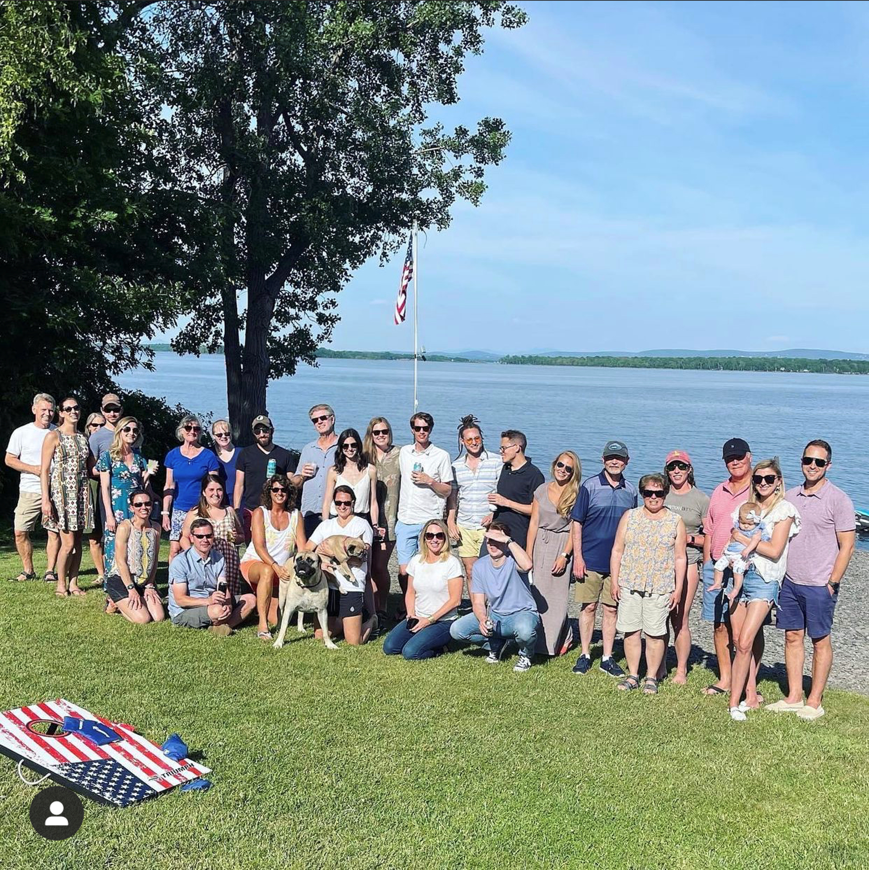
Extracurriculars

Slide 17
