Slide 1
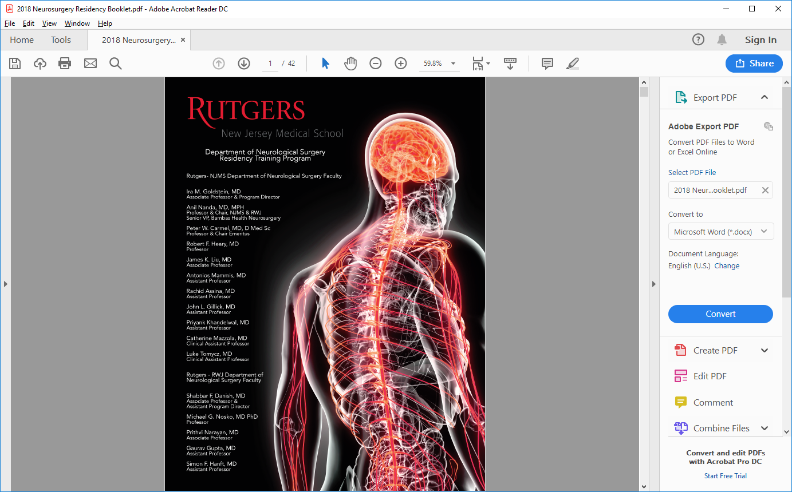

Slide 2
Rutgers Neurosurgery
Department of Neurological Surgery re-established by Dr. Peter Carmel in 1994 based on a vision that neurosurgical excellence could be achieved in the city of Newark

Slide 3
Evolution:
1986-93 - University Hospital + Saint Barnabas Medical Center; 4 faculty; 1 resident/year
1994 - Dr. Carmel named Chair
- Training program reinstated at NJMS-University Hospital + Hackensack UMC;
1 resident/year
- Residency complement increased to 10 (1.5/year)
- Residency complement increased to 2 residents/year
2009 - Training site change from HUMC to Robert Wood Johnson University Hospital
2015 - Former UMDNJ incorporated into Rutgers University;
- NJMS Chair named interim Chair at RWJ
2018 - Partnership between RWJ-Barnabas Health and Rutgers University announced
- Unified Chair of NJMS, RWJ, and Neurosurgery System Director for
RWJBarnabas Health
2019 - NBIMC and Saint Barnabas added as training sites
- Residency complement increased to 18; SBMC residents added to program
- Faculty growth: 10 at NJMS, 7 at RWJ, 50+ at SBMC, ongoing recruitment
2022 - Dr. Sambol named Interim Chair, search committee for new Chair organized
2023 - Dr. Gillick appointed Interim Residency Program Director

Slide 4
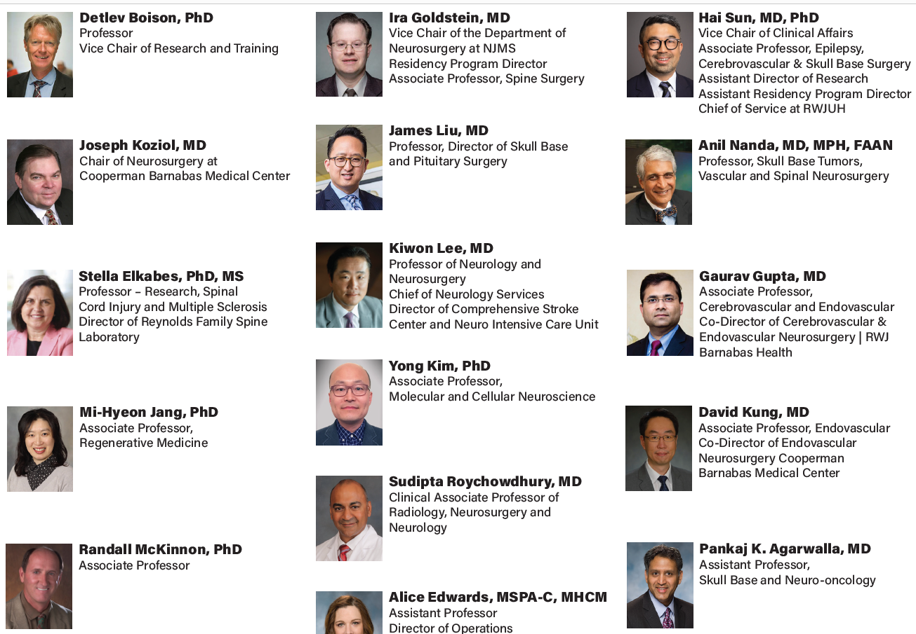
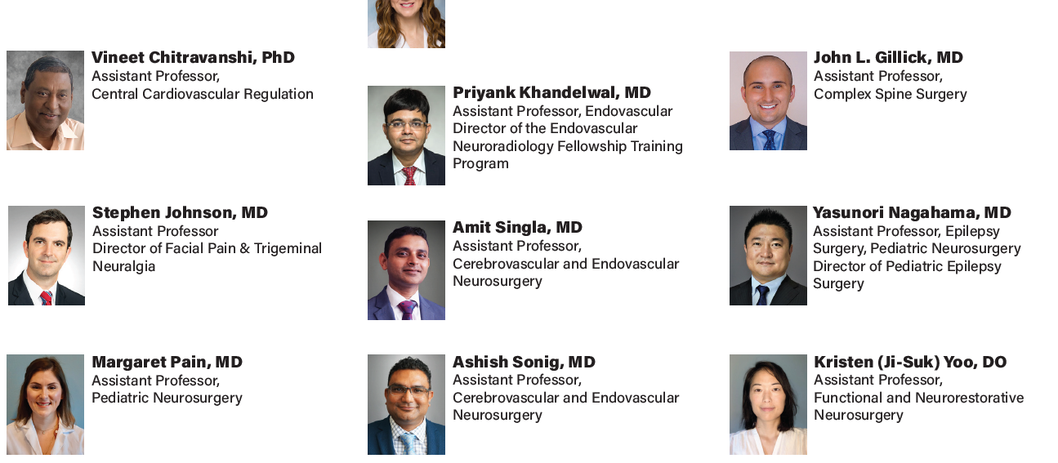
Our Faculty

Slide 5
Our raison de etre:

Slide 6
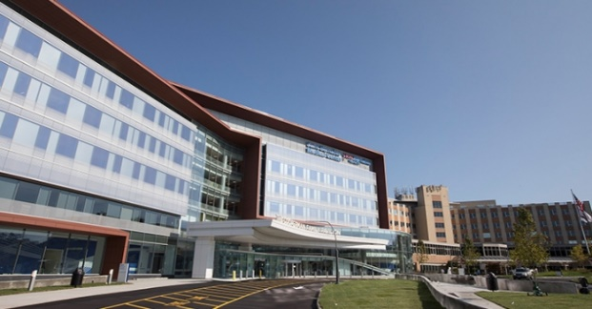
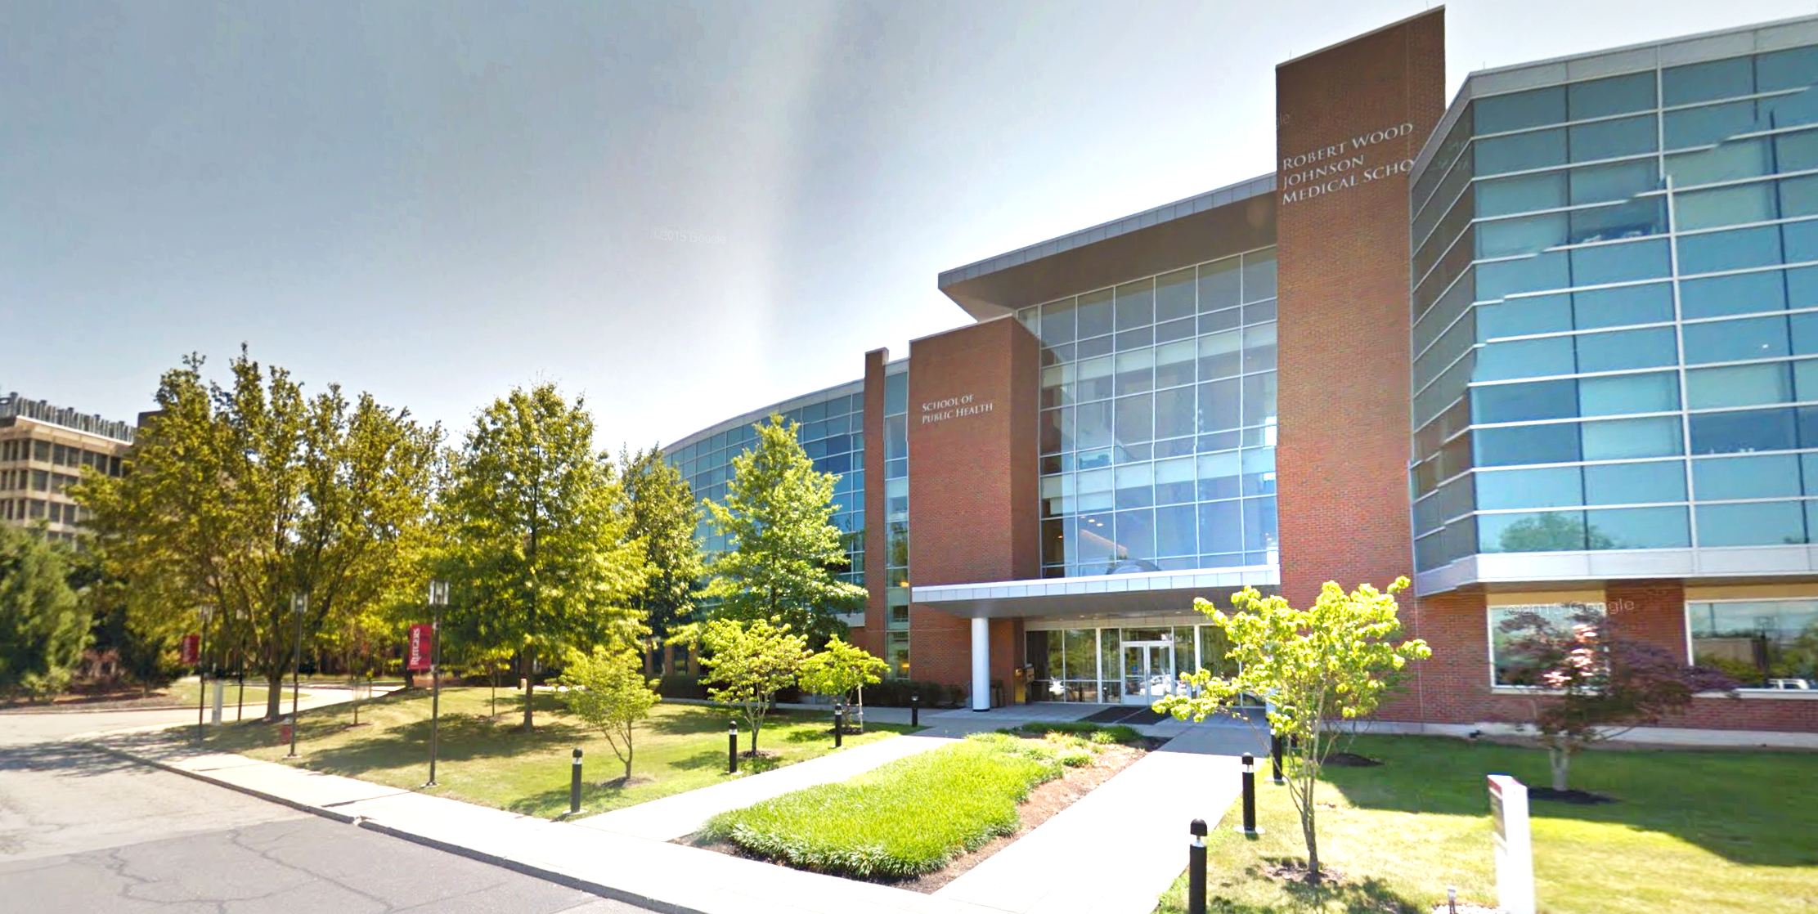
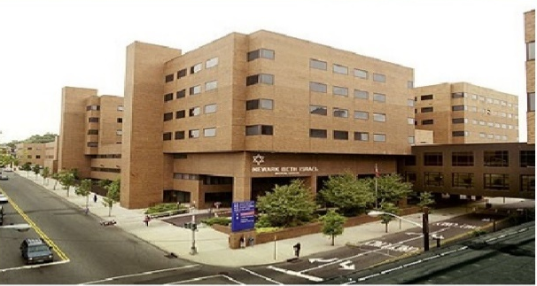
Residency Training Sites:
University Hospital, Newark
Cooperman Barnabas Medical Center
Robert Wood Johnson University Hospital
Newark Beth Israel Medical Center

Slide 7
University Hospital

Slide 8
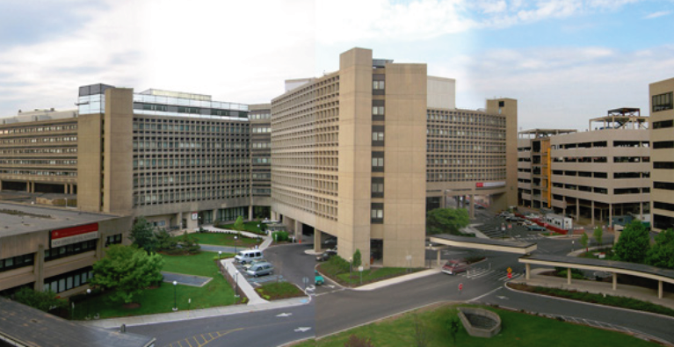

Location
Mid-sized urban setting
University Hospital within campus of New Jersey Medical School, along with Dental School, School of Nursing, School of Public Health

Slide 9
Facilities
University Hospital (UH)
  Level 1 Trauma Center
  Inpatient Units
  Endovascular Suite
  Neurosurgical ICU
  Comprehensive Stroke Center
Neurological Institute of New Jersey
New Jersey Trauma Center
Outpatient Resident Clinics

Slide 10
Operative Experience
Average of 2 rooms daily
Case distribution includes:
  Spinal tumors
  Complex spine deformity
  Skull base tumor
  Cerebrovascular, Open and Endovascular
  Functional: DBS and SCS
  Pediatric neurosurgery
  Brain and spine trauma
High degree of resident autonomy
Intensive Neurosurgical ICU experience

Slide 11
Cooperman Barnabas Medical Center

Slide 12
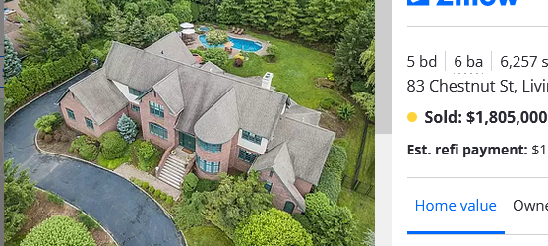
Location
Livingston, NJ
8 miles from University Hospital
Upscale suburban community
CBMC recent recipient of $100 Million donation

Slide 13
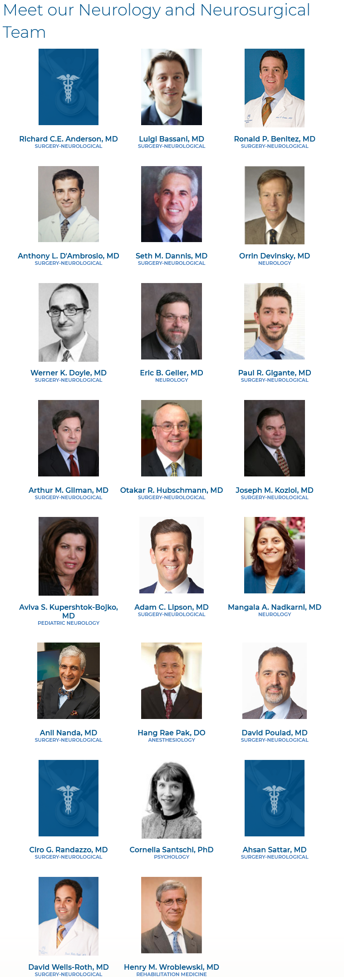
Facilities
Cooperman Barnabas Medical Center
  Not a trauma center
  Inpatient Units
  577 bed tertiary care teaching hospital
  50+ neurosurgeons on staff
  Endovascular Suite
  Neurosurgical ICU
  Open MRI

Slide 14
Operative Experience
Typically an average of 2-4 rooms daily
Case distribution includes:
  High volume of degenerative spine
  Skull base tumor
  Cerebrovascular and endovascular
  Functional: DBS and SCS
  Pediatrics
  Cyberknife
Neurosurgical NP’s and PA’s take care of floor tasks

Slide 15
Robert Wood Johnson University Hospital

Slide 16
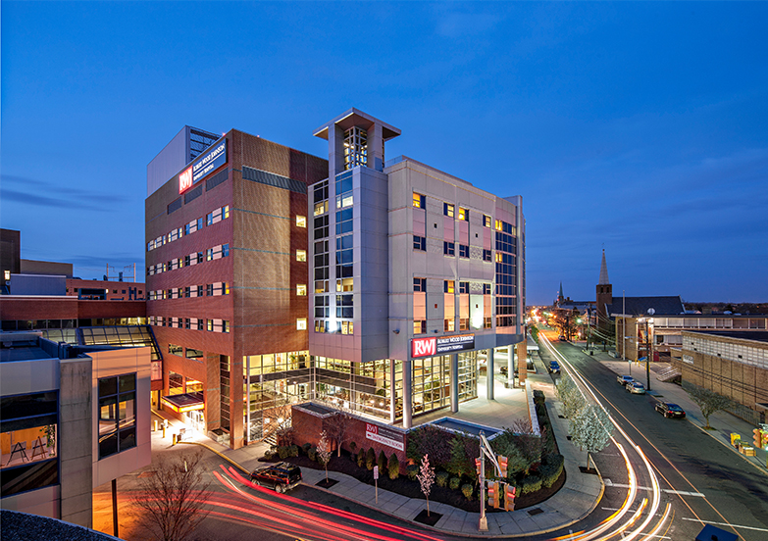

Location
New Brunswick, NJ Piscataway, NJ
24.8 miles from University Hospital
Located in the center of Rutgers University
New Brunswick is an urban environment with a college atmosphere
Piscataway has more of a suburban university campus feel, with a huge collection of basic science labs and facilities.

Slide 17
Facilities
Robert Wood Johnson University Hospital (RWJUH)
  Neurosurgical ICU
  Level 1 Trauma Center
  Inpatient Units
  Gamma Knife Center
  Proton Beam Center
  Endovascular Suite
Bristol-Myer’s Squibb Children’s Hospital
  Dedicated Pediatric operating Rooms
Cancer Institute of New Jersey (CINJ)
Child Health Institute
At this time, there is only 1 resident at this site for NS ICU.

Slide 18
Operative Experience
3-4 hospitals each with 2-5 OR running per day
Residents log 3000+ operative cases per year
Numbers took a hit from COVID as well as departure of several senior faculty in 2020
Effort to maintain progressive autonomy in OR
Use of Surgical Autonomy Program to track resident progress between sites
O-arm and stealth at all 4 hospitals
Hybrid OR at RWJUH and NBIMC
Endovascular program at all 4 sites
Actual ACGME case logs on next slides:

Slide 19
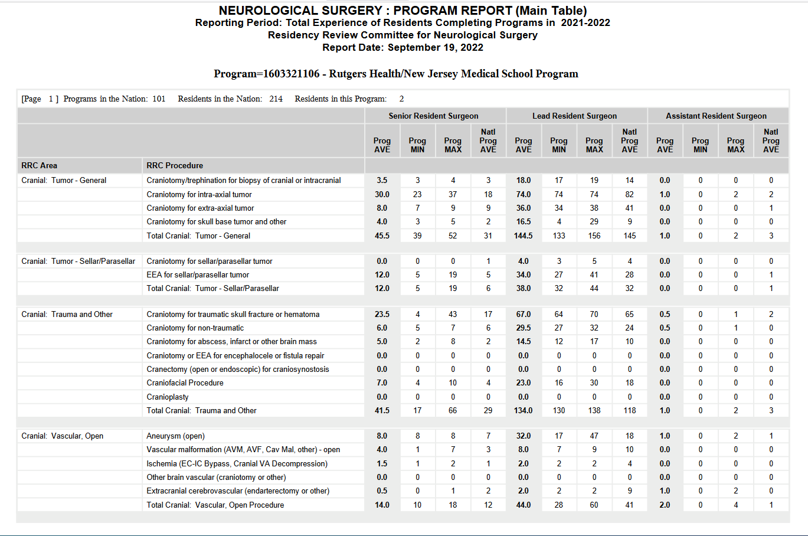
Operative Experience

Slide 20
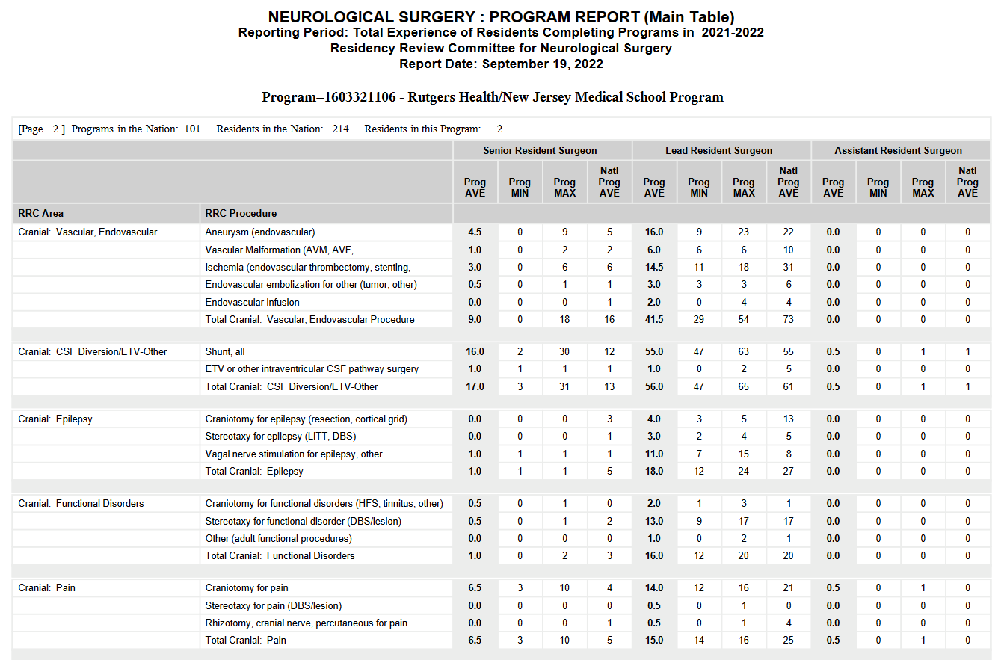
Operative Experience

Slide 21
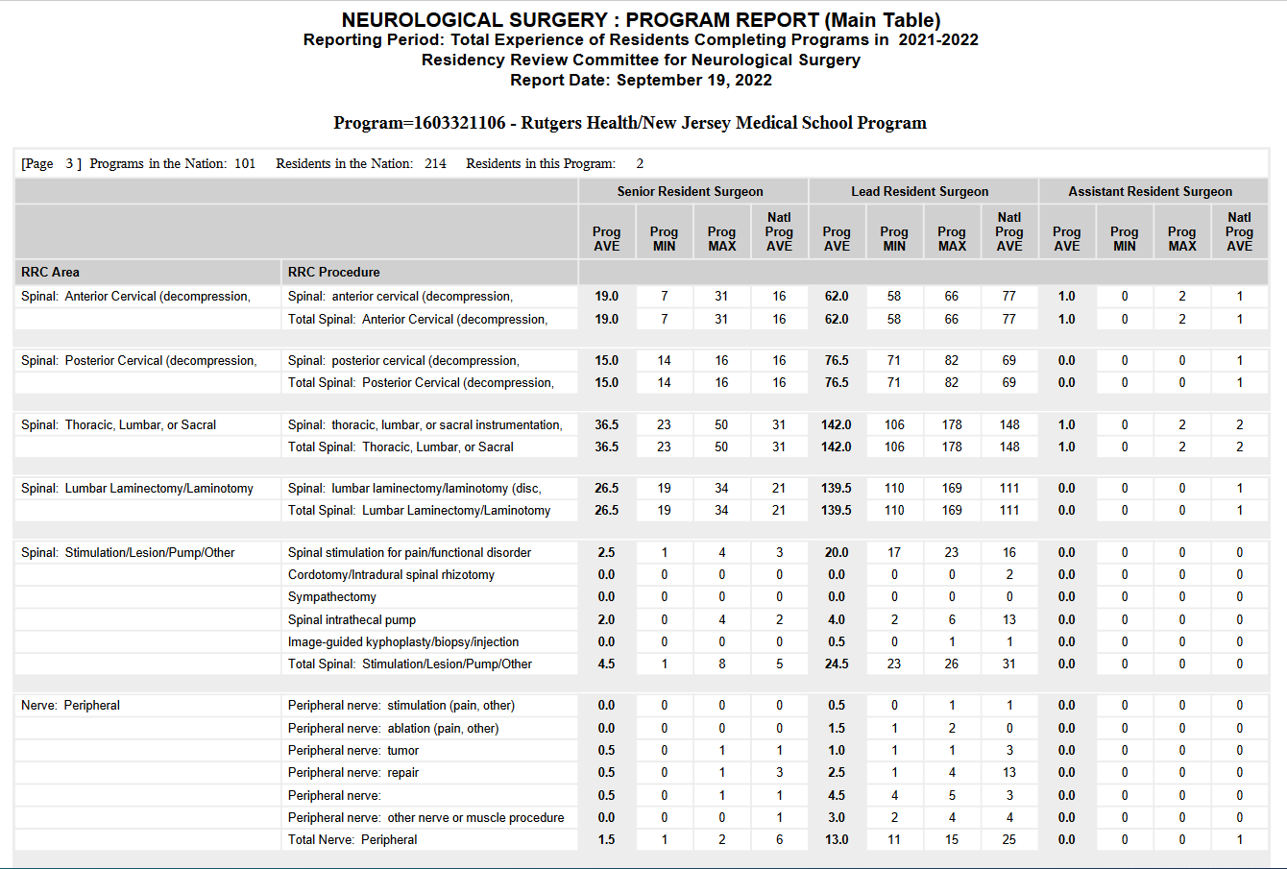
Operative Experience

Slide 22
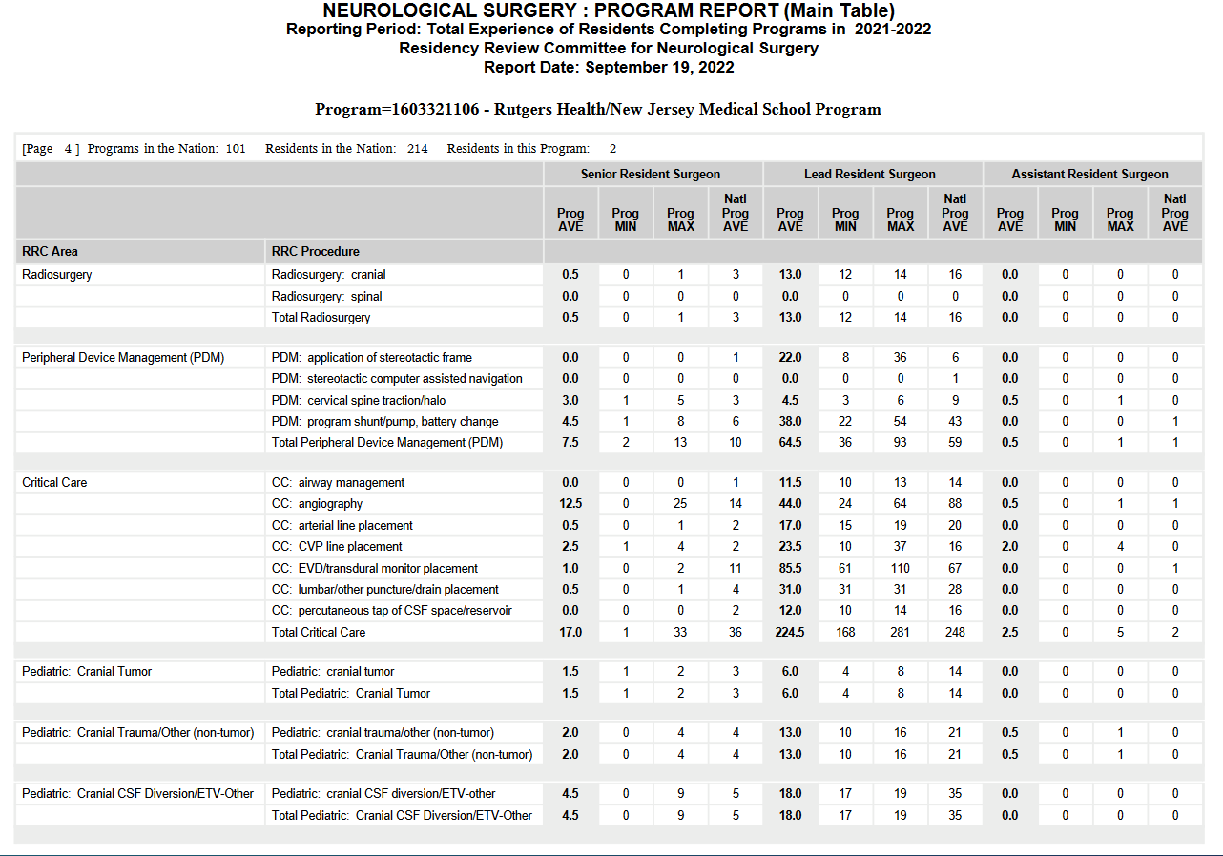
Operative Experience

Slide 23
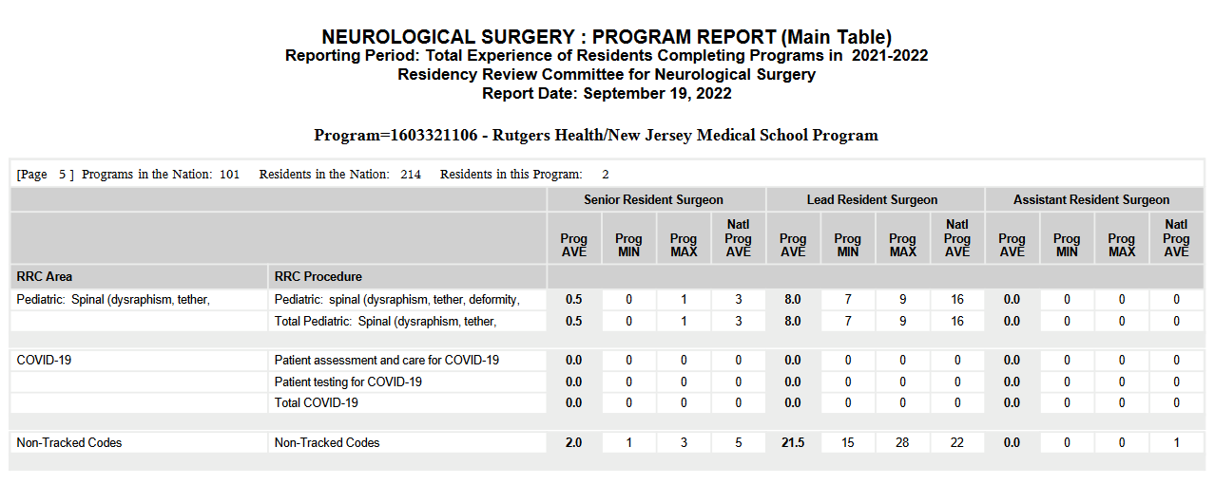
Operative Experience

Slide 24
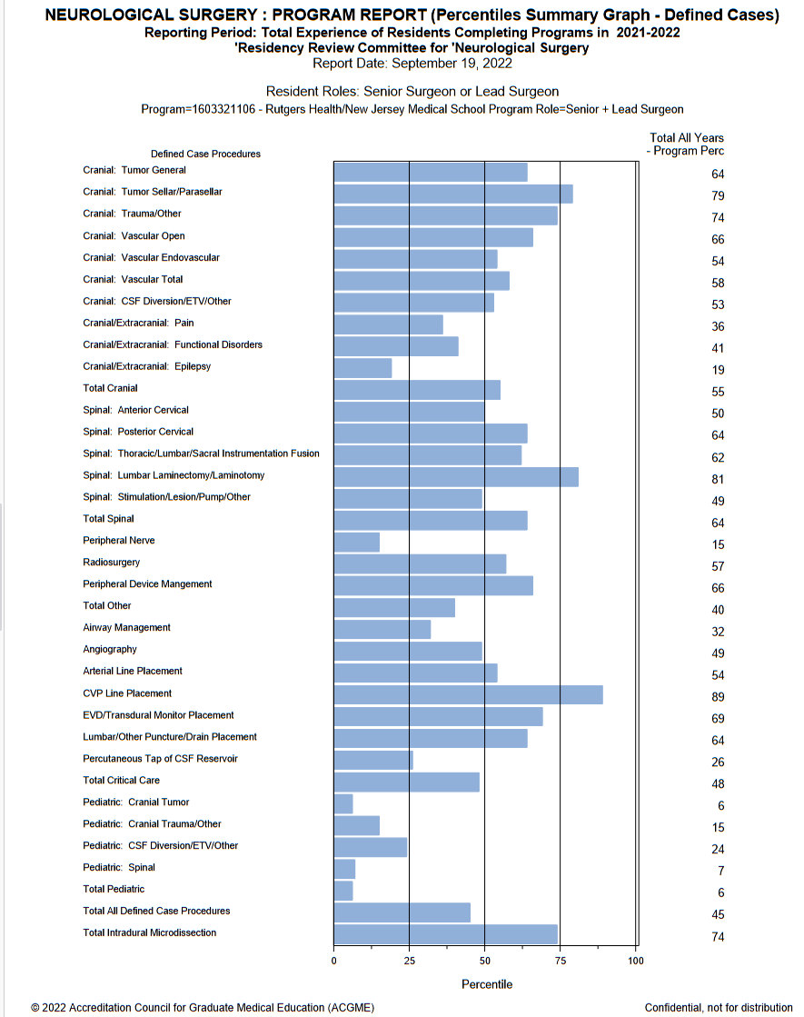
Operative Experience
(per resident; excludes PGY5)
Operative volume below average:
Epilepsy
Pain
Functional
Peripheral Nerve
Pediatrics
Operative volume above average:
Tumor
Skull Base
Trauma
Vascular
Endovascular
Spine
Radiosurgery
Critical Care
Microdissection

Slide 25
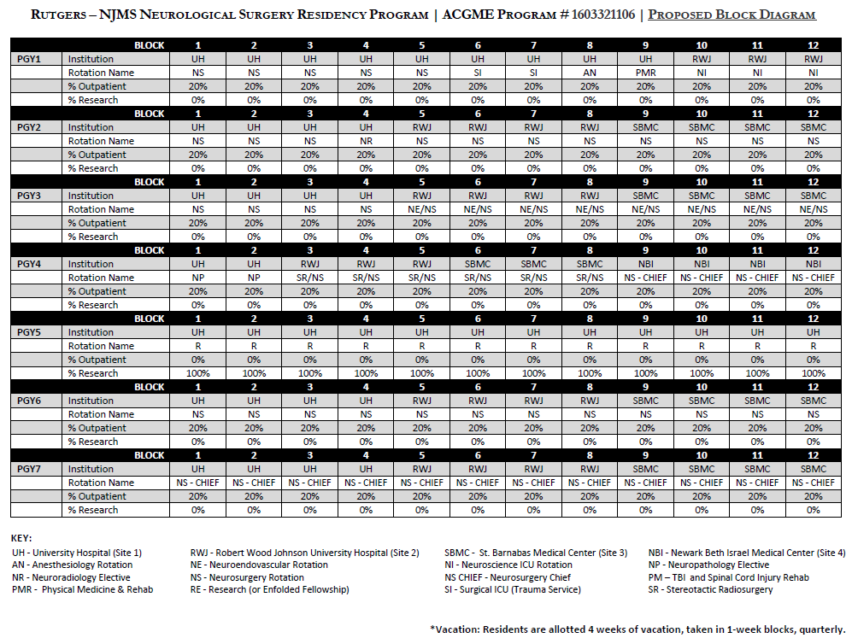

Slide 26
PGY-1 neurosurgery, neuro ICU and neuroscience, SICU, PMR and anesthesia
PGY-2 neurosurgery and diagnostic neuroradiology
PGY-3 neurosurgery and endovascular
PGY-4 neurosurgery – transition to senior call, neuropathology, time for boards study
PGY-5 elective
PGY-6 senior neurosurgery
PGY-7 chief residency

Slide 27
Didactic Program:
Weekly (Summer) Cadaver Dissection Courses
Weekly Tumor Board
Weekly Lunch Conference
Biweekly Indications Conference
Monthly Neuropathology Conference
Monthly Neuroradiology Conference
Monthly Statistics and Research Methods
Monthly Grand Rounds with Visiting Professors (virtual)
Monthly Cerebrovascular Conference
Monthly Morbidity and Mortality Conference
Monthly Journal Club at Chairman’s Home
Monthly Interdisciplinary Spine Case Conference (at restaurant)
5th Wednesday Wellness

Slide 28
Education
PGY-5 Research Year – Dr. Hai Sun
  Basic Science Research - encouraged
  Clinical Enfolded Fellowships
  Advanced Degree
Regional and National Meetings – podium presentations
Woods Hole/RUNN course
Board Prep Courses

Slide 29
Departmental Research Facilities
Dr. Sun lab: DOD funded, post-traumatic epilepsy (RWJ)
Tim Reynolds Family Lab: SCI modelling and neuroprotection (NJMS)
Dr. Boison lab: NIH funded, neuroprotection via endogenous adenosine(RWJ)
Dr. Chitravanshi lab: NIH funded, CNS regulation of CV and respiration (NJMS)
Vesalius anatomic lab
HOPE Outcomes Analysis Center (SBMC)

Slide 30
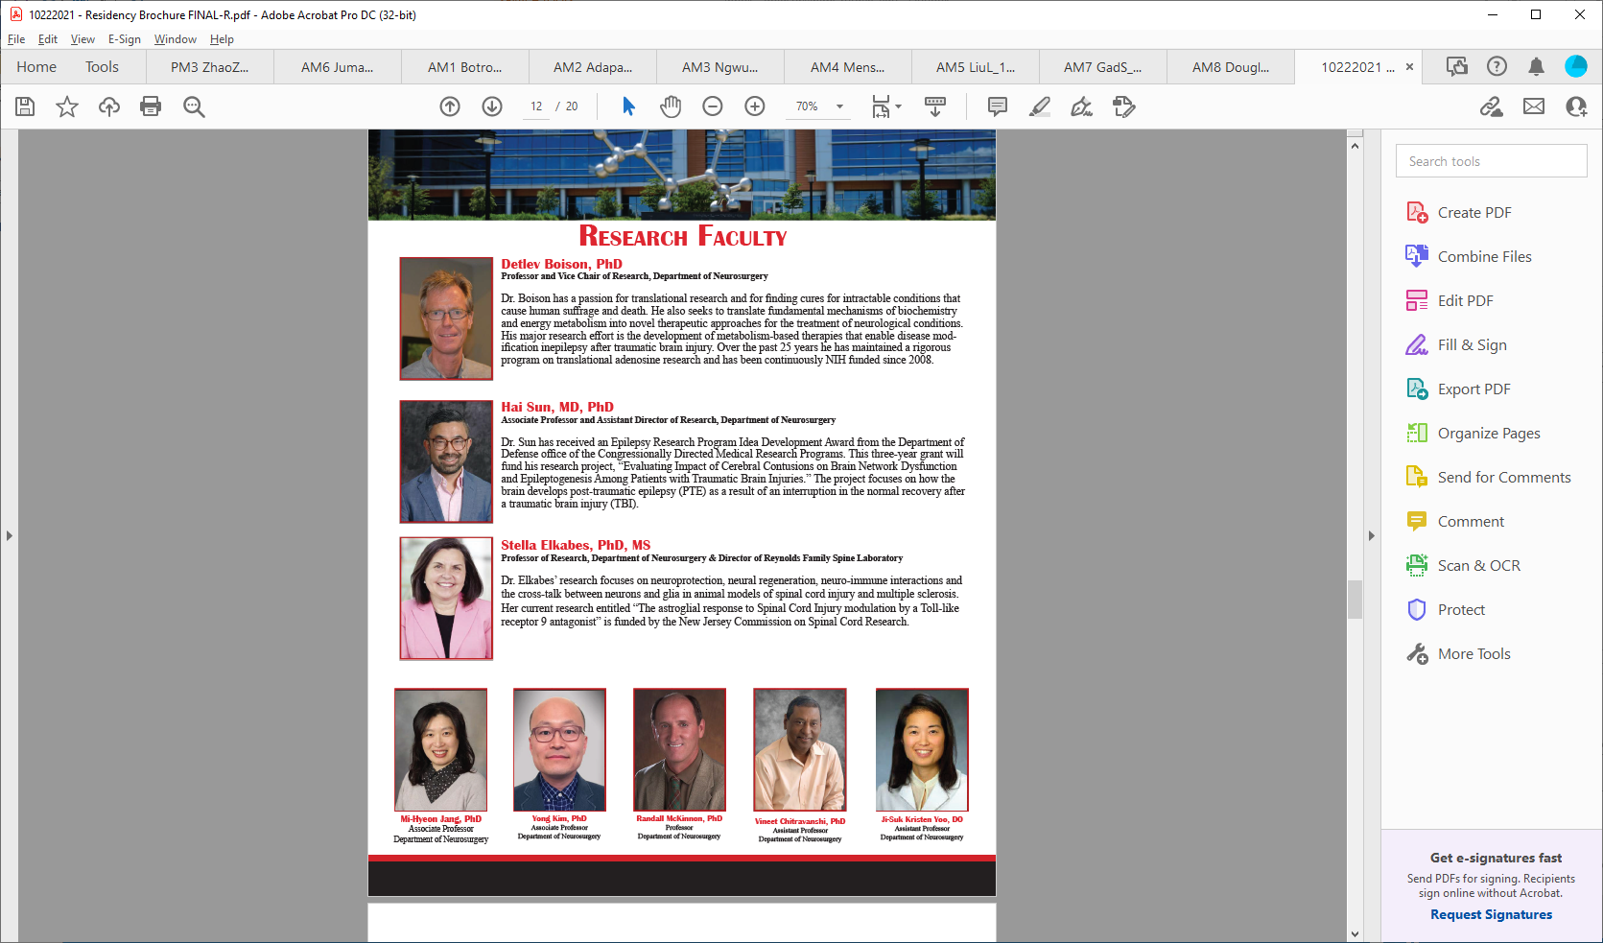
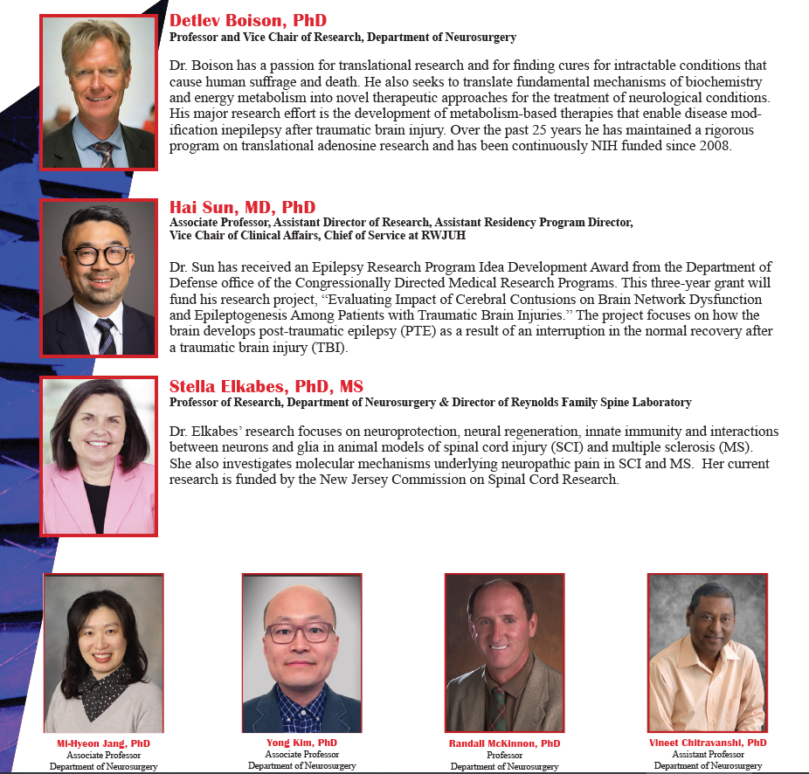
Research faculty:

Slide 32
Additional Research Facilities
Nelson Biology Labs
Keck Center for Spinal Cord Injury (Keck SCI)
Center for Advanced Bio and Medicine (CABM)
School of Public Health (Rutgers SPH)
Rutgers Biomedical Engineering
Cancer Institute of New Jersey (CINJ)
Child Health Institute (CHI)
Princeton Neuroscience Institute (PNI)
All of these facilities have active research in neural stem cells, molecular biology, neurogenetics, brain machine, neurooncology, and others.

Slide 33
Pillars of Neurosurgical Training:
Clinical Excellence
Education
Academic Contribution
Professional Development and Mentorship
Leadership

