Slide 1
Northwell Neuroscience Institute Donald and Barbara Zucker School of Medicine at Hofstra/Northwell
Michael Schulder, MD
Program Director

Slide 2
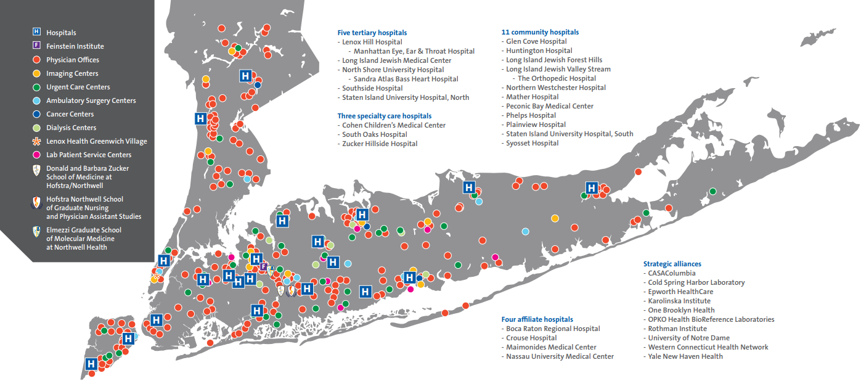

Slide 3
Northwell Health Hospitals
North Shore University Hospital
Long Island Jewish Medical Center
Cohen Children’s MC
Lenox Hill Hospital
South Shore University Hospital
Staten Island University Hospital
Forest Hills Hospital
Glen Cove Hospital
Huntington Hospital
LIJ Valley Stream Hospital
Northern Westchester Hospital
Peconic Bay Medical Center
Phelps Memorial Hospital
Plainview Hospital
South Oaks Hospital
Syosset Hospital
Zucker-Hillside Hospital

Slide 4
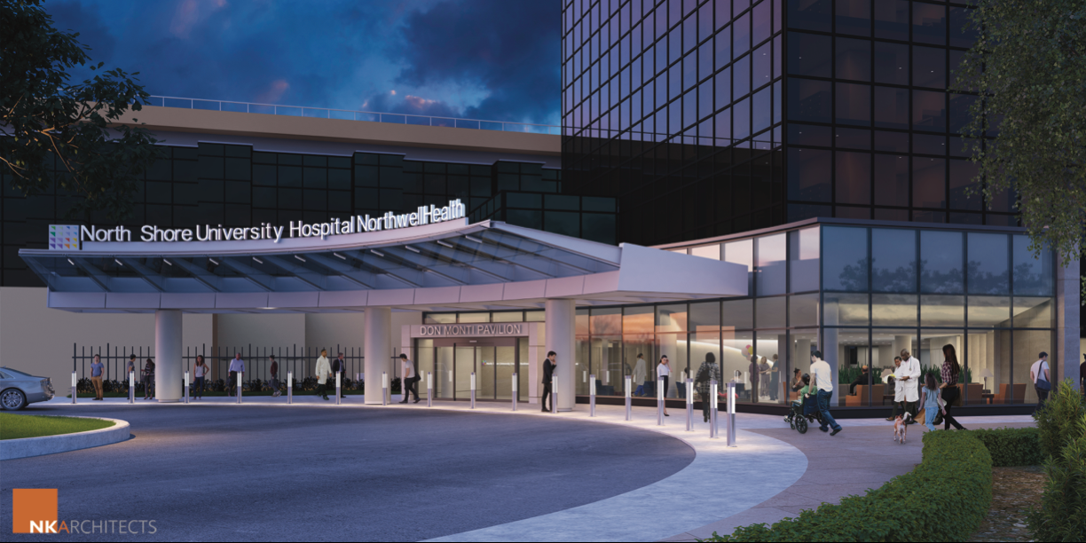
North Shore University Hospital
The “Mothership”
16-bed Neurosurgical ICU with full-time Neurointensivist presence
Level 1 Trauma Center
Comprehensive Stroke Center
New Surgery and ICU Pavilion under construction

Slide 5
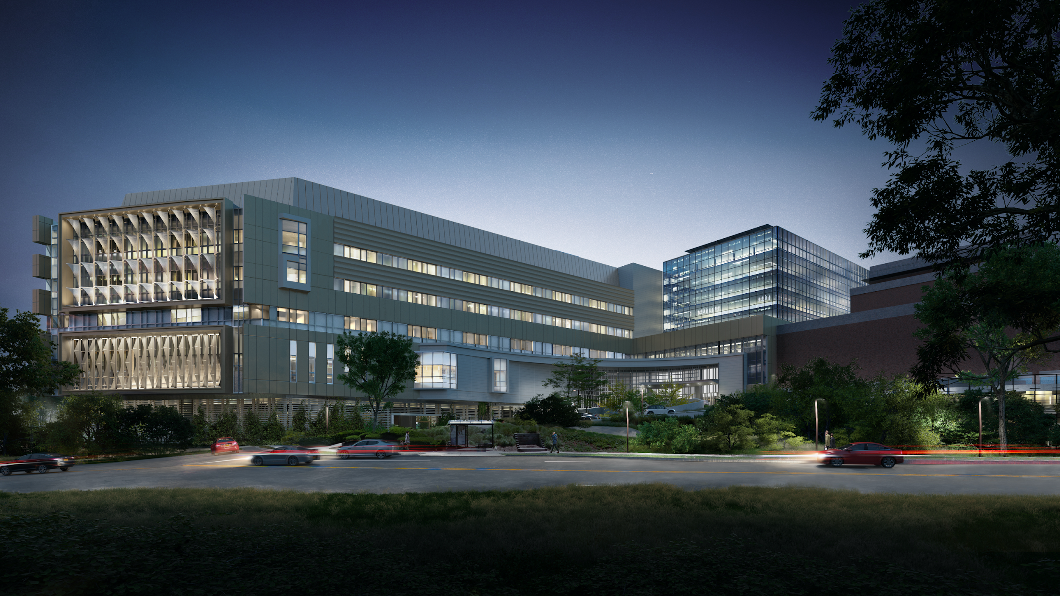
Petrocelli Advanced Surgical Pavilion (ASP) – February 2024

Slide 6
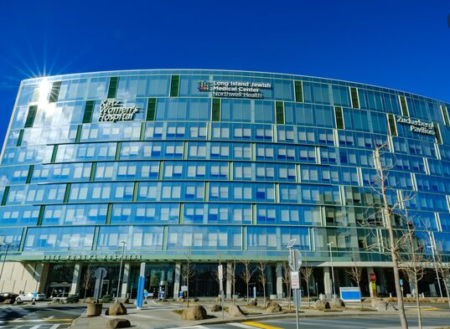
Long Island Jewish Medical Center
1.8 miles south of NSUH
Full complement of experienced PAs
Becoming the primary site for medical and surgical oncology

Slide 7
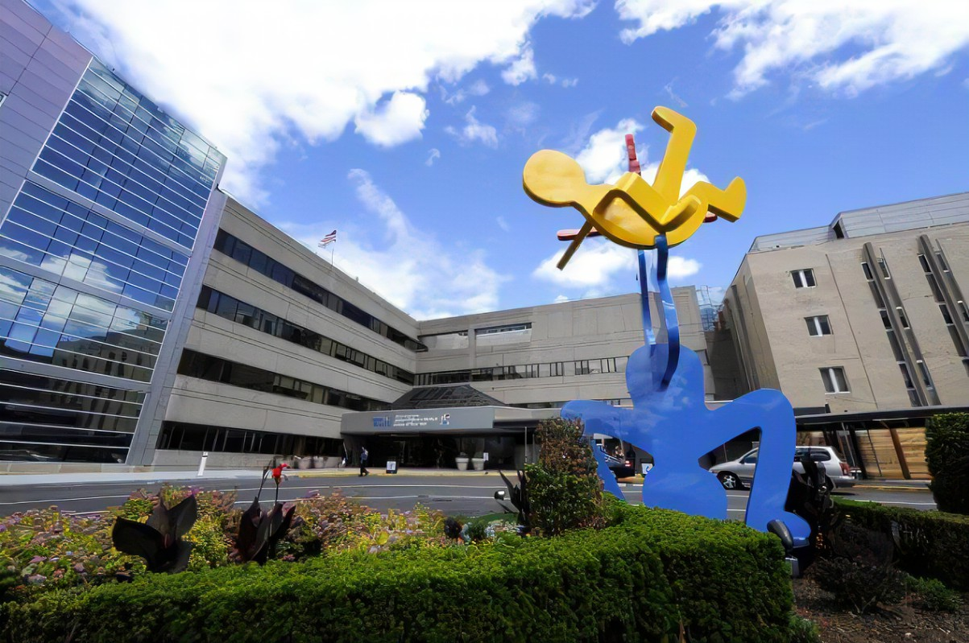
Cohen Children’s Medical Center
Physically connected to LIJMC
3 full-time pediatric neurosurgeons

Slide 8
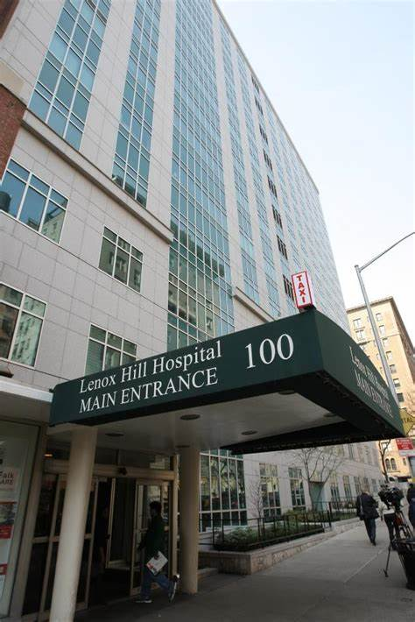
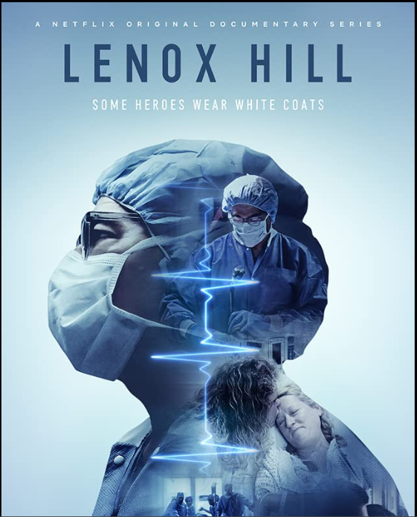
Lenox Hill Hospital
Major new construction and new hospital planned
Notes:
We are one of two neurosurgical training programs in the country, along with the Cleveland Clinic, where the residents train at three top 50 hospitals as ranked by US News & World Report.

Slide 9
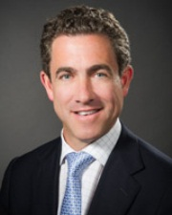
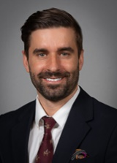
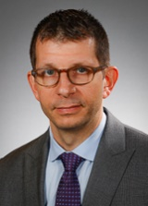
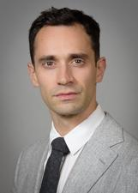
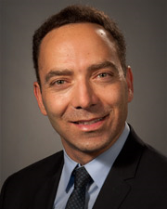
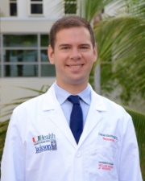
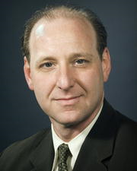
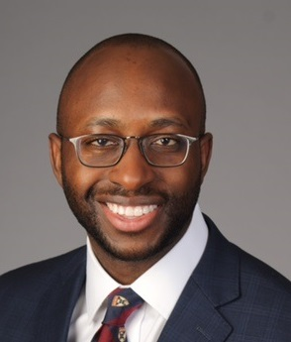
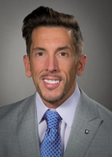
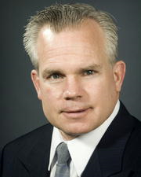
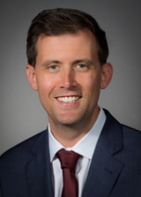
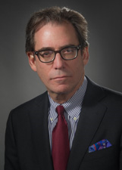
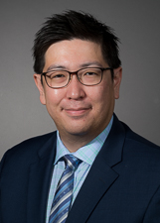
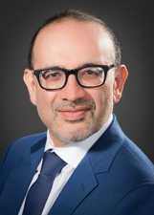
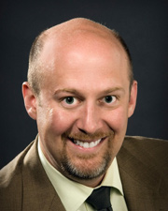
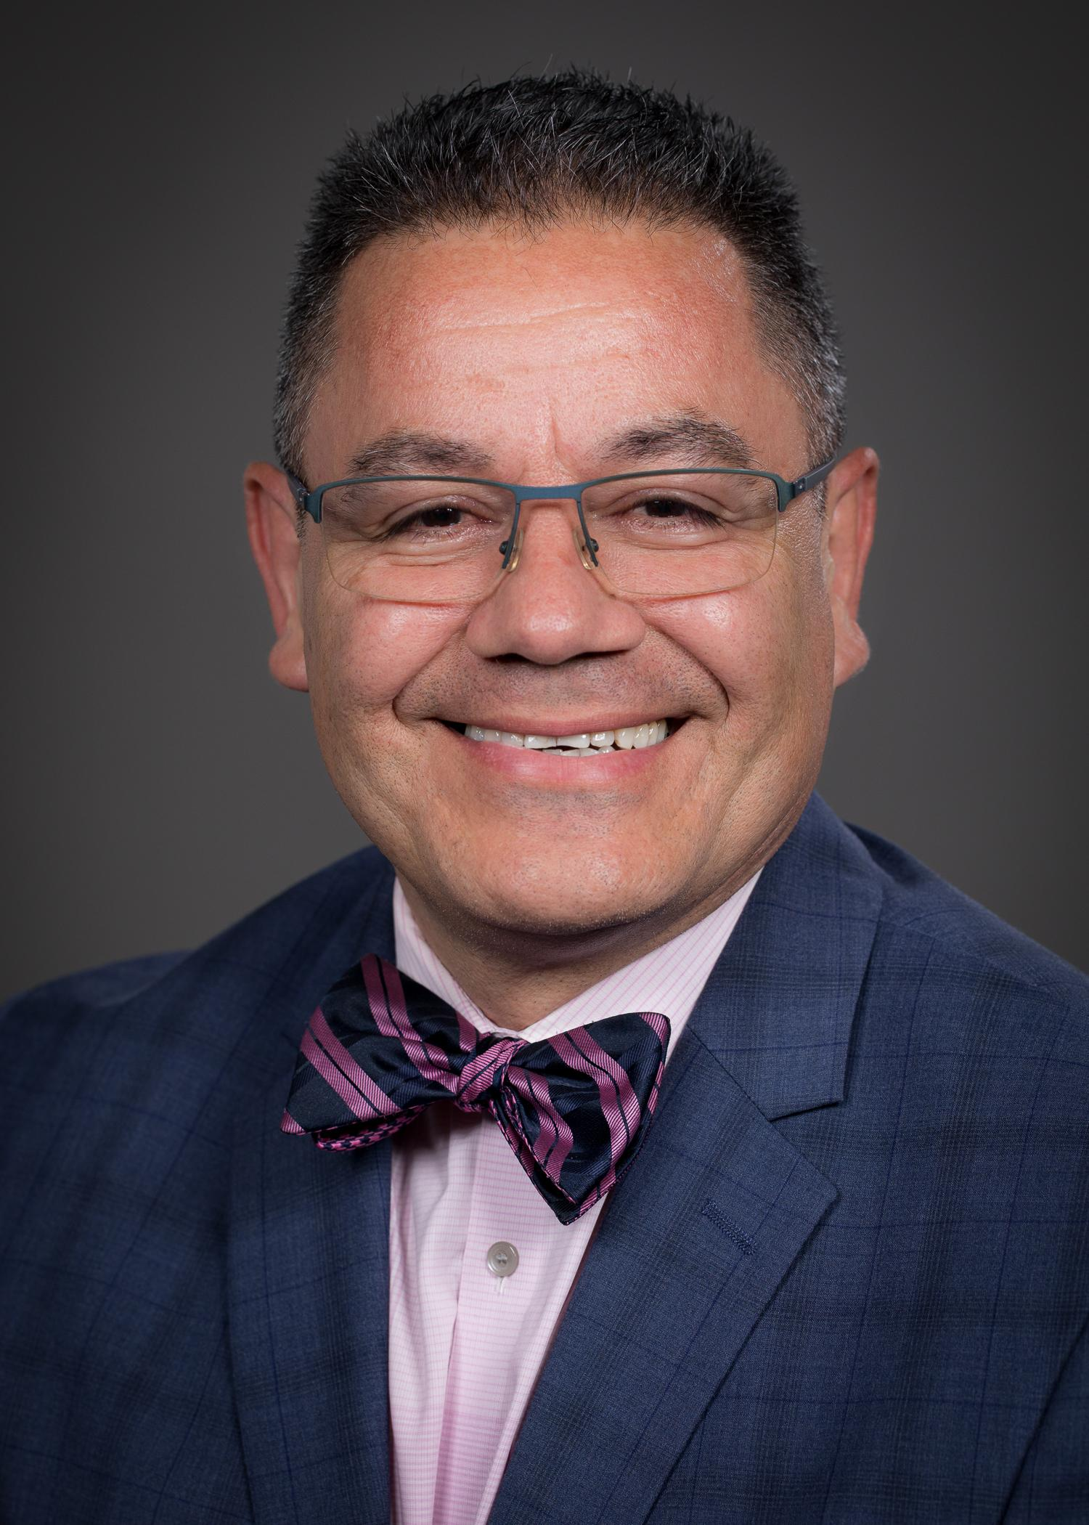
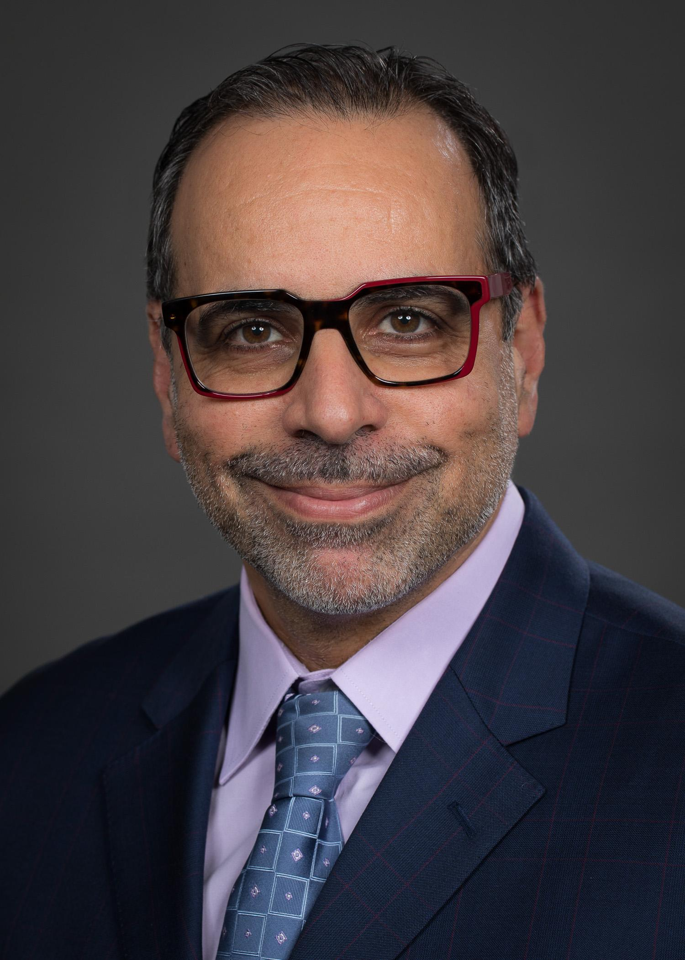
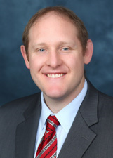
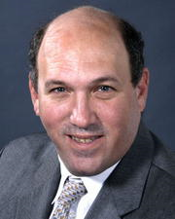
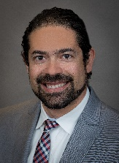
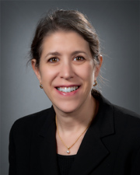
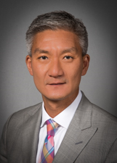
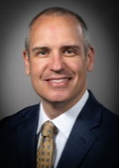
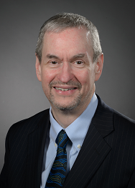
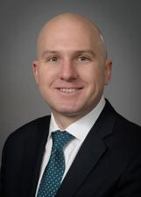
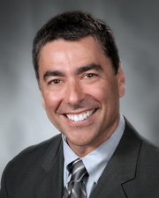
Neurosurgery Faculty
John Boockvar
Netanel Ben-Shalom
John Caridi
Randy D’Amico
Amir Dehdashti
Daniel Eichberg
Mark Eisenberg
Jason Ellis
Albert Fenoy
Peter Hollis
Thomas Link
Mitchell Levine
Larry Lo
Ashesh Mehta
Mark Mittler
Jaime Nieto
Athos Patsalides
Shaun Rodgers
Steven Schneider
Hesham Soliman
Jamie Ullman
Henry Woo
Daniel Sciubba, MD
Chair
North Shore University Hospital
Long Island Jewish Medical Center
Michael Schulder, MD
Vice Chair &
Residency Program Director
Griffin Baum, MD
Associate Program Director
David Langer, MD
Chair
Lenox Hill Neurosurgery

Slide 10
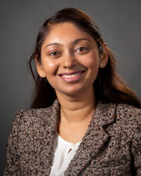
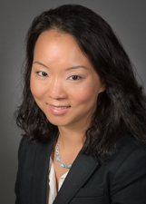
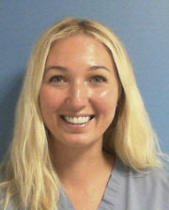
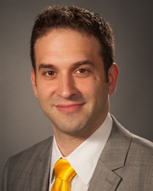
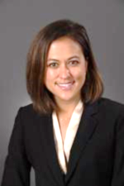
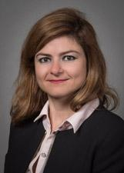
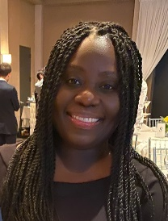
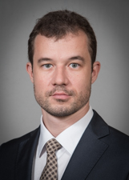
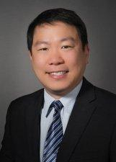
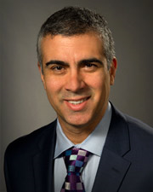
Neurointensivists
Celine DeMatteo
Jung Min Kim
Darya Khazanova
Zachary D. Levy
Krista Lim-Hing
Tanya Rebeiz
Kenia Samuel
Tagir Sabirov
Heustein Sy
Richard E. Temes
Director, Neurocritical Care
Northwell Health

Slide 11
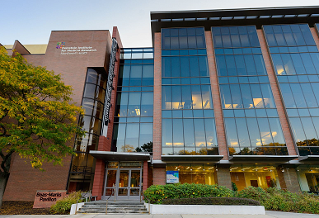
Feinstein Institutes for Medical Research
Established in 1999
Research campus for the Northwell Health System
Elmezzi Graduate School of Molecular Medicine
Ranks in top 6th percentile of NIH grants
Neurosciences
Psychiatry
Immunology and Autoimmune
Genetics
Oncology & Hematology

Slide 12
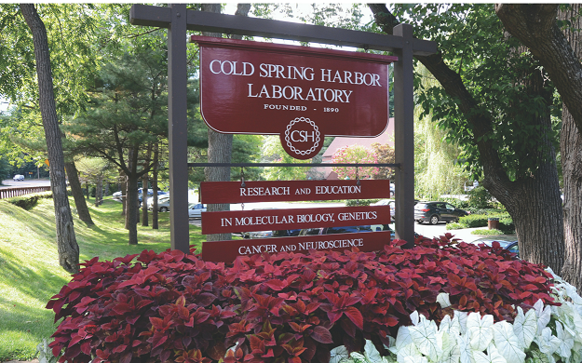
Cold Spring Harbor Laboratory
Established in 1890
>600 Researchers and Technicians
15 in Neuroscience and 38 in Cancer, including Brain Tumor Biology
8 Nobel Laureates
NCI-designated Cancer Center
School of Biological Sciences PhD Program
$177 million Operating Budget, Endowment $810 million, Annual Research Budget $125 million
30 Minutes from NSUH Campus
3 residents recently completed 2-year projects at CSHL
Other labs dedicated to genetics/epigenetics of brain tumor biology
Oncology labs being expanded

Slide 13
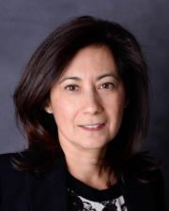
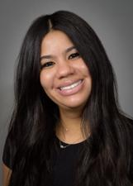
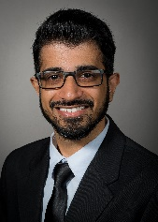
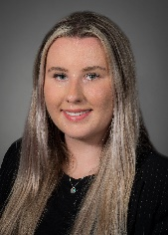
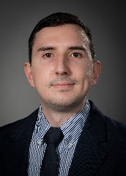
Division of Clinical Research
NSUH Research Team
LHH Research Team
Betsy Moclair, RN, Director
Clinical Research Programs
North Shore University Hospital
Tamika Wong, Director
Clinical Research Programs
Lenox Hill Hospital
Ajith Vellat
Clinical Research Coordinator
Patricia Kozikowski
Clinical Research Coordinator
Stan Ostrovskiy
Research Assistant
Imran Ali
Clinical Research Coordinator
Sanskruti Bokil
Clinical Research Project Manager
Olivia Albers
Nurse Practitioner Clinical Research
Brain Tumor Research at NSUH/LIJ
Joann Barthelemy, NP
Research Coordinator

Slide 15
Donald and Barbara Zucker School of Medicine at Hofstra/Northwell
Established March 27, 2008
Accredited by the Liaison Committee on Medical Education
First allopathic medical school in Nassau County and the first new medical school in the New York metropolitan area in more than 35 years
100% of research projects receive funding from the School of Medicine

Slide 16
Department of Neurosurgery Scholarly Activity 2017-2021

Slide 18
IR Neuro Statistics North Shore University Hospital 2022
Total # of procedures in 2022 = 1522
Stereotactic Radiosurgery 2022 = more than 300 patients treated

Slide 19
Neurosurgery Residency Program
ACGME Accredited July 9, 2010
First resident started in July 2011
Received first complement increase to 2 residents per year in 2015
Received an additional complement increase in 2021 for a total of 18 residents.
Based at North Shore University Hospital, Long Island Jewish Medical Center, Cohen Children’s MC, and Lenox Hill Hospital

Slide 20
2023-24 Academic Year
Neurosurgery Residents
Danielle Golub
New York University School of Medicine
Audrey Grossen
The University of Oklahoma
Alon Kashanian
American Program at Tel Aviv University Faculty of Medicine
Shyle Mehta
Drexel University College of Medicine
Jung Park
University of Iowa Carver College of Medicine
Jacob Gluski
Wayne State University School of Medicine
James Duehr
University of Pittsburgh
Sebastian Hajtovic
CUNY School of Medicine
Daniel Schneider
University at Buffalo School of Medicine
Miriam Shao
Albany Medical College
Daniel Toscano
Georgetown University School of Medicine
Justin Turpin
Sidney Kimmel College at Thomas Jefferson University
Prashin Unadkat
K J Somaiya Medical College & Research Center
Max Ward
Rutgers New Jersey Medical School
Cassidy Werner
Tulane University School of Medicine
Timothy White
Zucker School of Medicine at Hofstra/Northwell

Slide 21
Training Program Rotations
Training Year | Months of Training | Facility
PGY 7 | 12 Months Neurological Surgery | NSUH**
PGY 6 | 12 Months Neurological Surgery | 6 Months NSUH/6 Months LHH**
PGY 5 | 12 Months Research or Advanced Training/Research Neurosurgery Subspecialty | FIMR, CSHL, NSUH
PGY 4 | 12 Months Research | FIMR, CSHL*
PGY 3 | 3 Months Angio/9 Months Neurological Surgery | 6 Months NSUH/6 Months LIJMC
PGY 2 | 12 Months Neurological Surgery | 8 Months NSUH/4 Months LHH
PGY 1 | 2 Months Neurology/1 Month Neuroradiology/3 Months ICU/1 Month ENT/1 Month Anesthesia/1 Month Neuropathology/1 Month Peripheral Nerve & SRS/2 Months Neurological Surgery | NSUH
*Option for getting a PhD in 3 years
**Option for being Chief Resident as PGY6, with infolded fellowship as PGY7

Slide 22
Fellowships at Northwell Neurosurgery
CAST Approved Fellowships at NSUH:
Cerebrovascular Neurosurgery
Endovascular Neurosurgery
Neuro Critical Care
Neurosurgical Oncology
Neurotrauma
Spine

Slide 23
Welcome to the Zucker SOM at Hofstra/Northwell Neurosurgery Program!

