Slide 1
The essential educational and professional development partner for neurosurgeons, trainees, and industry innovators.
DARTMOUTH HITCHCOCK
NEUROSURGERY
LEBANON, NH

Slide 2
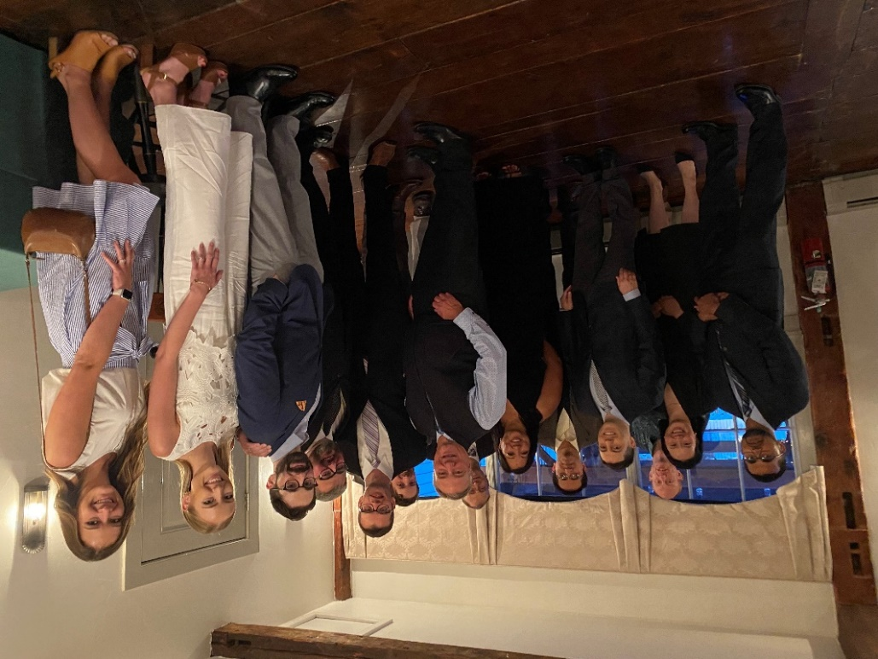
Dartmouth Neurological Surgery Residency Program
Established in 1947, our program is one of the oldest in the country. Residents in this program are respectfully treated as colleagues and are held to the highest professional standards. The collegial atmosphere, along with the program’s apprenticeship training structure, are enabled by a small, cohesive group of 7 residents and 10 faculty.
Our program covers all subspecialties: Neuro-oncology, Critical Care, Pain, Pediatrics, Peripheral Nerve, Stereotactic and Functional, Spine, Trauma, Endovascular and open Cerebrovascular

Slide 3
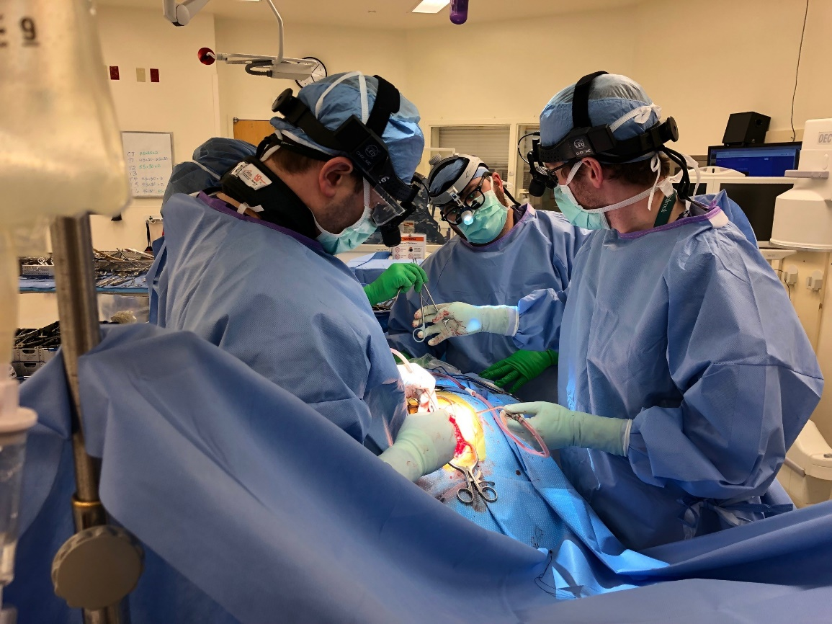
Dartmouth Neurological Surgery Residency Program
Our mission is to provide advanced neurosurgical care to our region of northern New England: we are a referral resource for subspecialty expertise across all areas of neurosurgery. We are committed to training the next generation of neurosurgeons who will enter practice as safe, competent and skillful surgeons. We believe that research is an integral part of the education of residents and the advancement of the field of neurosurgery.

Slide 4
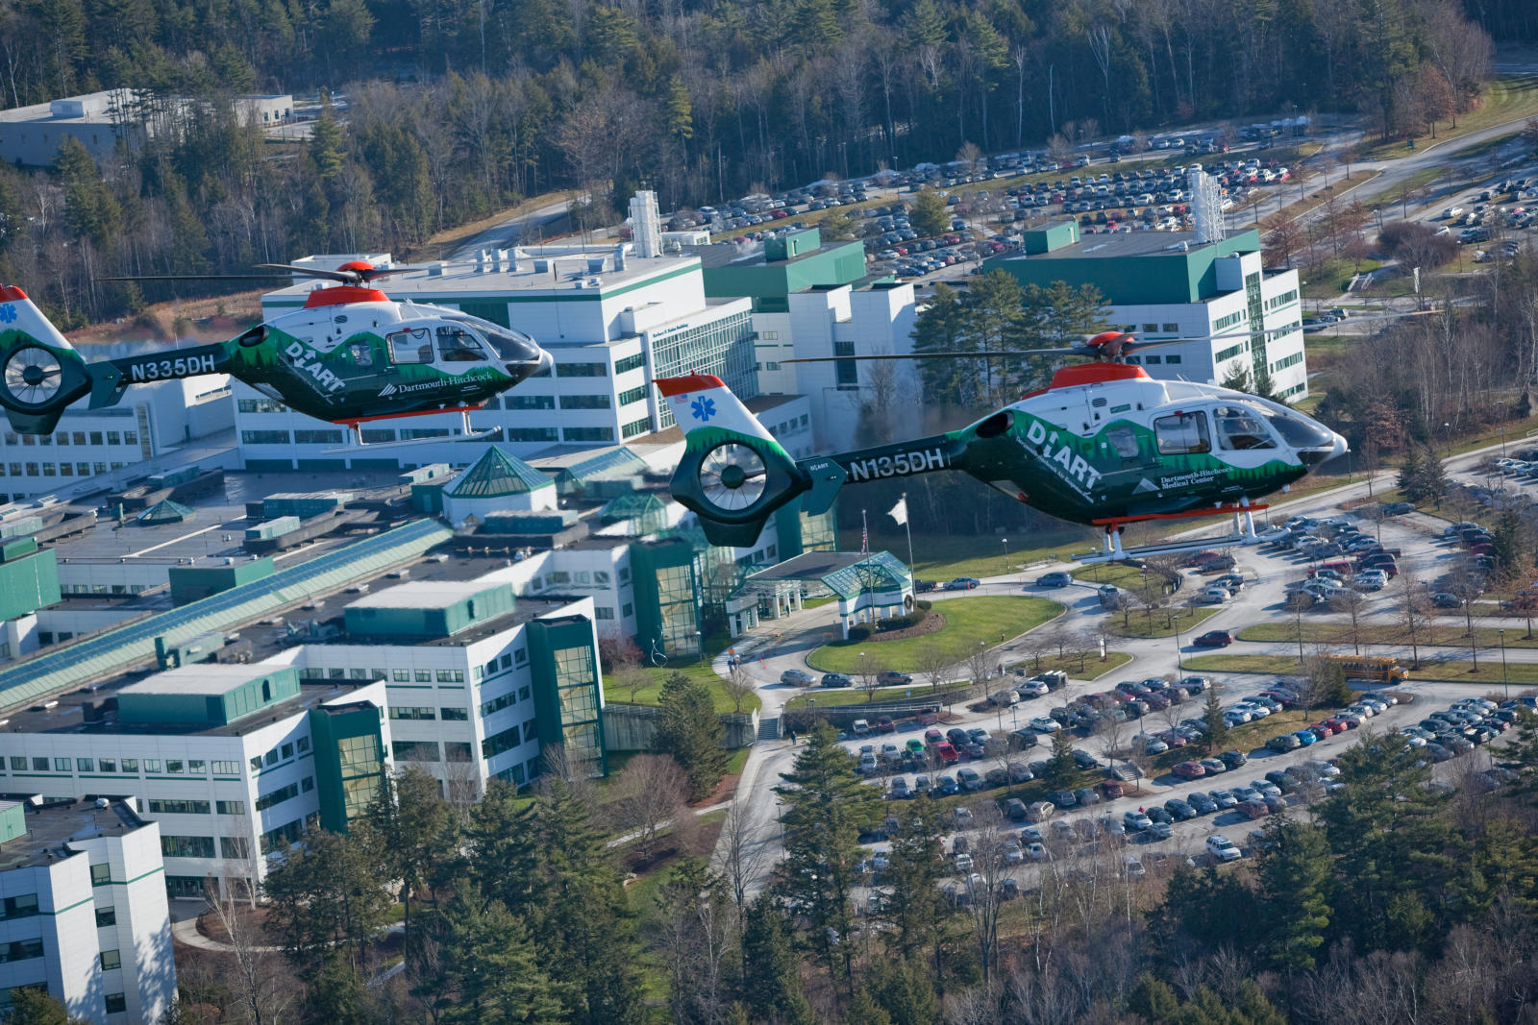
Dartmouth Neurological Surgery Residency Program
Dartmouth Hitchcock is a:
*Level 1 Trauma Center *NCI Designated Comprehensive Cancer Center
*Primary Stroke Center *Level 4 NEAC Epilepsy Center
*Children’s Hospital
We provide integral support to these programs
Currently all rotations are done on-site at
Dartmouth Hitchcock

Slide 5
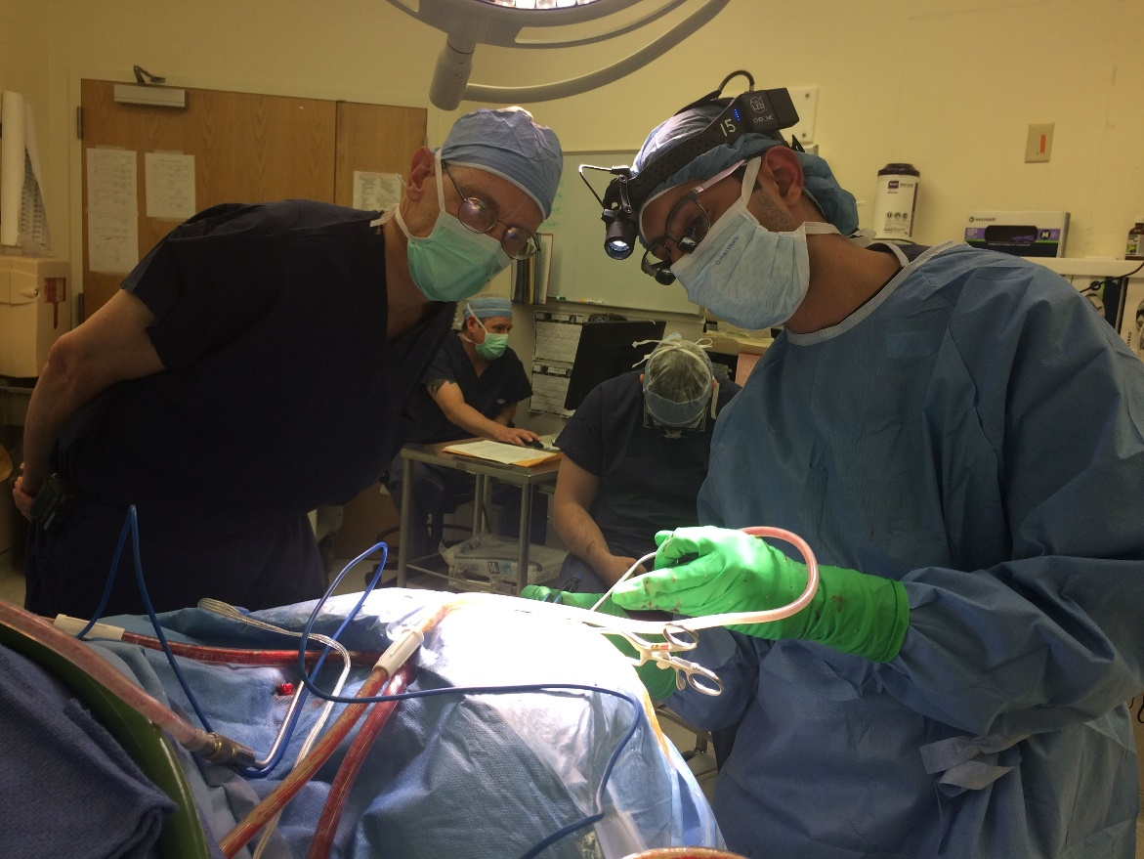
Dartmouth Neurological Surgery Residency Program
*July 1, 2021 our CAST Neuro Critical Care Fellowship welcomed its first fellow
Each of our 2021, 2022, and 2023 graduates performed well over 1,600 cases. The RC minimum required is 800.

Slide 6
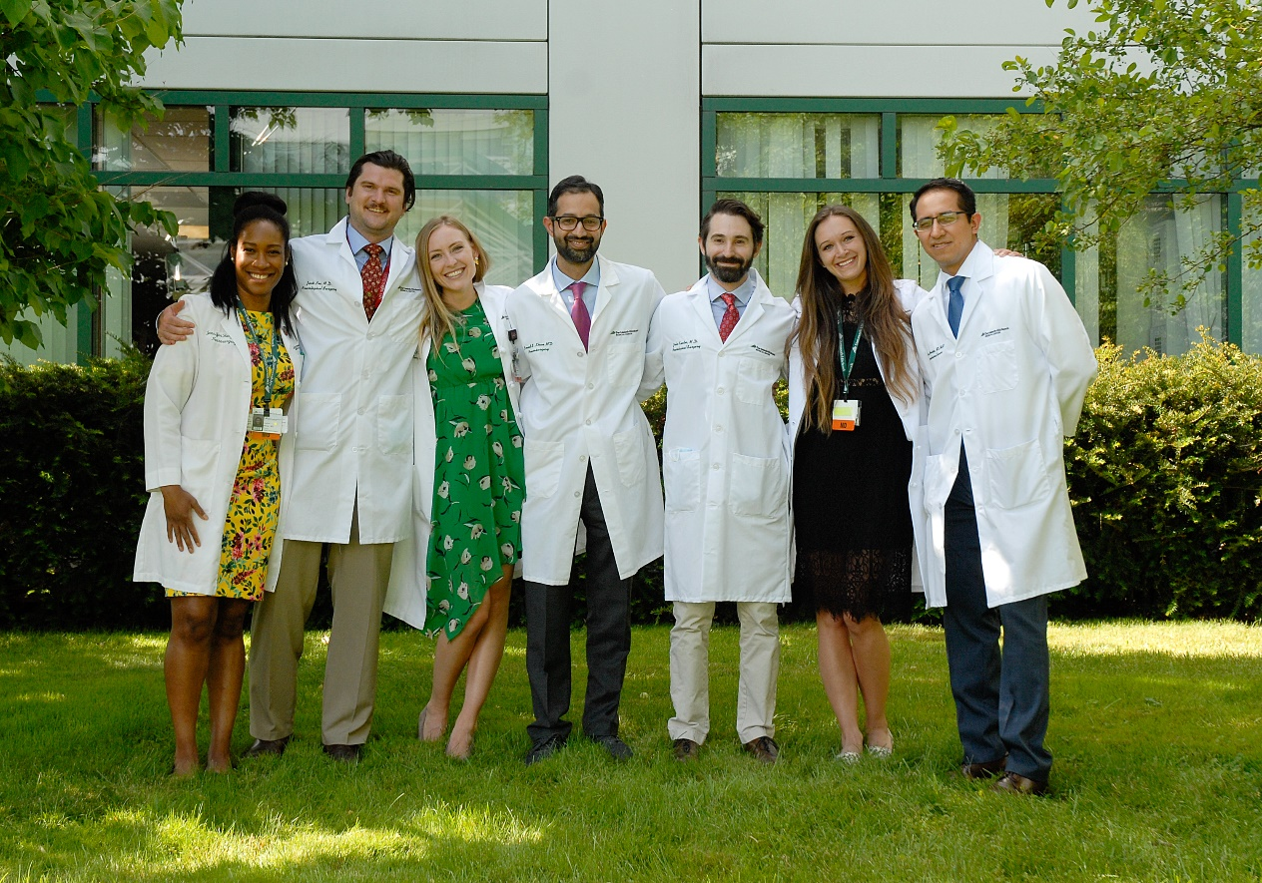
Dartmouth Neurological Surgery Residency Program
We provide each resident with:
* a hot breakfast 365 days/year
* a customized set of lead * loupes
* $300 in book money/year * $1,000 in travel funds/year

Slide 7
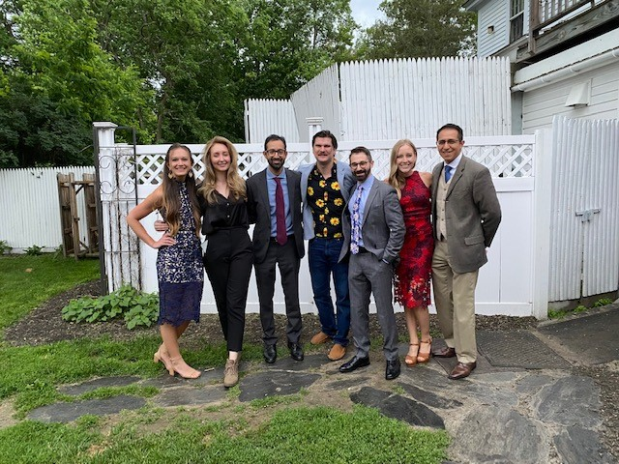
Dartmouth Neurological Surgery Residency Program
Each year our residents attend the following courses/meetings:
Intern Boot Camp * SNS Junior Resident Course
RUNN * UVM Skull Base Course
NREF Courses * SNS Senior Resident Course
AANS and CNS annual meetings

Slide 8
Dartmouth Neurological Surgery Residency Program
Visit https://gme.dartmouth-hitchcock.org/neurosurgery.html for more information and videos of our program.
Contact Tobi Cooney, Residency Program Coordinator at tobi.j.cooney@hitchcock.org

