Slide 1
The Ohio State University Department of Neurological Surgery Lauren Schulz, MD Program Director: Andrew J. Grossbach, MD FAANS Program Coordinator: Sarah Hancock

Slide 2
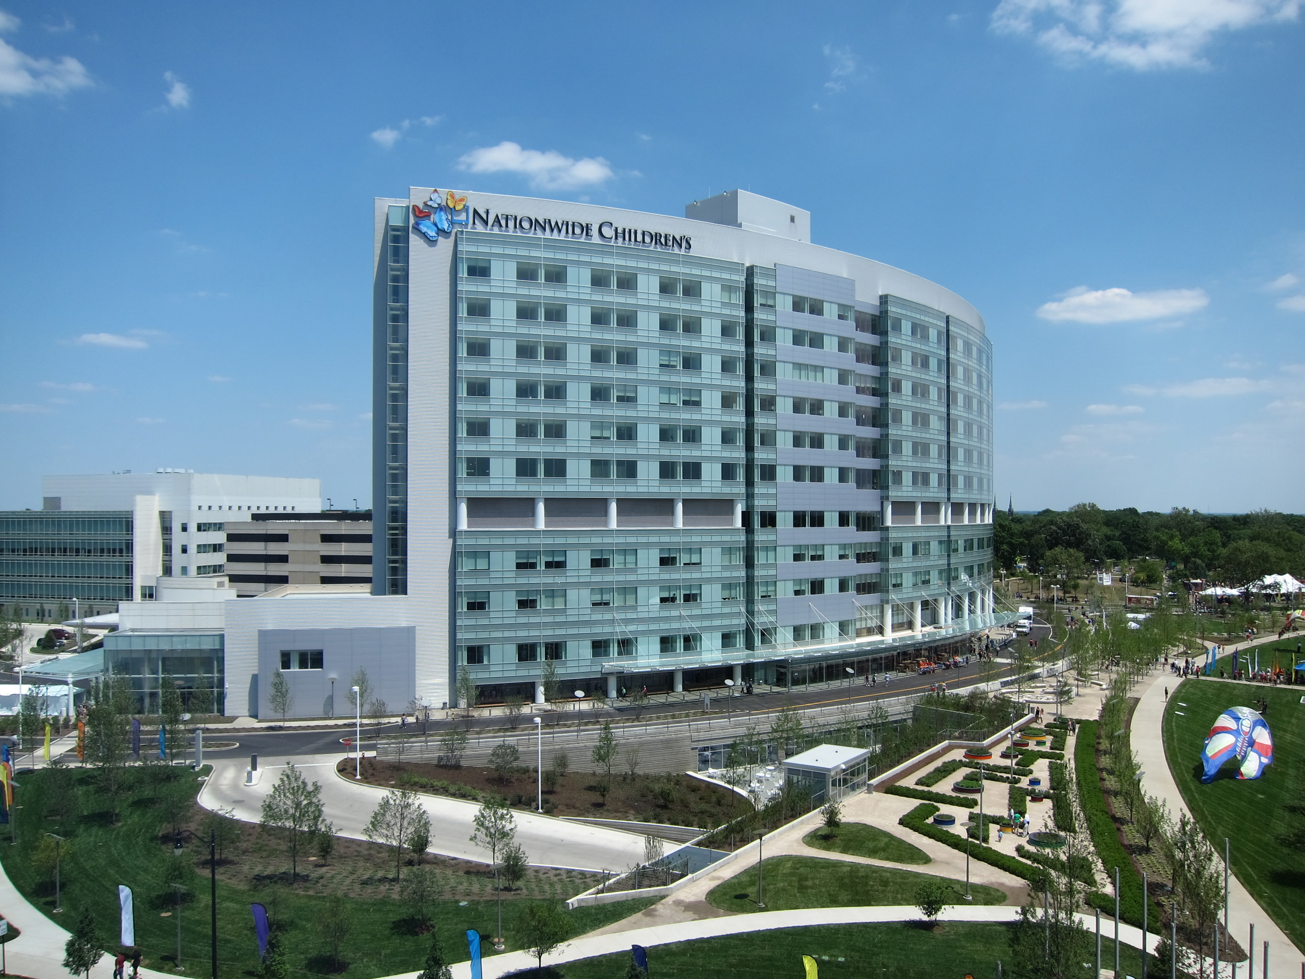
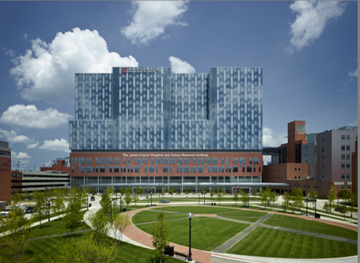
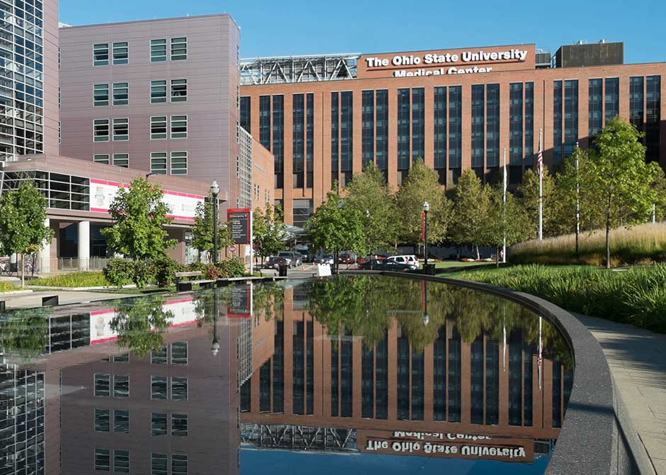
Neurological Surgery
Nationwide Children’s
James Cancer Center
University Hospital

Slide 3
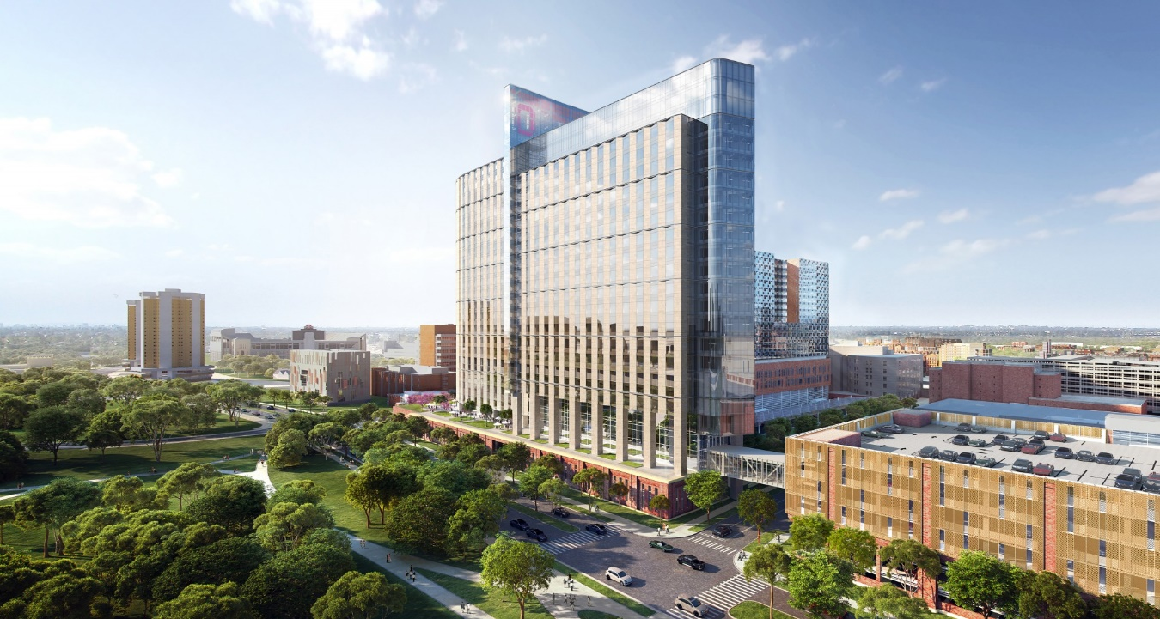
Neurological Surgery
New Tower 2026
New Tower
James Cancer Center
University Hospital
16 Neurosurgery (non-tumor) block/day
4 Neurosurgery (tumor) block/day

Slide 4
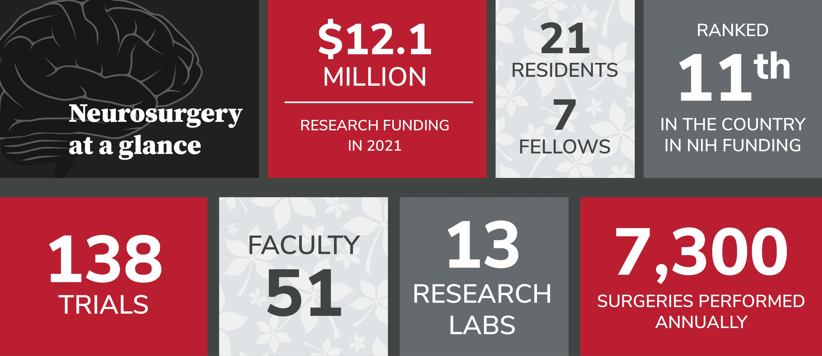
Training

Slide 5
Program Summary
3 residents per year
Bulk of training at one site
University Hospital/James Cancer Center
Rotations at Nationwide Children’s
4 months PGY 2 and PGY 3
Didactic Conferences
Weekly Grand Rounds
Weekly Case Conference
Monthly Journal Club
Yearly Cadaver labs & Skull Base Course

Slide 6
Program Summary
Great clinical experience (early autonomy)
Subspecialty focused faculty with international reputations
Large comprehensive and unique research platform
2 years focused research
Can be clinical or basic science

Slide 7
Have Questions?
Sarah Hancock
Program Coordinator
Sarah.Hancock@osumc.edu
Lauren Schulz
PGY-4
Lauren.Schulz@osumc.edu

