Slide 1
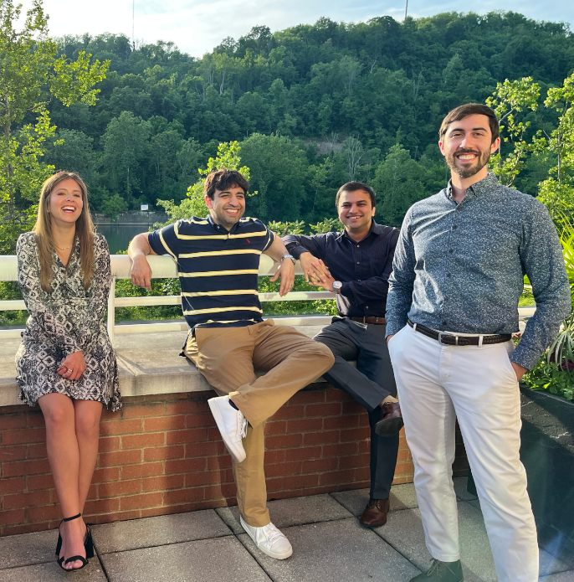
Neurosurgery Residency Program
Cara Sedney MD

Slide 2
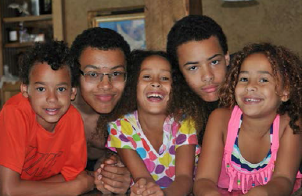
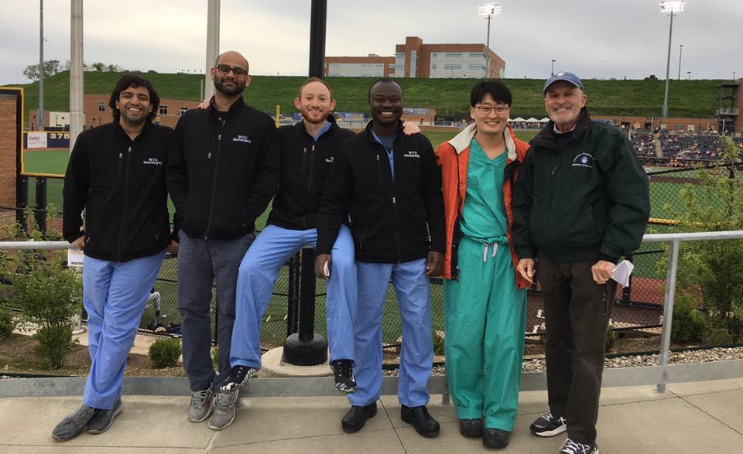
Our Program
Tradition of Excellence since 1966
Family Friendly (also single-friendly)
Diverse
Supportive Atmosphere
Notable Grads:
  Ossama Al-Mefty
  Regis Haid
  Vincent Traynelis
  Vikram Prabhu

Slide 3
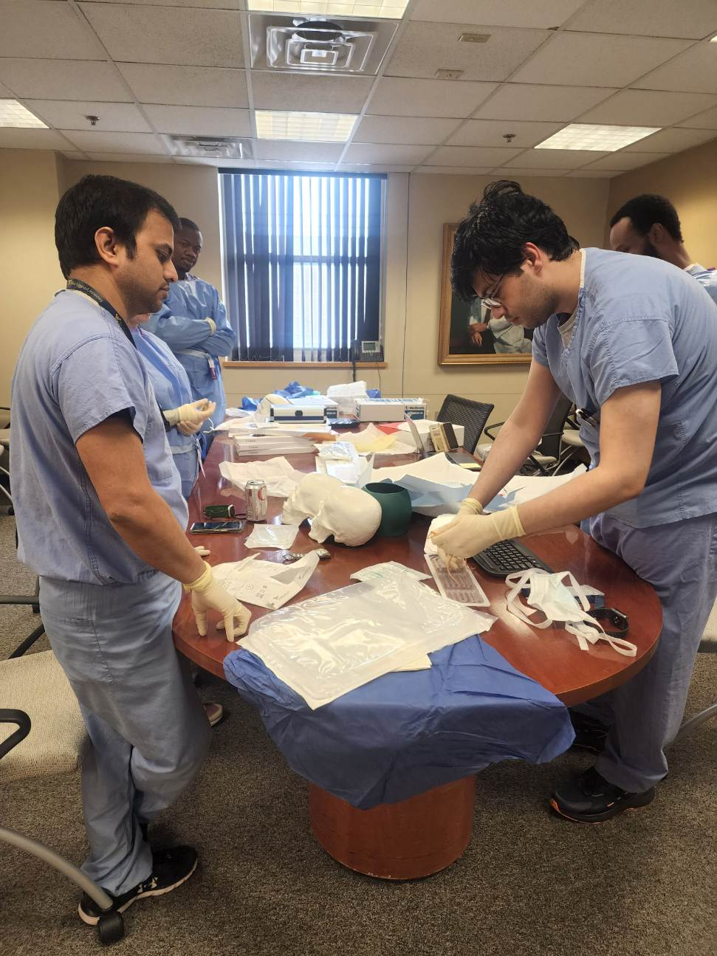
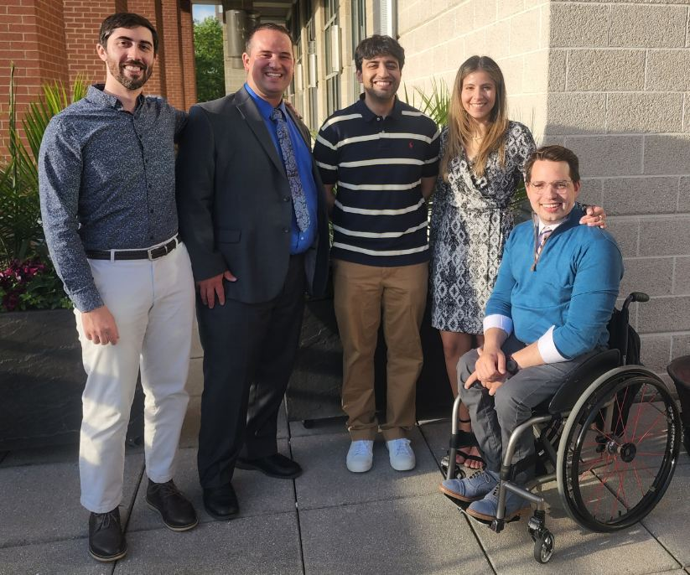
Philosophy
Mentorship + Didactics
Mutual Commitment to Training
Graduated Responsibility
Resident Goal-Driven

Slide 4
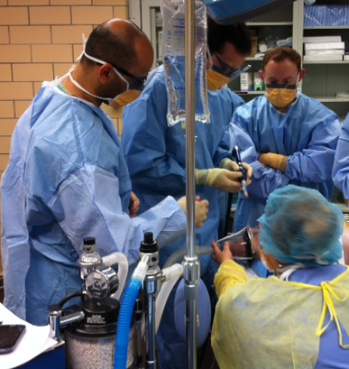
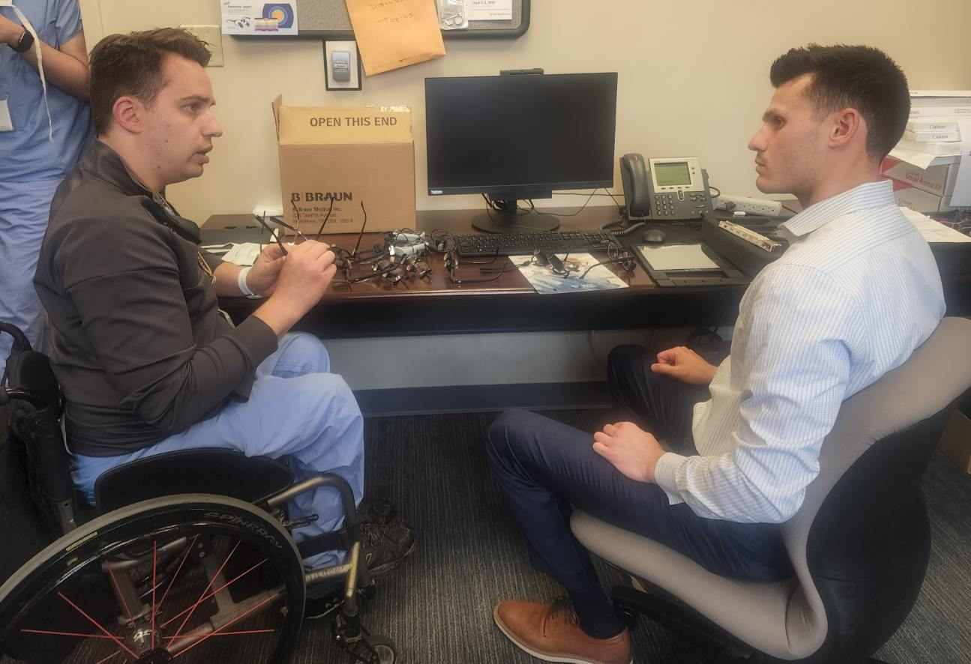

Didactics
1 hour on Wednesdays, 4-6 hours on Fridays
Subspecialty Conferences
Lab training

Slide 5
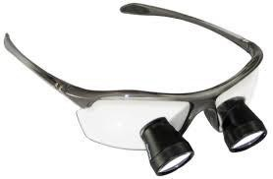
Perks
Generous Book Fund ($1500/yr)
Loupes
Meal Card ($630/6 mo)
Meeting attendance and professional days
Courses (Boot camp 1 and 2, RUNN, Washington Board Review Course (ANOVA), Chicago boards course, AANS courses – aggressive nomination, variety of skull base courses, Coding course, Oral Board prep)
Commitment to your success

Slide 6
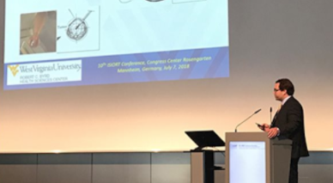
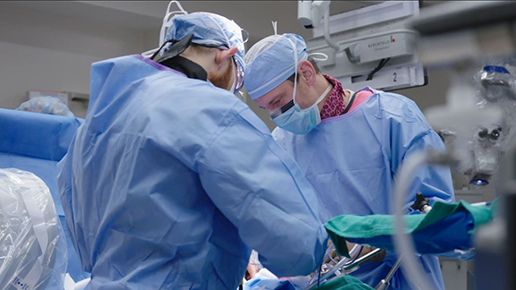
Faculty
Subspecialty training in skull base, vascular, functional, spine, pediatrics
Variety of intraoperative teaching styles
Variety of training backgrounds
Leadership positions national/international organizations
Variety of active research endeavors

Slide 7

Why WVU?
Case volume/resident ratio
Operative autonomy
Case variety & varied training
Subspecialty excellence
Flexibility
Ease/cost of living
Departmental support
Period of unprecedented growth

