Slide 1

CNS Virtual Residency Fair
Department of Neurological Surgery
University of California Davis
Allan R. Martin, MD, PhD, Associate Program Director
Kia Shahlaie, MD, PhD, Program Director, Chair

Slide 2
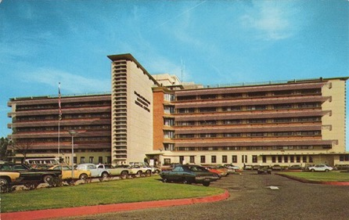
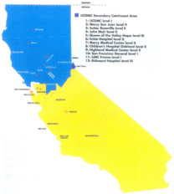
About Neurosurgery at UC Davis
Founded 1967 – Professor Julian Youmans
50+ years!
#1 Hospital in Sacramento, #36 in US in Neurosurgery/Neurology
Catchment area:
  65,000 square miles of northern and central CA
  33 counties, 6 million residents
Level 1 Adult Trauma Center
Level 1 Pediatric Trauma, Surgery Center
Comprehensive Cancer Center
650 bed hospital: 210 ED visits per day, 30,000 admissions per year

Slide 3

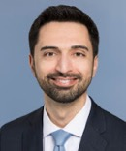
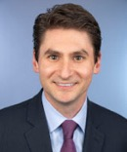
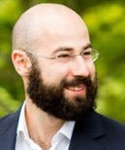
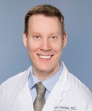
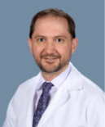
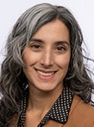
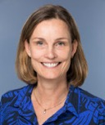

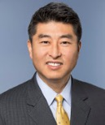
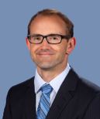
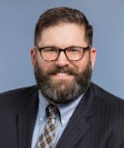
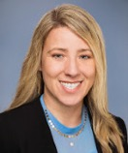
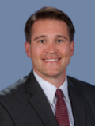
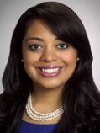
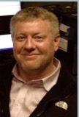
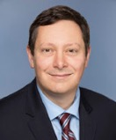
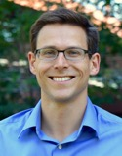
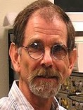
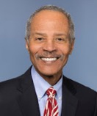
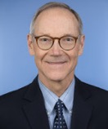
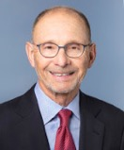
UC Davis Neurosurgery Faculty
Cranial
Vascular/Endovascular
Pediatric Neurosurgery
Spine Neurosurgery
Peripheral Nerve
?
?
Kia
Shahlaie
Orin
Bloch
David
Brandman
Ben
Waldau
Branden
Cord
Julia
Sharma
Marike
Zwienenberg
Cameron
Sadegh
Kee
Kim
Allan
Martin
Search
Underway
Search
Underway
Neuro-Critical Care
Translational Neuroscience
Emeritus/Non-Clinical
?
Ryan
Martin
Lara
Zimmermann
Jeff
Vitt
Krupa
Savalia
Patrick
Fuller
Gene
Gurkoff
Sergey
Stavisky
Bruce
Lyeth
Search Underway
James
Boggan
Griffith
Harsh
Michael
Edwards

Slide 4
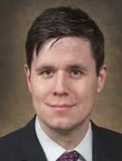
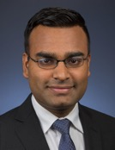
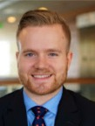
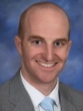
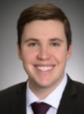
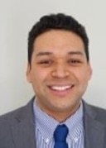
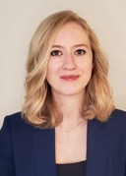
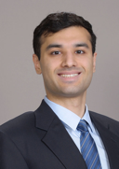
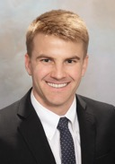
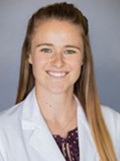
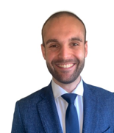
2023 UC Davis Neurosurgery Residents
PGY7
PGY6
PGY5
PGY4
PGY3
PGY2
PGY1
Dylan Goodrich
St. George
Spine
Tejas
Karnati
UPMC
Spine
Clayton
Gerndt
Wisconsin
Vascular/ Skull Base
Freddie Rodriguez
Puerto Rico
Skull Base
Jared
Clouse
Indiana
TBD
Matthew
Kercher
Nebraska
TBD
Jose Castillo
VCU
TBD
Anzhela Moskalik
Connecticut
TBD
Arash Ghaffari
Hawaii
TBD
Bob Reistenberg
NWU
TBD
Gunnar
Lee
U Hawaii
TBD
Maritza Taylor
UBuffalo
TBD
Morgan Jude
UC Davis
TBD
Paolo Palmisciano
U Catania
TBD

Slide 5
Our Clinical Programs
Program | NSG Faculty | Details
Neurovascular | Dr. Ben Waldau Dr. Branden Cord | Joint Commission Comprehensive Stroke Center, endovascular robot, CAST Endovascular Fellowship
Neurooncology | Dr. Orin Bloch | NCI Comprehensive Cancer Center (1 of 56 in the country)
Skull base Pituitary | Dr. Kia Shahlaie | NASBS Multidisciplinary Team of Distinction (1 of 2 in CA), CAST Skull Base Fellowship
Functional | Dr. Kia Shahlaie Dr. David Brandman | NAEC Level 4 Comprehensive Epilepsy Program, Parkinson’s and Huntington’s COE, cranial robot, BrainGate 2 site
Spine | Dr. Kee Kim Dr. Allan Martin | Comprehensive Spine Center (Neuro, Ortho, Pain, PM&R), MIS, deformity, spine robot, CAST Spine Fellowship (x2)
Pediatric | Dr. Marike Zwienenberg Dr. Julia Sharma Dr. Cameron Sadeh | Level 1 Children’s Surgery Center (4th in the country) ACS Level 1 Pediatric Trauma Center
Neurocritical Care | Dr. Ryan Martin Dr. Lara Zimmermann Dr. Jeff Vitt Dr. Krupa Savalia | ACS Level 1 Adult Trauma Center ACS Level 1 Pediatric Trauma Center UCNS Fellowship

Slide 6
UC Davis Neurosurgery – Program Highlights
High clinical volumes -> strong operative exposure
Close faculty involvement
Subspecialty Neurosurgery:
  Open Vascular: clipping, EC-IC bypass
  Endovascular: coiling, flow-diversion, WEB, TCAR, stroke, endovascular robot
  Skull base
  Tumor: LITT
  Functional: DBS, SEEG, SCS, Brain-Computer Interfaces, cranial robot
  Pediatric: tumor, epilepsy, hydrocephalus
  Spine: MIS, trauma, tumor, deformity, spine robot
Advanced Techniques:
  Robotics: Spine, Cranial, Endovascular
  Endovascular Robot
  MRI-guided LITT
  O-arm x 2
Positive program culture***

Slide 8
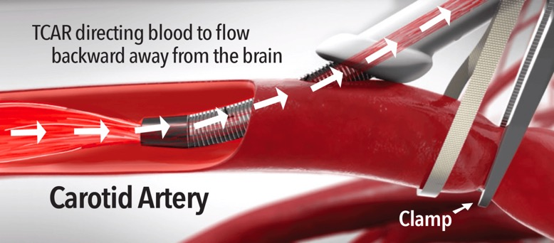
UC Davis Neurosurgery – Program Highlights
High clinical volumes -> strong operative exposure
Close faculty involvement
Subspecialty Neurosurgery:
  Open Vascular: clipping, EC-IC bypass
  Endovascular: coiling, flow-diversion, WEB, TCAR, stroke, endovascular robot
  Skull base
  Tumor: LITT
  Functional: DBS, SEEG, SCS, Brain-Computer Interfaces, cranial robot
  Pediatric: tumor, epilepsy, hydrocephalus
  Spine: MIS, trauma, tumor, deformity, spine robot
Advanced Techniques:
  Robotics: Spine, Cranial, Endovascular
  Endovascular Robot
  MRI-guided LITT
  O-arm x 2
Positive program culture***

Slide 9
UC Davis Neurosurgery – Program Highlights
High clinical volumes -> strong operative exposure
Close faculty involvement
Subspecialty Neurosurgery:
  Open Vascular: clipping, EC-IC bypass
  Endovascular: coiling, flow-diversion, WEB, TCAR, stroke, endovascular robot
  Skull base
  Tumor: LITT
  Functional: DBS, SEEG, SCS, Brain-Computer Interfaces, cranial robot
  Pediatric: tumor, epilepsy, hydrocephalus
  Spine: MIS, trauma, tumor, deformity, spine robot
Advanced Techniques:
  Robotics: Spine, Cranial, Endovascular
  Endovascular Robot
  MRI-guided LITT
  O-arm x 2
Positive program culture***

Slide 10
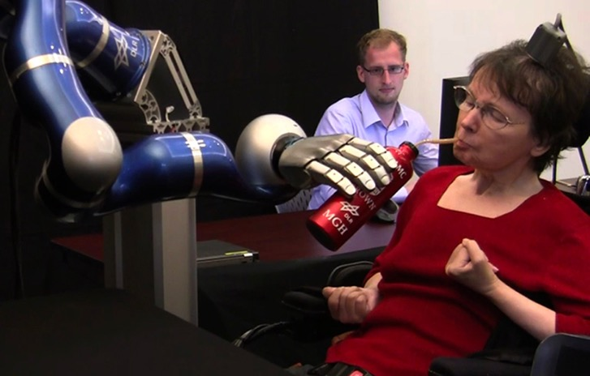
UC Davis Neurosurgery – Program Highlights
High clinical volumes -> strong operative exposure
Close faculty involvement
Subspecialty Neurosurgery:
  Open Vascular: clipping, EC-IC bypass
  Endovascular: coiling, flow-diversion, WEB, TCAR, stroke, endovascular robot
  Skull base
  Tumor: LITT
  Functional: DBS, SEEG, SCS, Brain-Computer Interfaces, cranial robot
  Pediatric: tumor, epilepsy, hydrocephalus
  Spine: MIS, trauma, tumor, deformity, spine robot
Advanced Techniques:
  Robotics: Spine, Cranial, Endovascular
  Endovascular Robot
  MRI-guided LITT
  O-arm x 2
Positive program culture***

Slide 11
UC Davis Neurosurgery – Program Highlights
High clinical volumes -> strong operative exposure
Close faculty involvement
Subspecialty Neurosurgery:
  Open Vascular: clipping, EC-IC bypass
  Endovascular: coiling, flow-diversion, WEB, TCAR, stroke, endovascular robot
  Skull base
  Tumor: LITT
  Functional: DBS, SEEG, SCS, Brain-Computer Interfaces, cranial robot
  Pediatric: tumor, epilepsy, hydrocephalus
  Spine: MIS, trauma, tumor, deformity, spine robot
Advanced Techniques:
  Robotics: Spine, Cranial, Endovascular
  Endovascular Robot
  MRI-guided LITT
  O-arm x 2
Positive program culture***

Slide 12
UC Davis Neurosurgery – Program Highlights
High clinical volumes -> strong operative exposure
Close faculty involvement
Subspecialty Neurosurgery:
  Open Vascular: clipping, EC-IC bypass
  Endovascular: coiling, flow-diversion, WEB, TCAR, stroke, endovascular robot
  Skull base
  Tumor: LITT
  Functional: DBS, SEEG, SCS, Brain-Computer Interfaces, cranial robot
  Pediatric: tumor, epilepsy, hydrocephalus
  Spine: MIS, trauma, tumor, deformity, spine robot
Advanced Techniques:
  Robotics: Spine, Cranial, Endovascular
  Endovascular Robot
  MRI-guided LITT
  O-arm x 2
Positive program culture***

Slide 13
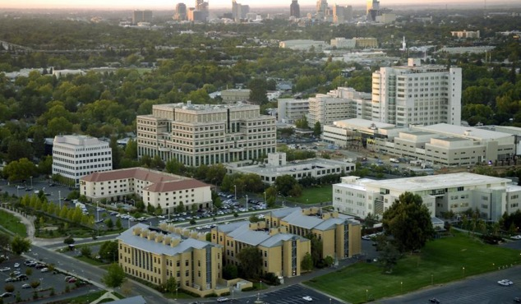
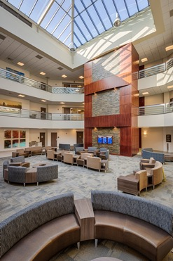
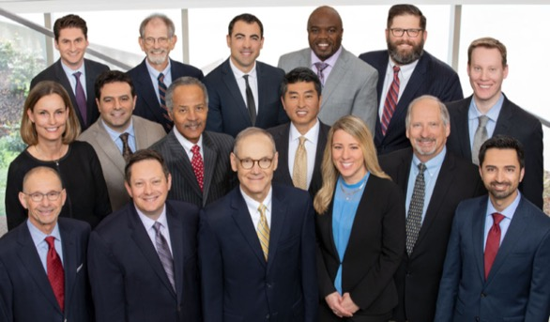
Clinical Training Environment: UCDMC
Growing
  3 major construction projects underway
  Faculty
  Residency program
Operating Rooms
  36 adult, 4 pediatric
  8 same day surgery
Emergency Department
  100,000 patients/year
  3 trauma bays, 2 CT scanners
Intensive Care Units
  10 bed NSICU, 18 bed Trauma/SICU
  80 adult, 24 pediatric
Outpatient NSG Clinics
  Midtown ACC, Spine Center

Slide 14
Training Curriculum: Rotations
 | JUL/AUG/SEP | OCT/NOV/DEC | JAN/FEB/MAR | APR/MAY/JUN | CALL
PGY1 | Neurosurgery (UCDMC) | Neurocritical Care | Basic Neuroscience | Neurosurgery (UCDMC) | None*
PGY2 | Neurosurgery (UCDMC) | Neurosurgery (UCDMC) | Neurosurgery (UCDMC) | Neurosurgery (UCDMC) | ~7/mo
PGY3 | Neurosurgery (UCDMC) | Neurosurgery (UCDMC) | Neurosurgery (UCDMC) | Neurosurgery (UCDMC) | ~5/mo
PGY4 | Research/Clinical Electives |  |  |  | ~3/mo
PGY5 | Neurosurgery (UCDMC) | Neurosurgery (UCDMC) | Neurosurgery (UCDMC) | Neurosurgery (UCDMC) | 0
PGY6 | Chief Resident (UCDMC) | Chief Resident (Kaiser) | Chief Resident (UCDMC) | Chief Resident (Kaiser) | Chief Call
PGY7 | Enfolded Fellowship/Research (R25) |  |  |  | Chief Call

Slide 15
Training Curriculum: Academic Tuesdays
Resident educational meetings
Neuroradiology conference
Mock oral boards
Journal club
Cranial approaches lecture/lab
Spine & Peripheral nerve approaches
Neuropathology review
Grand Rounds lecture
Clinical care conferences
Brain tumor board
Skull base case conference
Epilepsy case conference
Neurovascular conference
DBS case conference
Spine case conference, spine deformity, spine tumor boards

Slide 16
Clinical Training Environment: UCDMC and Kaiser
UC DAVIS MEDICAL CENTER
KAISER SACRAMENTO
36-48 months on-service training
11 Neurosurgeons, ~2000 cases/year
Subspecialty academic practice, trauma, pediatric center, cancer center
6-12 months on-service training
14 Neurosurgeons, ~2500 cases/year
Community, elective practice

Slide 17


Training Neurosurgeons
Academic Tuesday conferences, lectures
Book fund
Library
Conference support
National courses
Medical Knowledge
Patient Care
Practice-Based Learning and Improvement
Systems Based Practice
Inpatient care (OR, ICU, ED, bedside rounds)
Outpatient care (clinics)
Professionalism
Interpersonal & Communication Skills
Committee service (dept, hospital, school)
QI projects
Research projects

Slide 18
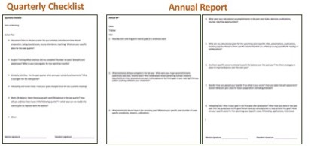
Professional and Personal Development
Mentorship Program
  Faculty mentor
  Peer mentor
Wellness Program
  Team building events
  Campus resources
Leadership Development Program
Committee Service
Medical Knowledge
Patient Care
Practice-Based Learning and Improvement
Systems Based Practice
Professionalism
Interpersonal & Communication Skills

Slide 19
Academic Resources
Department
Book fund
Conference attendance
Clinical courses/meetings
Resident research funds
Clinical research staff support (40+ ongoing trials)
Mentorship program
Institution
Clinical and Translational Science Center
Center for Neuroscience, MIND Institute, Center for Mind and Brain, Institute for Regenerative Cures, NCI Comprehensive Cancer Institute, BME, etc.

Slide 20













Our Recent Graduates
 | Graduate | Fellowship Training | Current Position
2023 | EDWIN KULUBYA | PEDIATRIC (BOSTON CHILDREN’S) | FELLOW
2023 | KATE PETERSON | ENDOVASCULAR | FELLOW
2022 | BART THACI | Endovascular (UC Davis, Boston Medical Center) | Assistant Professor, UPMC Harrisburg
2021 | JOTI THIND | Spine (UC Davis) | Neurosurgeon, Ortho Illinois
2021 | AMIR GOODARZI | Spine (UCSF) | Neurosurgeon, Sutter Vacaville
2020 | SEUN OMOFOYE | Oncology (Cedars Sinai) | Tidelands Health, South Carolina
2019 | TAMAR BINYAMIN | Vascular/Endovascular (UTSW) | Neurosurgeon, Sutter Danville
2018 | JARED AMENT, MD, MPH | Spine Neurosurgery (Cedars Sinai – Enfolded) | Neurosurgeon, Sierra Neuroscience Inst (Los Angeles)
2017 | DARRIN LEE, MD, PHD | Functional Neurosurgery (U Toronto) | Assistant Professor, U.S.C.
2017 | KRISTA GREENAN, MD | Pediatric Neurosurgery (U Colorado) | Assistant Professor, U. Colorado
2016 | JONATHAN LIU, MD | Vascular Neurosurgery (Stanford) | Staff Neurosurgeon, Kaiser Permanente (Vacaville)
2015 | GILBERT CADENA, MD | Skull Base/Vascular Neurosurgery (UC Irvine) | Staff Neurosurgeon, CentraCare (Minnesota)
2014 | AZEEM OLADUNJOYE, MD | Spine Neurosurgery (UC Davis – enfolded) | Staff Neurosurgeon, San Joaquin Hospital (Stockton)
2013 | EDWARD KERR, MD | Skull Base Neurosurgery (Ohio State) | Assistant Professor, Baylor Associates (Dallas)

Slide 21
Diversity, Equity, and Inclusion
Diverse faculty and resident groups
Institutional and Departmental Priority
  DEI Committee
  SEED Training
  Implicit bias training
  Recruitment Focus
  Anonymous reporting and support

Slide 22
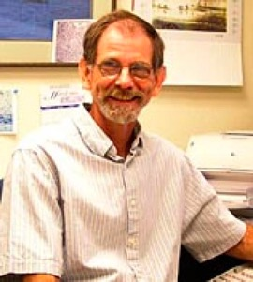
Research Labs:
Dr. Orin Bloch, Dr. Orwa Aboudf
Dr. Bruce Lyeth, Dr. Patrick Fuller
Dr. David Brandman, Dr. Segei Stavisky
Dr. Kia Shahlaie, Dr. Gene Gurkoff
Dr. Allan R. Martin

Slide 23
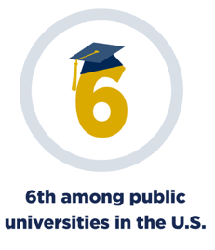
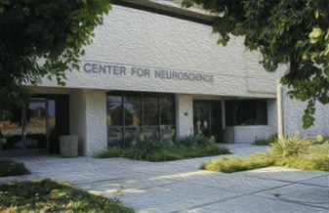
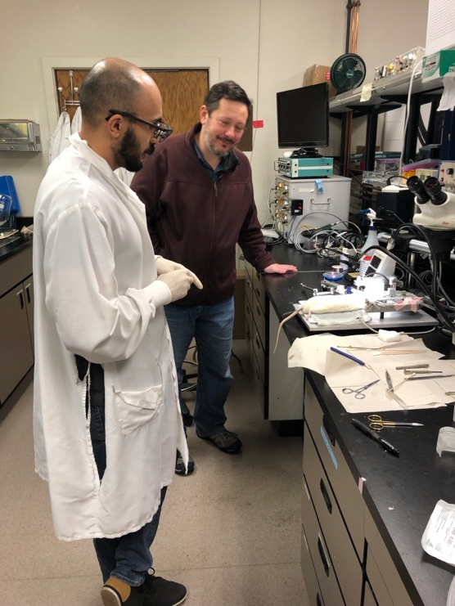

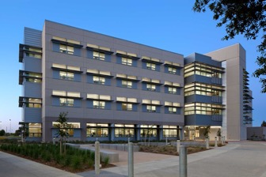
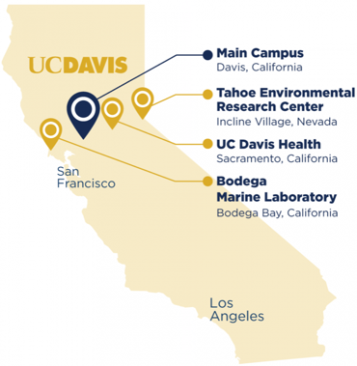
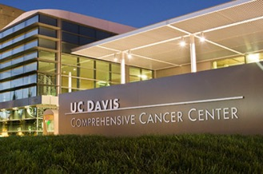
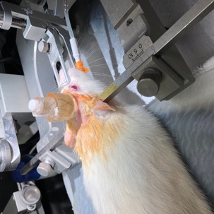
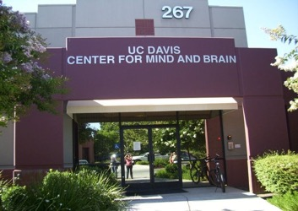
Research: UC Davis Neuroscience Community

Slide 24
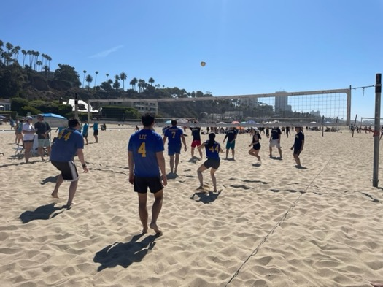
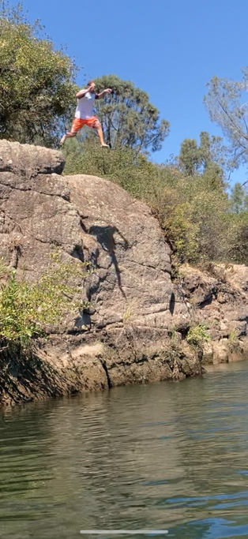





Resident Wellness
Team Building Events
5th Tuesdays
West Coast Neurosurgery Games
Resources
GME Wellness Program
Academic and Staff Assistance Program
Office of the Ombuds
UC Living Fit Forever
Health Management and Education Program

Slide 25








About Sacramento

Slide 26

Questions?

